Slide 1


English
Date: 25.01.21
Week 4 – Lesson 1
Hansel and Gretel

Slide 2
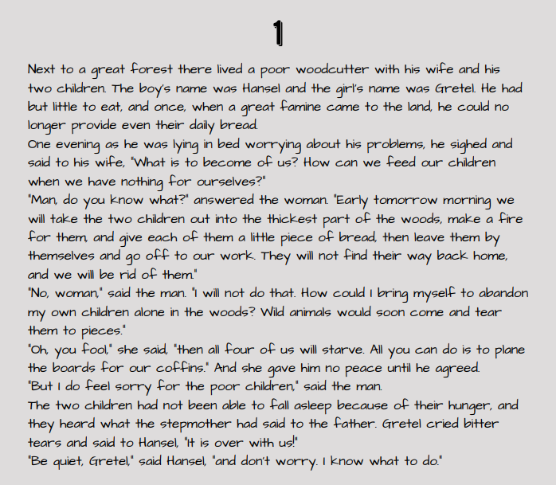

Scan back through pages 1 and 2:
Can you find any speech?
What does the speech tell us about the characters?
How is it punctuated?

Slide 3
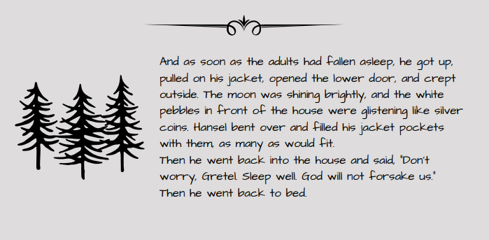
Scan back through pages 1 and 2:
Can you find any speech?
What does the speech tell us about the characters?
How is it punctuated?

Slide 4
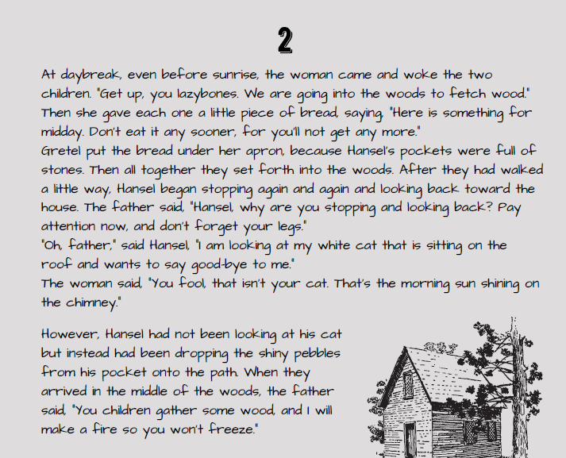
Scan back through pages 1 and 2:
Can you find any speech?
What does the speech tell us about the characters?
How is it punctuated?

Slide 5
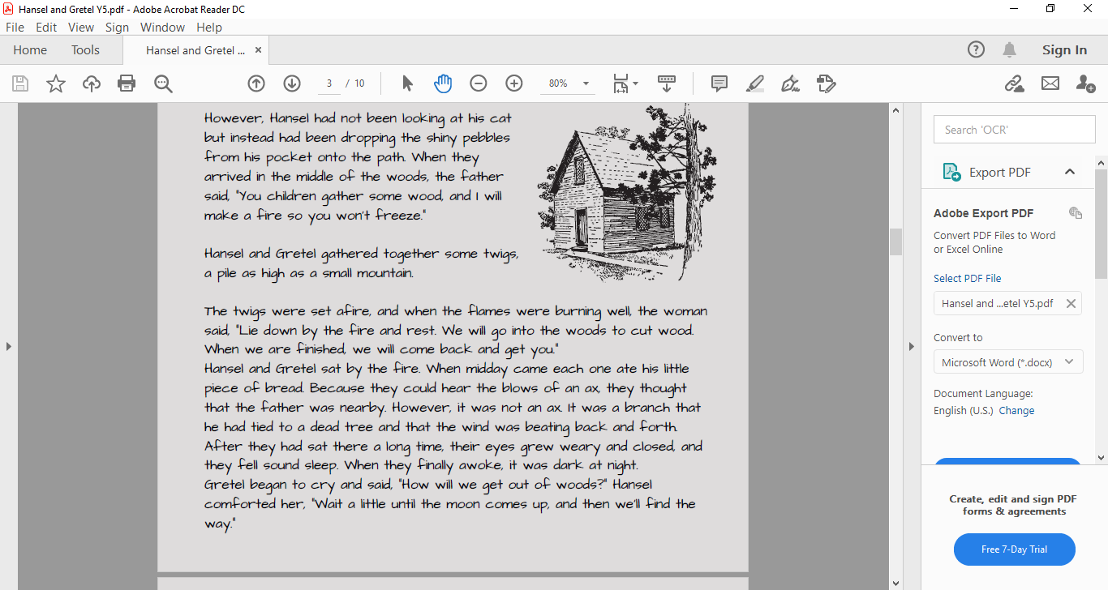
Scan back through pages 1 and 2:
Can you find any speech?
What does the speech tell us about the characters?
How is it punctuated?

Slide 6
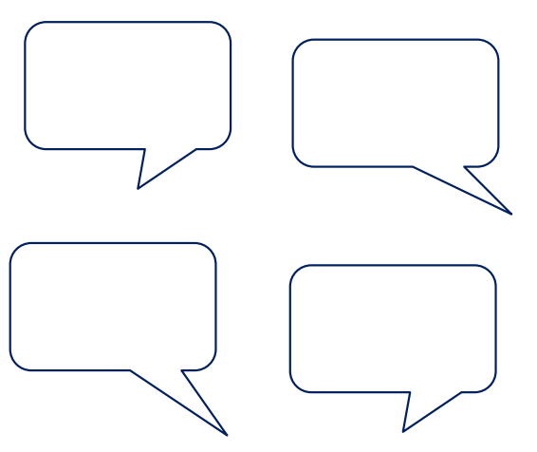
Click on the sound button to hear activity 1 read to you.
Activity 1:
Create/draw 4 speech bubbles for the stepmother which conveys her character.
What might a character like her say?
What tone will she use?
Think about your language choice
You do not need to use inverted commas in speech bubbles.
We don’t need those useless children anyway!
Come here you lazy, silly boy!

Slide 7
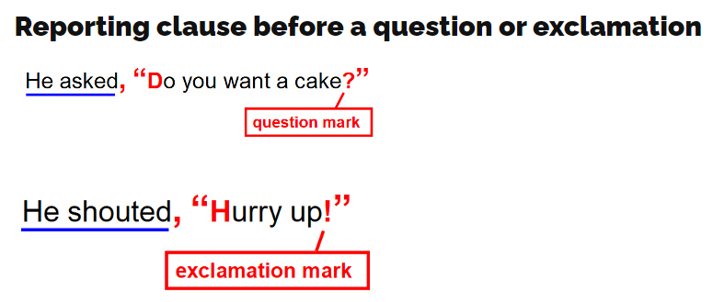
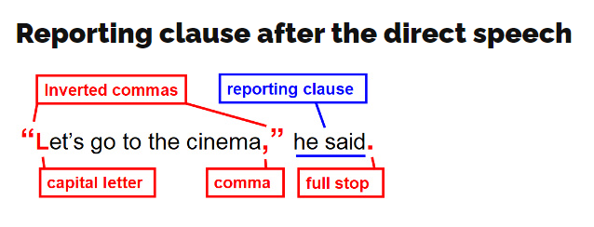
Let’s recap Speech Rules:
Use a capital letter at the start of the speech
Use either a comma, full stop, ? or ! at the end of the speech
Choose an appropriate verb for the reporting clause (said, explained, questioned, shouted, whispered)
Write speech by a new character on a new line
Click on the sound button to hear this slide read to you:

Slide 8
Click on the sound button to hear activity 2 read to you.
Activity 2:
Use the speech written in your speech bubbles to create a conversation between the stepmother and either Hansel or Gretel. Punctuate this correctly. Remember to use our speech rules:
Use a capital letter at the start of the speech
Use either a comma, ? or ! at the end of the speech
Choose an appropriate verb for the reporting clause (explained, questioned, shouted, whispered)
Write speech by a new character on a new line
Example:
“Come here boy, I have something to tell you!” exclaimed the wicked stepmother.
“I’m coming,” replied Hansel with a concerned look on his face.
The old woman reached out and grabbed Hansel’s wrist, “I want you and your sister to follow me out into the woods today,” she said with a sly smirk on her face.

Slide 9



