Slide 1
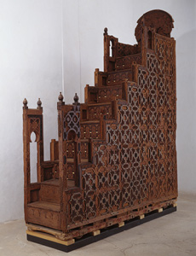
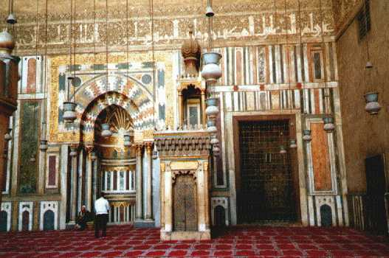

Islam
Can I describe what is inside a mosque?

Slide 2
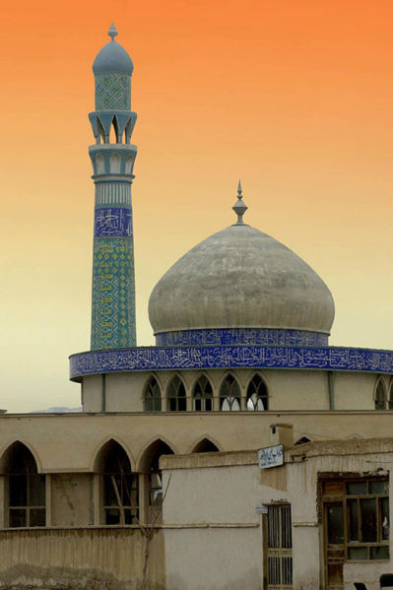
Islam
Lets have a quick recap on what we have covered so far about Islam
What do we call people who follow Islam?
What do we call their place of worship?
How many times a day are they expected to pray?
What can you remember about the Muslim Call to Prayer?
What happens in a mosque?

Slide 3
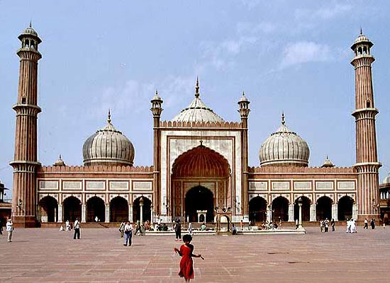

Lets take a closer look at this Mosque.
A Muslim Mosque
It’s a very grand place.
It has a rounded roof.
What do we notice?
Much of it is made out of gold.
It is extremely large.
Can anyone tell me anything else that’s interesting about the Mosque?

Slide 4
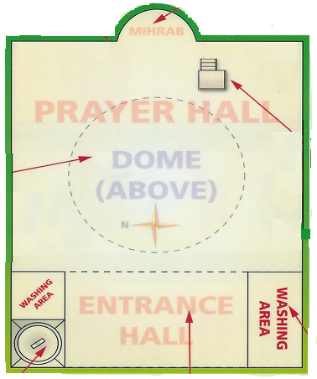


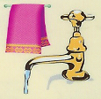
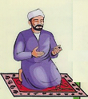
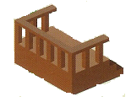

Plan of a Mosque
Mihrab
Qiblah
Minbar
Prayer Mat
Minaret
Wash Area

Slide 5
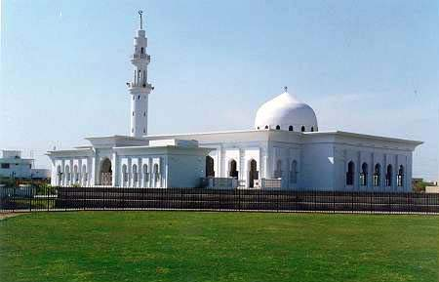
Look for the minaret and the domed roof.

Slide 6
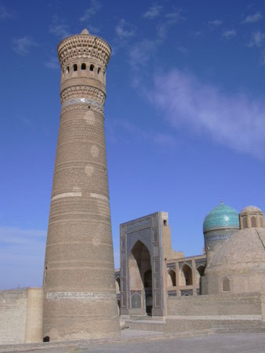
Minaret
The call for prayer is called from the minaret by the imam (leader). This usually happens on Fridays although it can happen on other days as well.

Slide 7
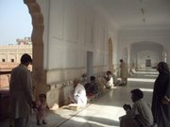
Washing Area
Before going into the mosque, everyone must remove their shoes. They must then wash their hands, feet and mouths. There are separate washing areas for men and women.

Slide 8
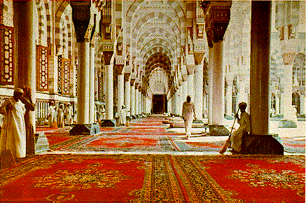
Inside a Mosque

Slide 9
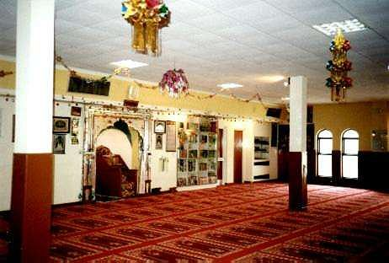
.
There is no furniture
Decorated in Arabic text.
Never any pictures
May have a large single dome on the roof or one or more smaller ones

Slide 10
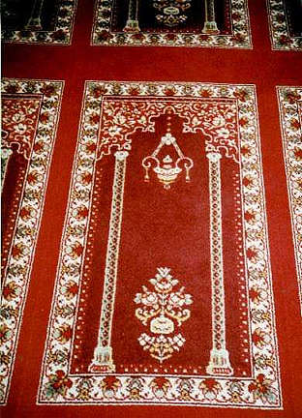
The floor is carpeted and the pattern is designed to provide individual prayer mats for each worshipper. Prayer mats are also put on the walls for decoration.
Muslims prayers involve standing, bowing and kneeling

Slide 11
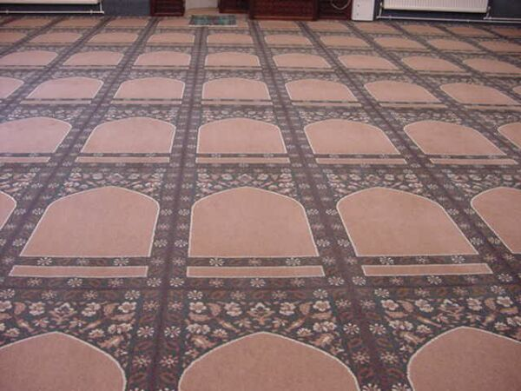
Prayer mat
Usually when Muslims pray, they do so on a prayer mat. However, in a mosque the prayer hall is usually carpeted so they don’t need to bring mats. In this mosque, the carpet is designed so that everybody knows where to sit and how much space to take up.

Slide 12
Qiblah wall
This is the wall in the mosque which faces Mecca. When praying, Muslims face Mecca as they believe it is the holiest city.

Slide 13
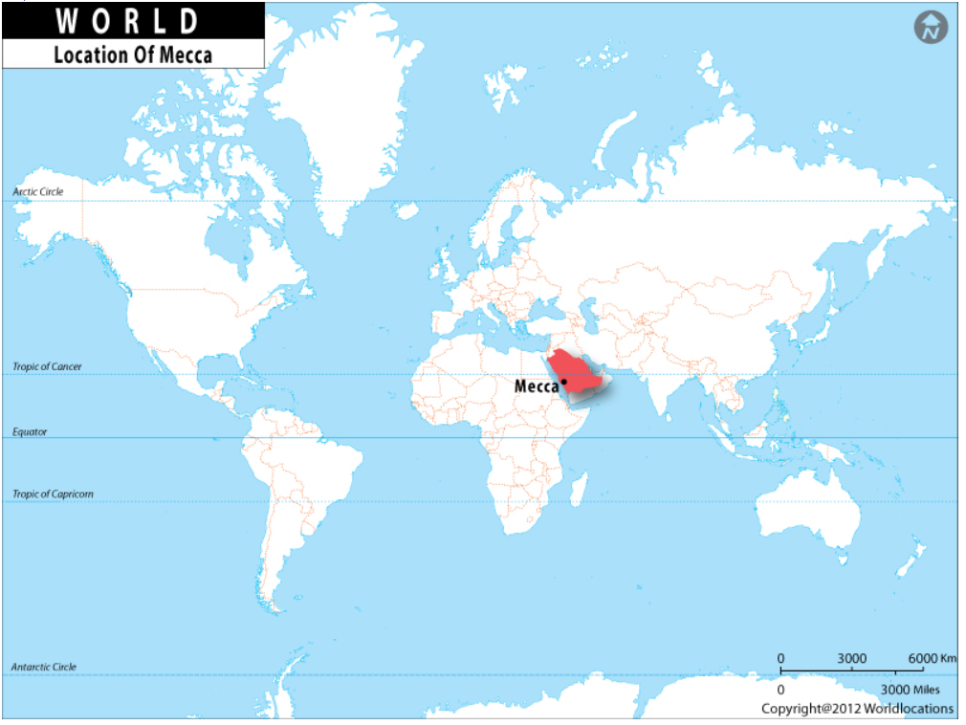
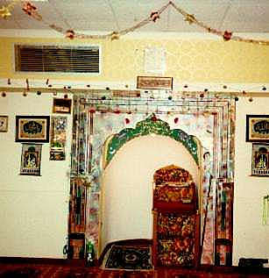
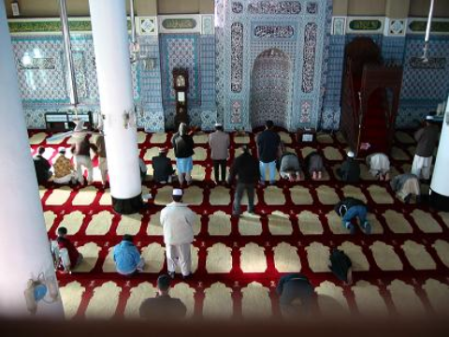
The niche in the wall is known as the Mihrab. It marks the direction of Mecca. Prayers are offered whilst facing in this direction.

Slide 14
Minbar
Minbars are used on Fridays, the holy day. The person who is giving the special prayers (khatib) stands on one of the lower steps to deliver the prayers. Nobody uses the top step as this is reserved for the prophet.

Slide 15
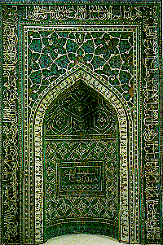
Mihrab
The mihrab is an alcove in the Qiblah wall. The Imam
(leader) stands in the alcove to deliver prayers. The mihrab is normally very ornately decorated.

Slide 16
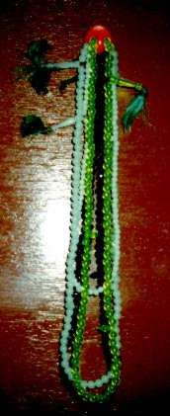
Subha or tasbih beads are hung around the mosque for worshippers. The strings of beads help worshippers think about Allah; each bead stands for one of the names of God.

Slide 17
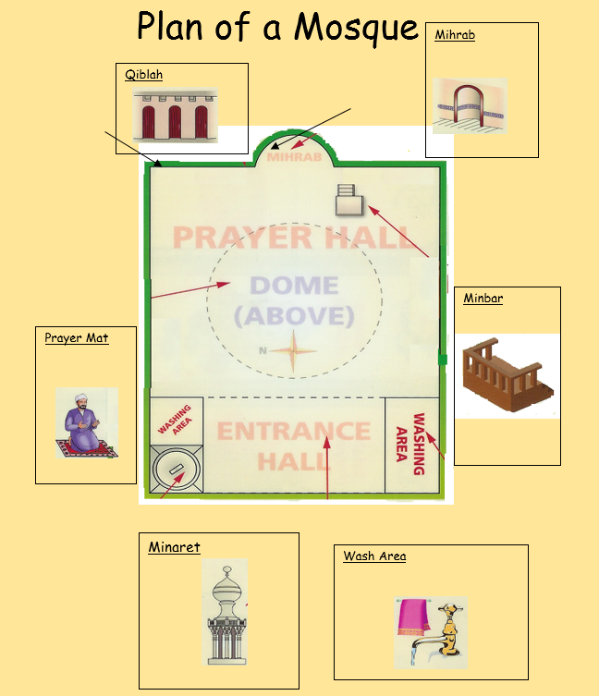
Describe what is inside a mosque?
Task: Think about the objects that we have learned about today, could you draw and label some of these or maybe draw your own floor plan of a mosque.

Slide 18
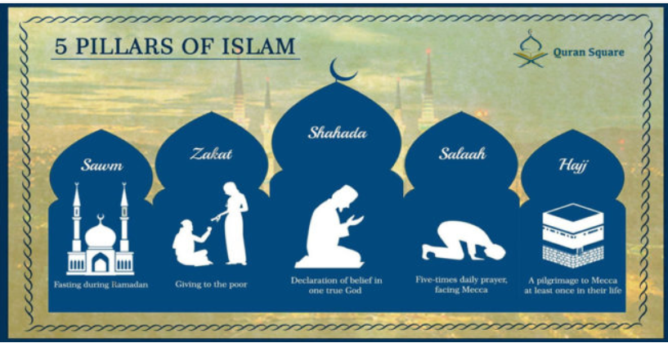
Further Learning
Take a look at this website to find out more about Islam
https://www.bbc.co.uk/bitesize/topics/zpdtsbk/articles/zrxxgwx
Next Week – we will begin to find out about the 5 Pillars of Islam
Audio 1
Audio 2

