Slide 1

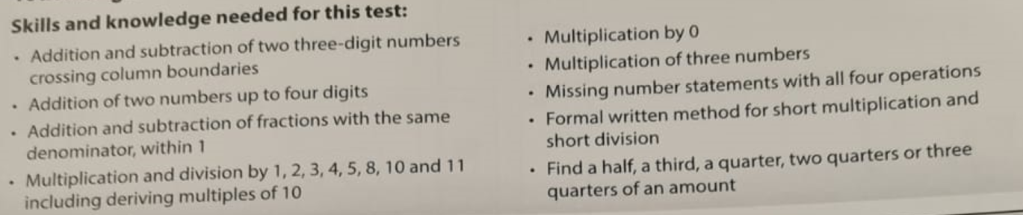
Spring Arithmetic Test 2
345 + 179 =
1245
+1354
2/5 + 1/5 = ?/5
Times tables
45 x 0 = 0
4 x 5 x 6 = (4 x 5) x 6 = 4 x (5 x 6)
34 + ? = 75
36 divided by 6 =
½ of 24 = 2/4 of 24 =

Slide 2
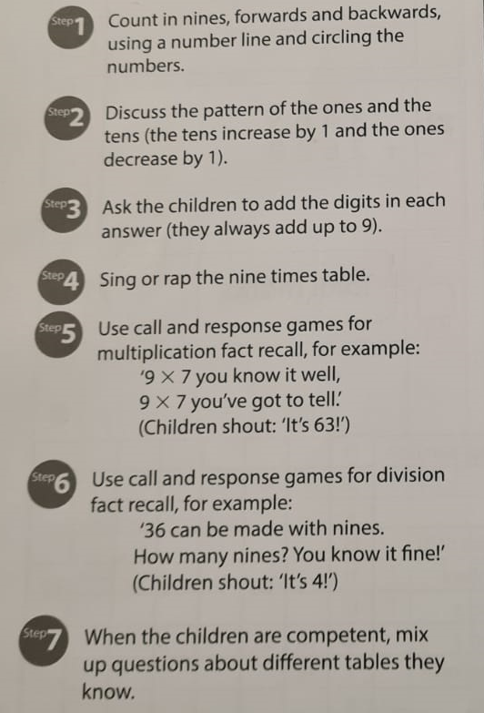
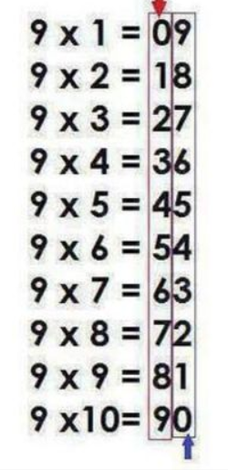
9 Times Tables!
https://www.youtube.com/watch?v=1ww7gUr7T7k

Slide 3
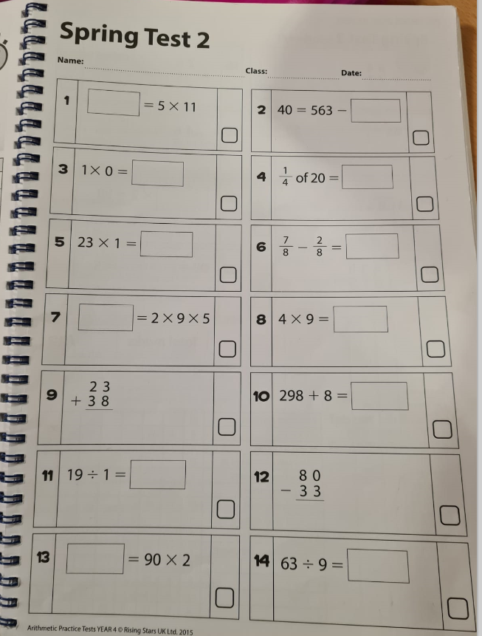

Slide 4
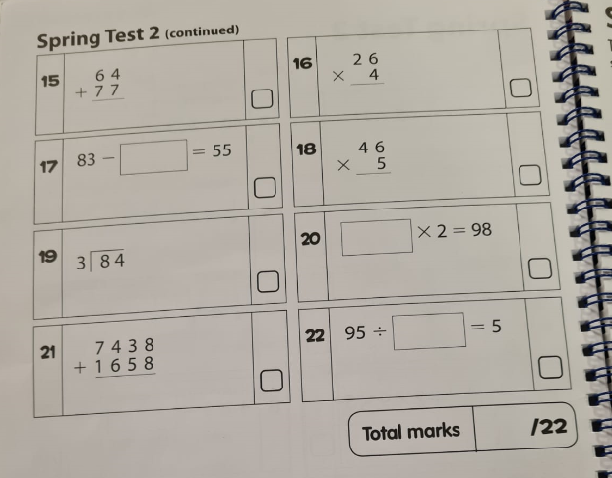

Slide 5
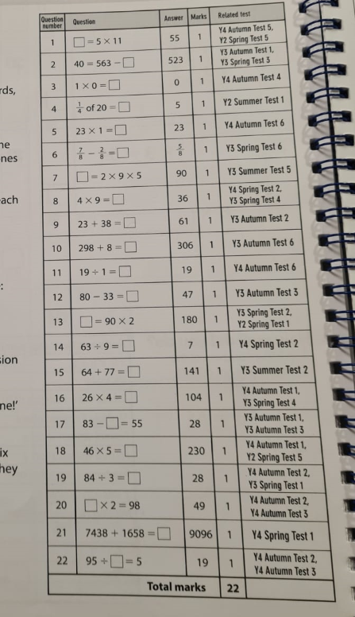
Answers

Slide 6
Next Week
Multiplication and division
9 Times Tables
Adding 4 digit numbers
https://www.topmarks.co.uk/times-tables/coconut-multiples

