Slide 1


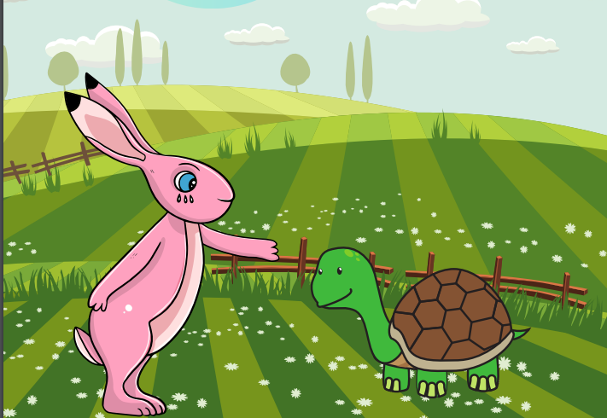
Starlings English Home Learning
Friday 22nd January

Slide 2



Today we are going to re read the long version of the text (please use the attachment or listen to my recording of it) and answer some questions about it.
Today you will:
Re read the long version of the story.
Answer my comprehension questions about the story.
Write your own questions about the story.

Slide 3
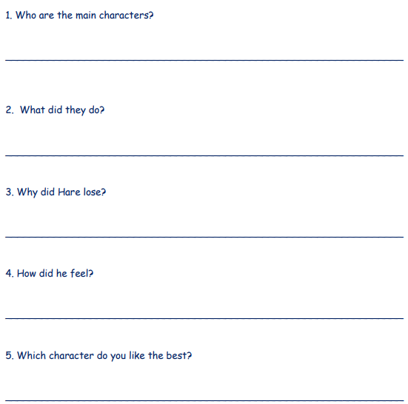
Listen to the story and you can follow the words on the which I have attached if you like.
Can you answer my questions about the text?
You can look back or listen to the story as many times as you like – it’s not a memory test!

Slide 4

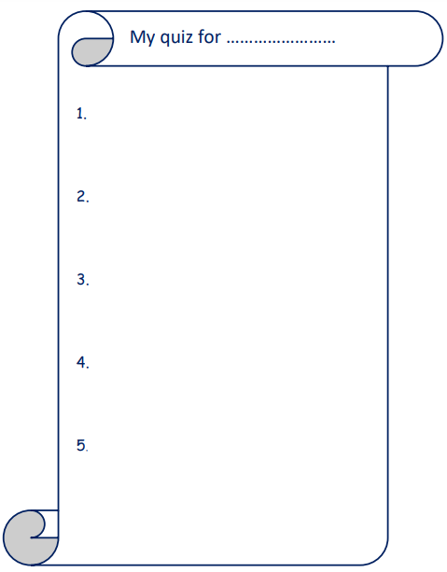
Can you write your own questions about The Hare and the Tortoise and get your grown up to answer them? Here’s a quiz sheet if you would like to write your questions on it.

Slide 5
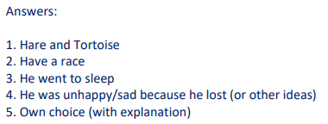
Here are the answers for you from my quiz – how many did you get right?

Slide 6

Red group – Please have a look at the separate RWI PowerPoint for set 1. We have added some special friends work for you.
Green group you need to look out for set 2 videos on the link below:
https://www.youtube.com/channel/UCo7fbLgY2oA_cFCIg9GdxtQ
We would like you to watch 4 videos: set 2 speed sounds, set 2 spelling, red words 1, and read and hold a sentence 1
Pink, yellow and blue groups you need to look out for set 3 videos on the link below.
https://www.youtube.com/channel/UCo7fbLgY2oA_cFCIg9GdxtQ
We would like you to watch 4 videos: set 3 speed sounds, set 3 spelling, red words 2 and read and hold a sentence 2

Slide 7





Words of the day!
walk walking walked
Can you write the word walk 5 times in different colours?
Can you write the word walking 5 times in a squiggle?
Can you write the word walked 5 times as small as you can?

