Slide 1


Starlings Maths Home Learning
Friday 22nd January

Slide 2



TIME LESSON SEVEN
Wow Starlings we have come to the end of our third week of home learning and our last lesson about time. You are now time experts and I am very proud of how hard you have worked.
So today we are going to try and solve some time word problems. A word problem is a few sentences describing a 'real-life' scenario where a problem needs to be solved by way of a mathematical calculation.

Slide 3
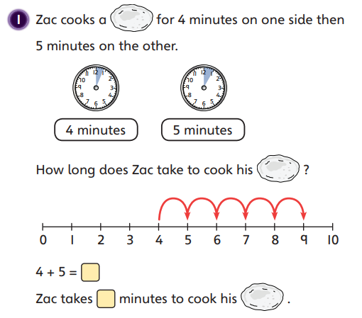
Let’s have a look at this word problem together. I’ve used a number line to help me but you might use your fingers, counters or just be able to do it in your head.

Slide 4
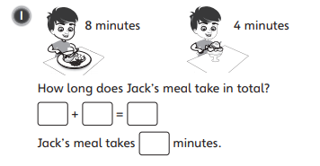
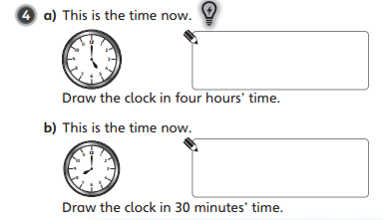
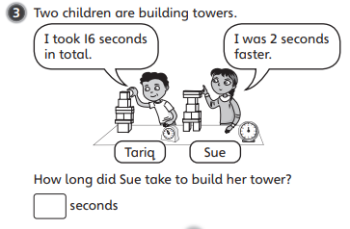
Try some of these word problems.

Slide 5

