Slide 1
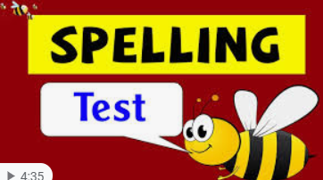



Click the microphone to hear your spelling quiz!
Good Luck xxx

Slide 2
Here are the answers.
Time to ticky tick and dotty dot!
Character
Chaos
Chemist
School
Echo
Mechanic
Stomach
Chorus
chemical

Slide 3
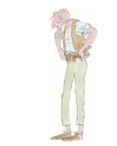


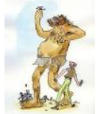
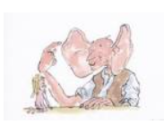
Story Time

