Slide 1



SCIENCE
Diet & Lifestyle
Lesson 1

Slide 2
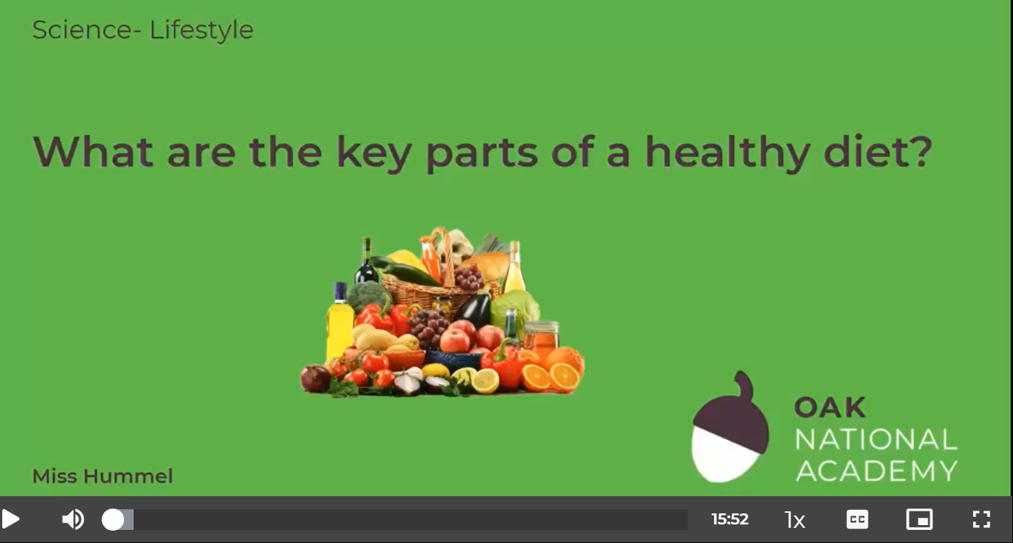
What are the key parts of a healthy diet?
In this lesson, we are going to learn about what is important in a healthy diet.
We will discuss the seven nutrients we need to know as well as their role in the body.
Click on the following link to watch and take part in the following video lesson.
https://classroom.thenational.academy/lessons/what-are-the-key-parts-of-a-healthy-diet-60wkgr?activity=video&step=1
Play Audio first

Slide 3
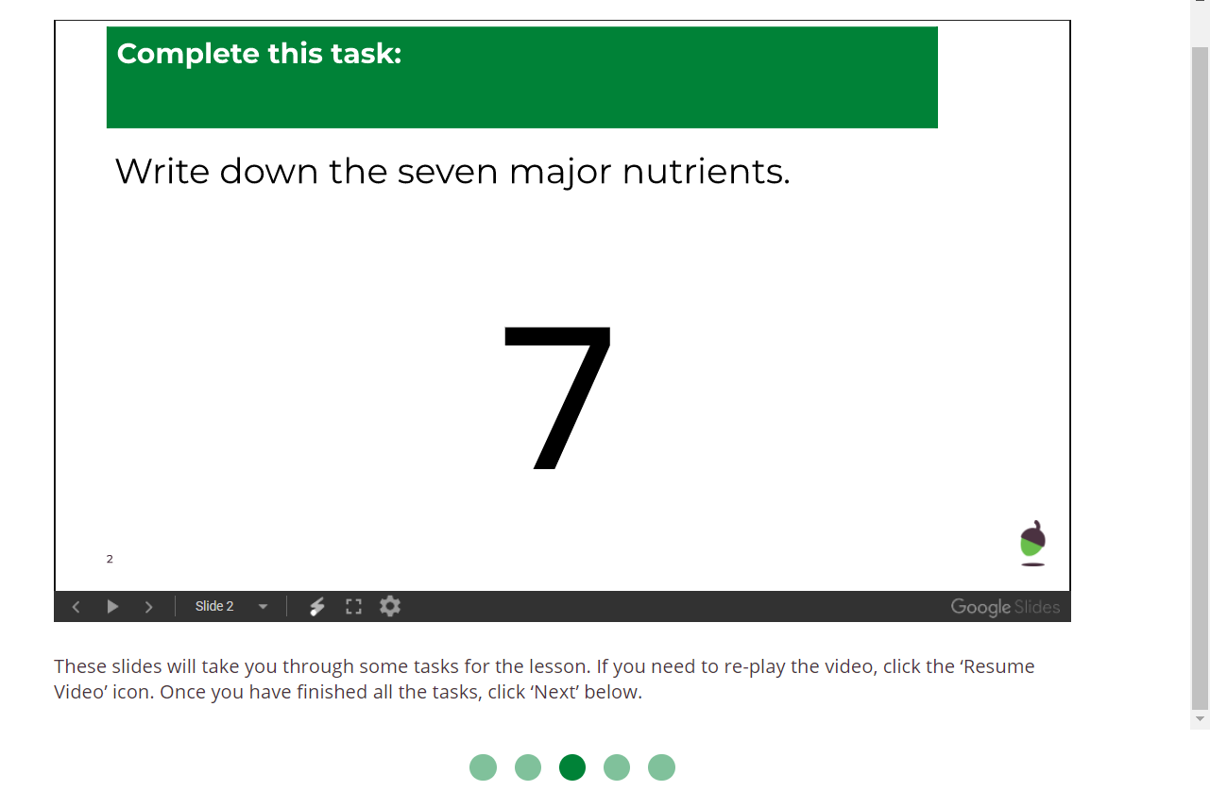
What are the key parts of a healthy diet?
Click on the following link to complete the activities for today’s lesson:
https://classroom.thenational.academy/lessons/what-are-the-key-parts-of-a-healthy-diet-60wkgr?step=2&activity=worksheet
Play Audio first
This worksheet is attached to our blog

Slide 4

Creating your own healthy menu….
The last activity is to create a healthy menu. Have a look at the following website:
https://www.nhs.uk/change4life/recipes

