Slide 1


Mathematics
Date: 22.01.21
Week 3 – Lesson 5
Comparing and Ordering Fractions

Slide 2
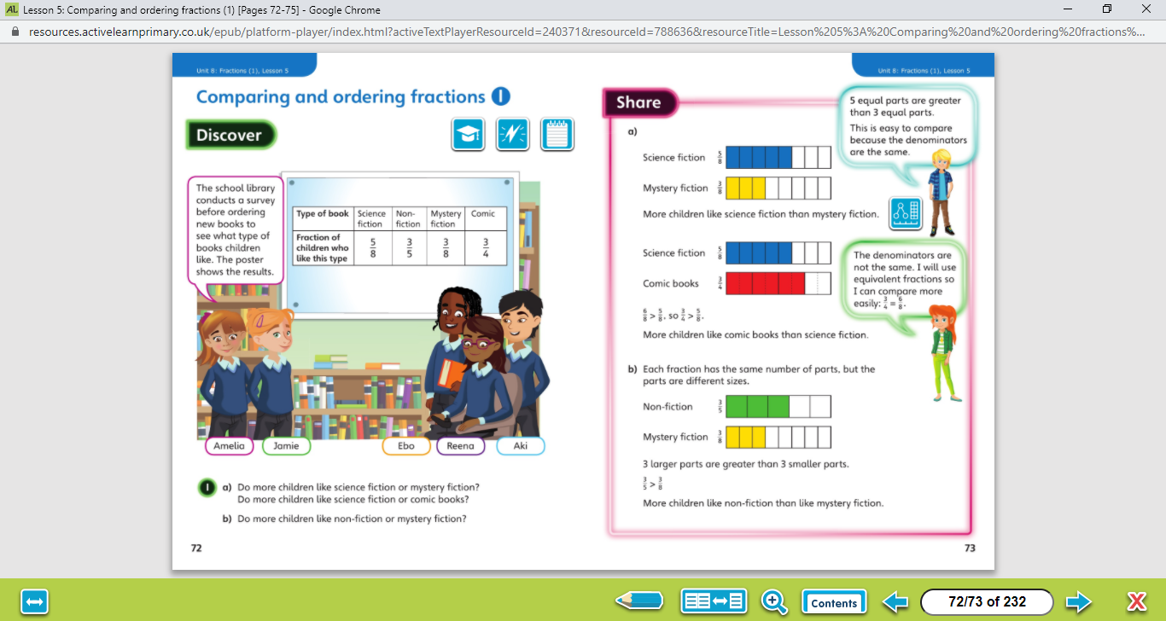

Reminder: To find equivalent fractions, multiple the numerator and denominator by the same number.
Let’s work together!
Look at the picture clue. What can you see?
Have a look at the questions.
Click on the sound button below to hear the questions read to you. We will also talk through the questions together like we do in school.
We will go through the possible methods and answers on the next slide.

Slide 3
Let’s work together!
Click on the sound button below to hear the answers and possible methods for question A.
Click on the sound button below to hear the answers and possible methods for question B.

Slide 4
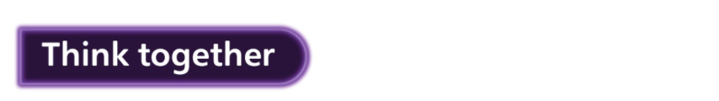
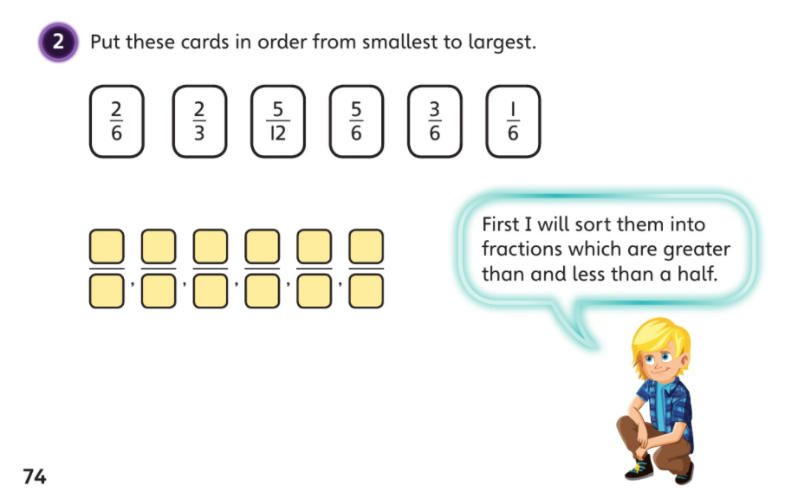
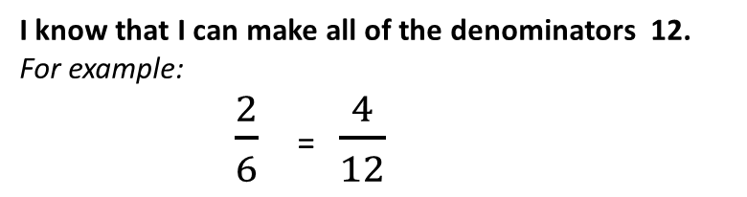
Let’s work together!
Click on the sound button below to hear the question read to you. We will work together to reach the answer.
I know that I can make all of the denominators 12. For example:
      $\frac{2}{6}$ = $\frac{4}{12}$
Click on the sound button below to hear the answers.
x2

Slide 5
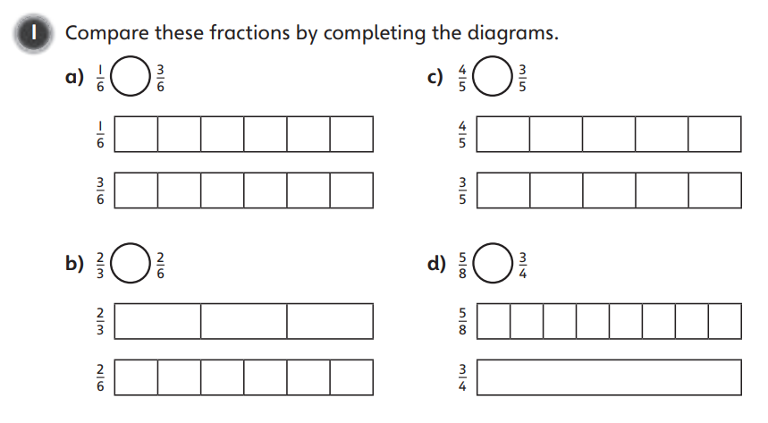
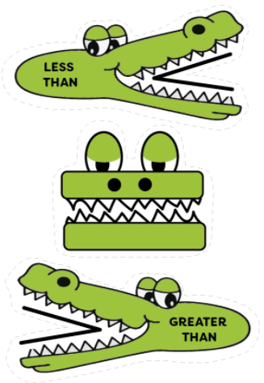
Have a go at these questions independently. Click on the button below if you would like the questions read to you.
Your Turn…
We will go through the answers for questions 1, 2 and 3 after completing all of the questions.

Slide 6
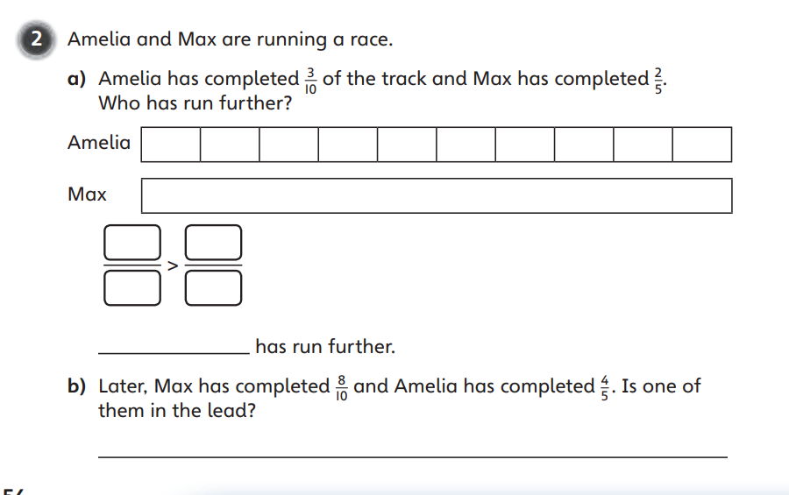
Have a go at these questions independently. Click on the button below if you would like the questions read to you.
Your Turn…
We will go through the answers for questions 1, 2 and 3 after completing all of the questions.

Slide 7
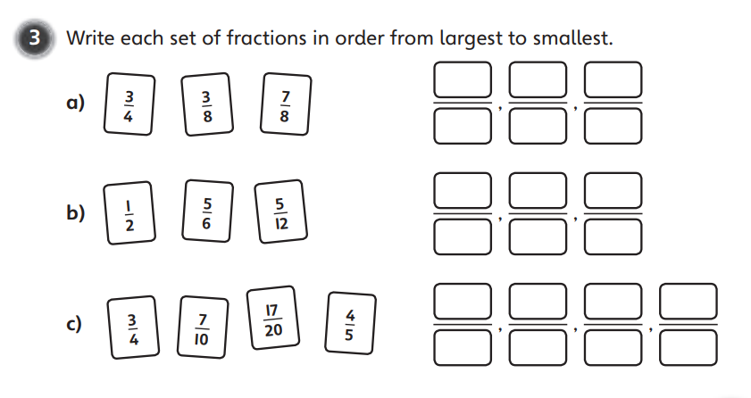
Have a go at these questions independently. Click on the button below if you would like the questions read to you.
Your Turn…
We will go through the answers for questions 1, 2 and 3 after completing all of the questions.

Slide 8
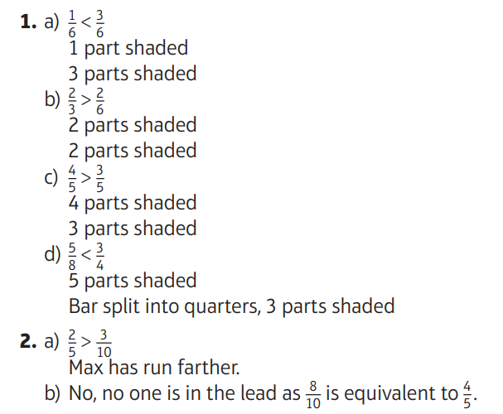
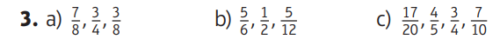
Questions 1, 2 and 3 Answers:
Your Turn…
Click on the sound button to hear the answers being read to you.

Slide 9
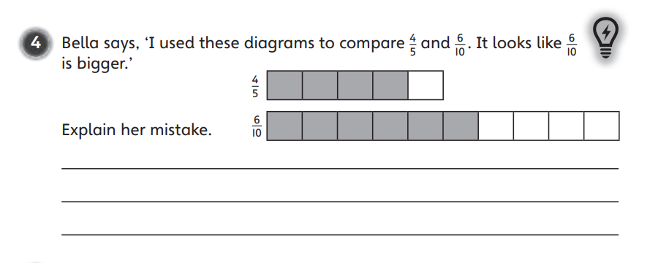
Challenge Time!
Only try this question if you are feeling confident ☺
Your Turn…
Click on the button below if you would like the question read to you.
Click on the button below to hear the answer.

