Slide 1


English
Date: 22.01.21
Week 3 – Lesson 5
Hansel and Gretel

Slide 2
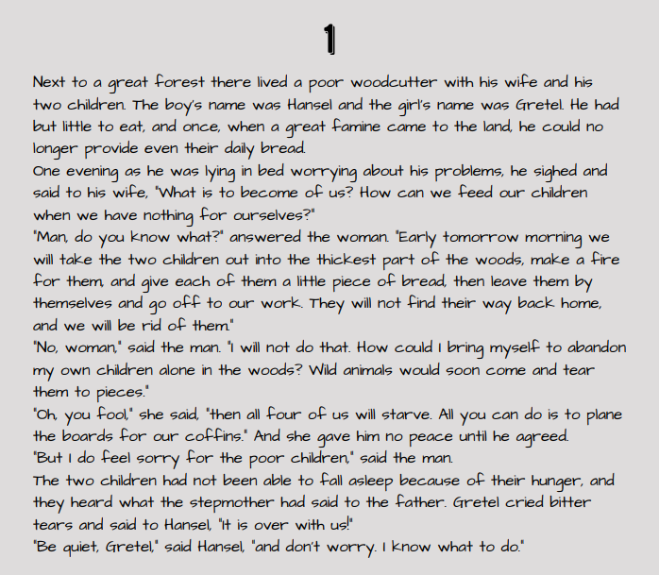

Re-read pages 1 and 2 of ‘Hansel and Gretel’ by Jacob and Wilhelm Grimm or click on the sound button to hear it being read to you.
The text is also attached to our blog if you want to open or print it this way.

Slide 3
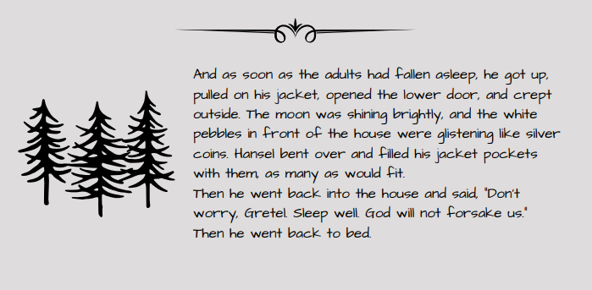
Read pages 1 and 2 of ‘Hansel and Gretel’ by Jacob and Wilhelm Grimm or click on the sound button to hear it being read to you.
The text is also attached to our blog if you want to open or print it this way.

Slide 4
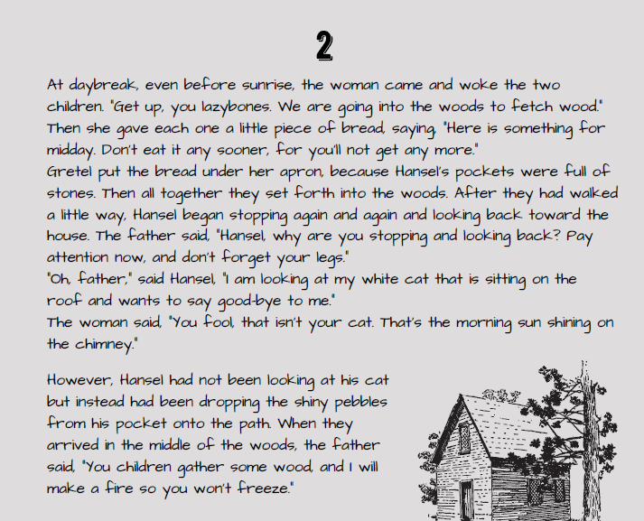
Read pages 1 and 2 of ‘Hansel and Gretel’ by Jacob and Wilhelm Grimm or click on the sound button to hear it being read to you.
The text is also attached to our blog if you want to open or print it this way.

Slide 5
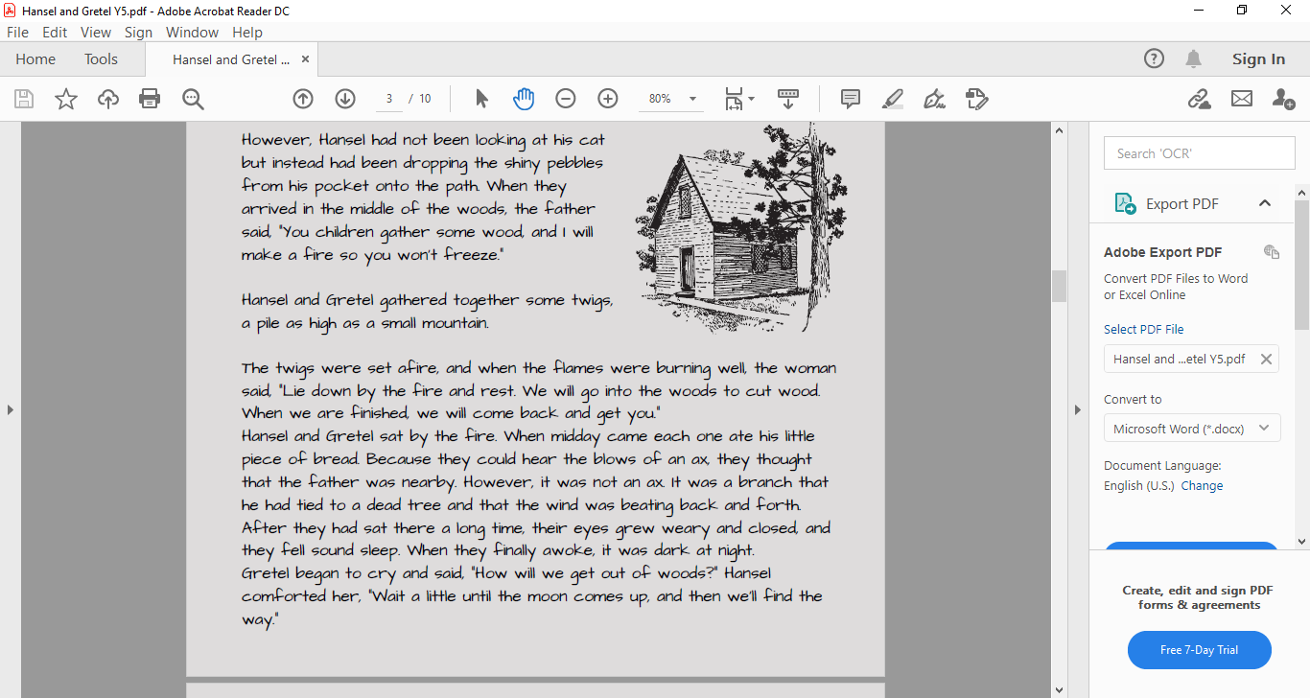
Read pages 1 and 2 of ‘Hansel and Gretel’ by Jacob and Wilhelm Grimm or click on the sound button to hear it being read to you.
The text is also attached to our blog if you want to open or print it this way.

Slide 6
Click on the sound button to hear this slide read to you.
Today we are going to be focussing on noun phrases
Remember: Noun phrases create extra detail and description about a noun.
Here is video and further explanation of noun phrases:
https://www.bbc.co.uk/bitesize/articles/zmqh2v4#:~:text=A%20noun%20phrase%20is%20a,word%20that%20describes%20a%20noun
An example of a noun phrase is: The old woman (who lived in the woods)
It is made up of:
Determiner/Article – the
Adjective – old
Noun - woman
Adverbial phrase or relative clause – who lived in the woods (this does not need to be included to make a noun phrase).

Slide 7
Click on the sound button to hear this slide read to you.
Activity 1:
Look back over the two pages and pick out/highlight any noun phrases in the text.
Copy some of the noun phrases into an exercise book or notepad.
You could also give each noun phrase a score out of ten on how well it creates a picture in your mind.
Sentence Structure:
Determiner/Article – the, a, those, their, etc.
Adjective – a describing word
Noun – person, place or thing
You can then challenge yourself to add even more detail at the end of your sentence.
Activity 2:
Can you write your own noun phrases based on the story so far?
E.g. A wicked stepmother to those children
The horrible, old woman who had a plan
The dark forest in the middle of nowhere

Slide 8
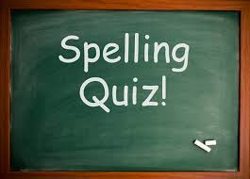
Click on the sound button to hear the spellings for this week’s quiz.

Slide 9
Answers:
considerably
adorably
comfortably
suitably
understandably
Click on the sound button to hear the spelling quiz answers.

Slide 10
