Slide 1


Starlings Maths Home Learning
Thursday 21st January

Slide 2



TIME LESSON SIX
Good Morning Starlings
Today we are going to use different vocabulary (words) to compare different times.
This is the vocabulary we are going to use:
faster, slower, longer, shorter, less, more, greater, smaller, left, earlier, later.
Ask your grown up if you are not sure about any of these words.

Slide 3
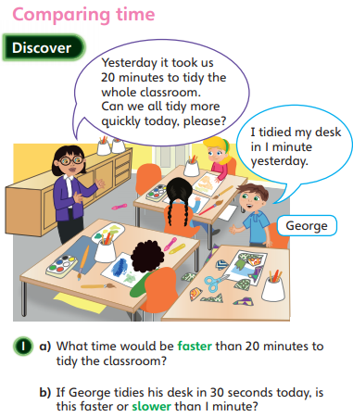
We’re going to think of time being faster or slower.
Have a look at the picture below and see if you
can answer the questions:
Who would be faster running round the track? Mrs Judge or Mrs O’Marah?
If Mrs Judge ran around the track in 4 minutes and Mrs O’Marah was slower how long did Mrs O’Marah take?
I think Starlings could definitely tidy up much faster.
How long do you think it would take us?

Slide 4
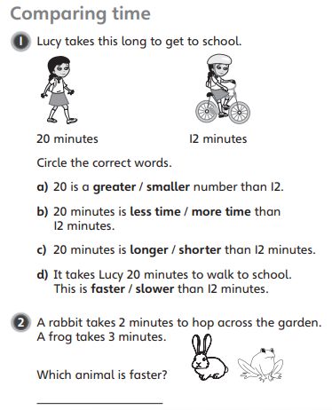
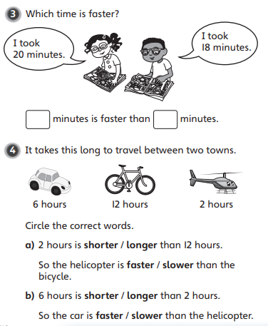
Now see if you can answer these questions below using our words for comparing time:

Slide 5
