Slide 1






English
Floating Island

Slide 2
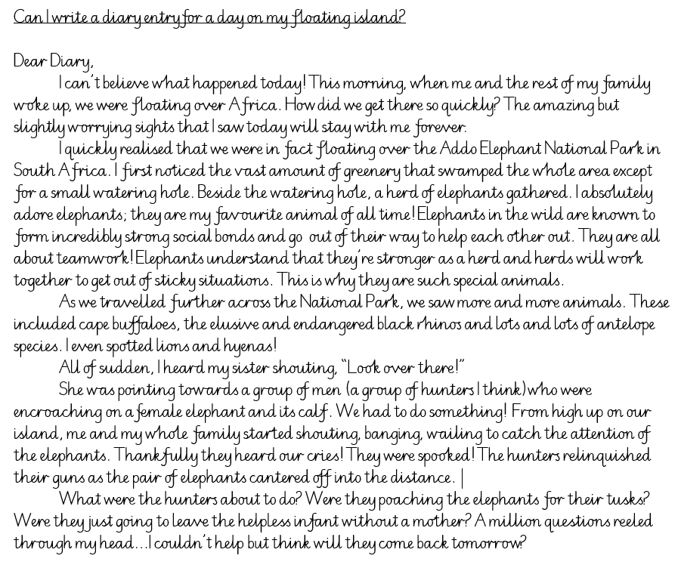

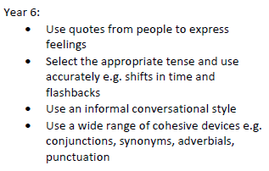
Recap of Monday, Tuesday and Wednesday’s lessons…
During today’s lesson, I would like you to finish your diary entry, edit and improve it and present it for an audience in any way you like.
Success Criteria

Slide 3

Press play at the bottom to see and hear me explain my modelled conclusion.

Slide 4
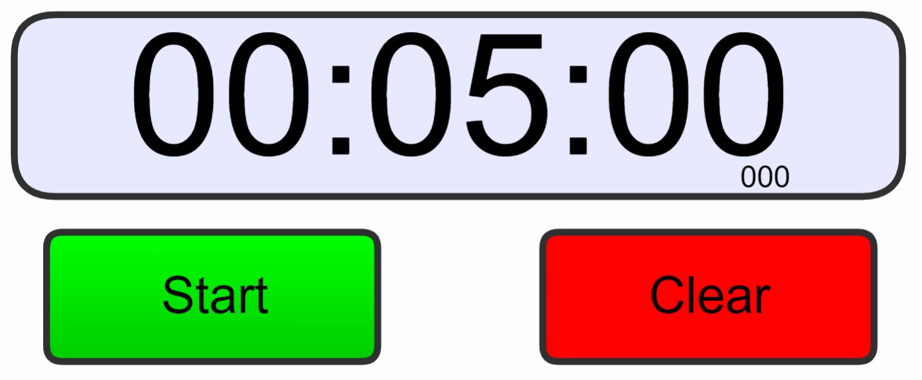
Edit & Improve
I would now like you to spend some time editing and improving your writing.
You are going to spend 5 minutes on each of the following bullet points checking the following:
Spellings
Punctuation
Sense and tense
Cohesive devices – conjunctions, synonyms, adverbials,
Feelings
Informal language – apostrophes for contraction e.g. don’t, couldn’t, won’t, can’t, they’re, he’ll etc.
https://www.online-stopwatch.com/countdown/

Slide 5

Here is the video link to see Mrs Whittingham read part 5 of this beautiful book.
https://youtu.be/FRN2_SsucLo

