Slide 1


English
Date: 21.01.20
Week 3 – Lesson 4
Hansel and Gretel

Slide 2
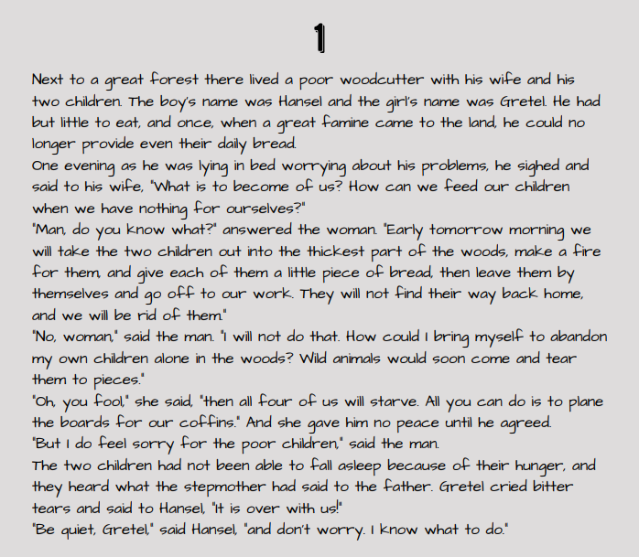

Read pages 1 and 2 of ‘Hansel and Gretel’ by Jacob and Wilhelm Grimm or click on the sound button to hear it being read to you.
The text is also attached to our blog if you want to open or print it this way.

Slide 3
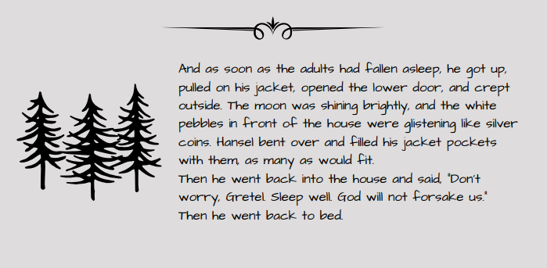
Read pages 1 and 2 of ‘Hansel and Gretel’ by Jacob and Wilhelm Grimm or click on the sound button to hear it being read to you.
The text is also attached to our blog if you want to open or print it this way.

Slide 4
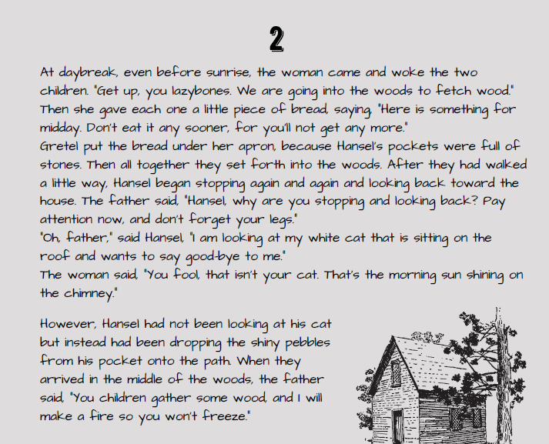
Read pages 1 and 2 of ‘Hansel and Gretel’ by Jacob and Wilhelm Grimm or click on the sound button to hear it being read to you.
The text is also attached to our blog if you want to open or print it this way.

Slide 5
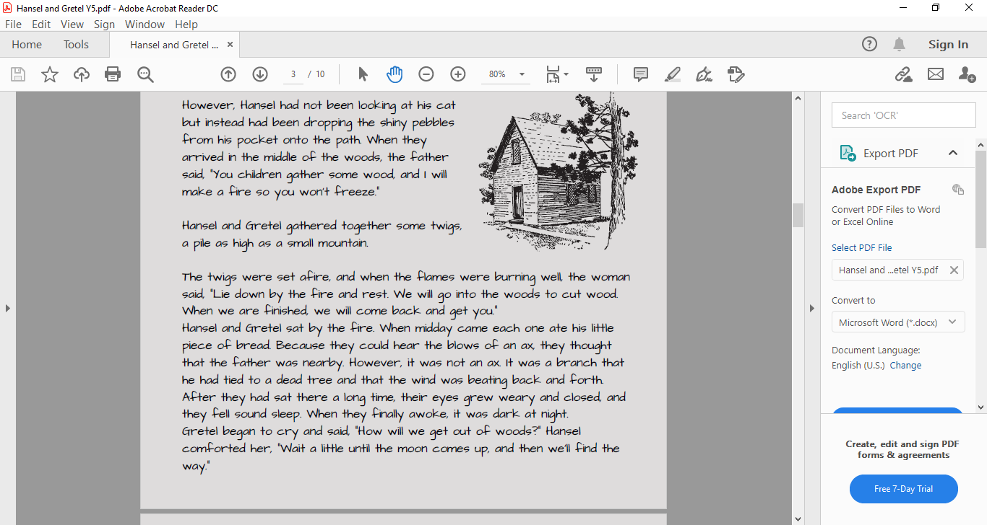
Read pages 1 and 2 of ‘Hansel and Gretel’ by Jacob and Wilhelm Grimm or click on the sound button to hear it being read to you.
The text is also attached to our blog if you want to open or print it this way.

Slide 6
Click on the sound button to hear the questions read to you.
Questions:
What characters have we met so far?
How can you tell when it was set?
What evidence is there?

Slide 7
Click on the sound button to hear this slide read to you.
Today we are going to focus on the character of the step mother
In traditional tales, the settings are well described but the characters are not. The main detail comes through speech. We need to make inferences about what the characters are like using clues from the next.
For example: In this story the father is weak because he can’t say no to his wife who is a bully.

Slide 8
Click on the sound button to hear activity 1 read to you.
Activity 1:
Go back through the text and point out or highlight (if you have printed the text) any description or speech about the stepmother.
For example:
“They will not find their way back home, and we will be rid of them.“ – she wanted to get rid of the children. This tells me she is nasty and wicked.

Slide 9
Click on the sound button to hear activity 2 read to you.
Activity 2:
Generate 10 words to describe the stepmother’s character e.g. wicked, thoughtless, selfish.
You could use www.thesaurus.com to help you come up with ideas or to improve the words you have come up with even more.
Finally, choose a top 5 from your edited list.
Keep this list of words safe for tomorrow’s lesson.

Slide 10



