Slide 1




Thursday 21st January 2021
Writing

Slide 2
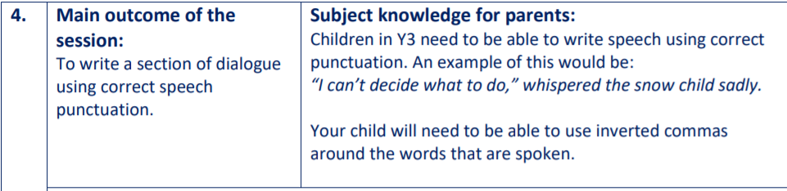

1. Cut up the sentences on the next slide and put them in order so that the conversation makes sense.
2. Put speech marks in the right places around the words that are spoken.

Slide 3
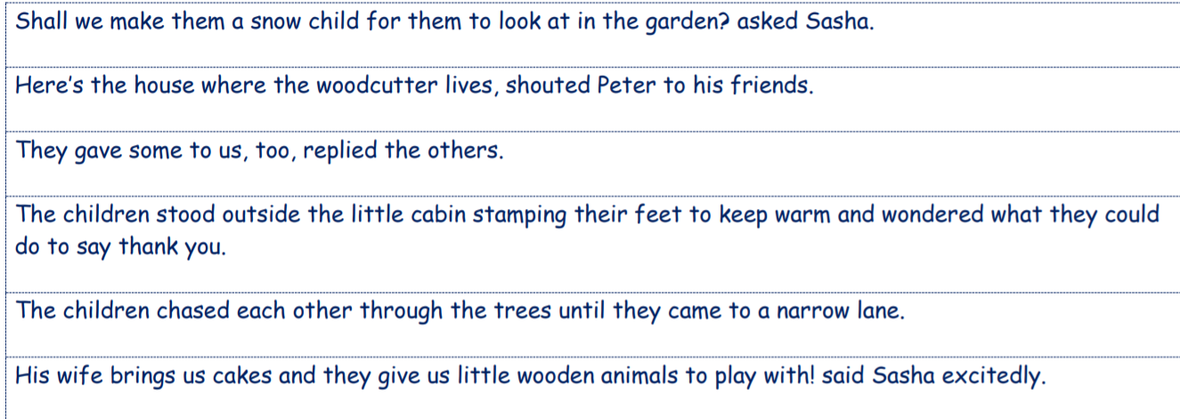
Cut these sentences up and order them so that the conversation makes sense.
Please add the speech marks.

Slide 4
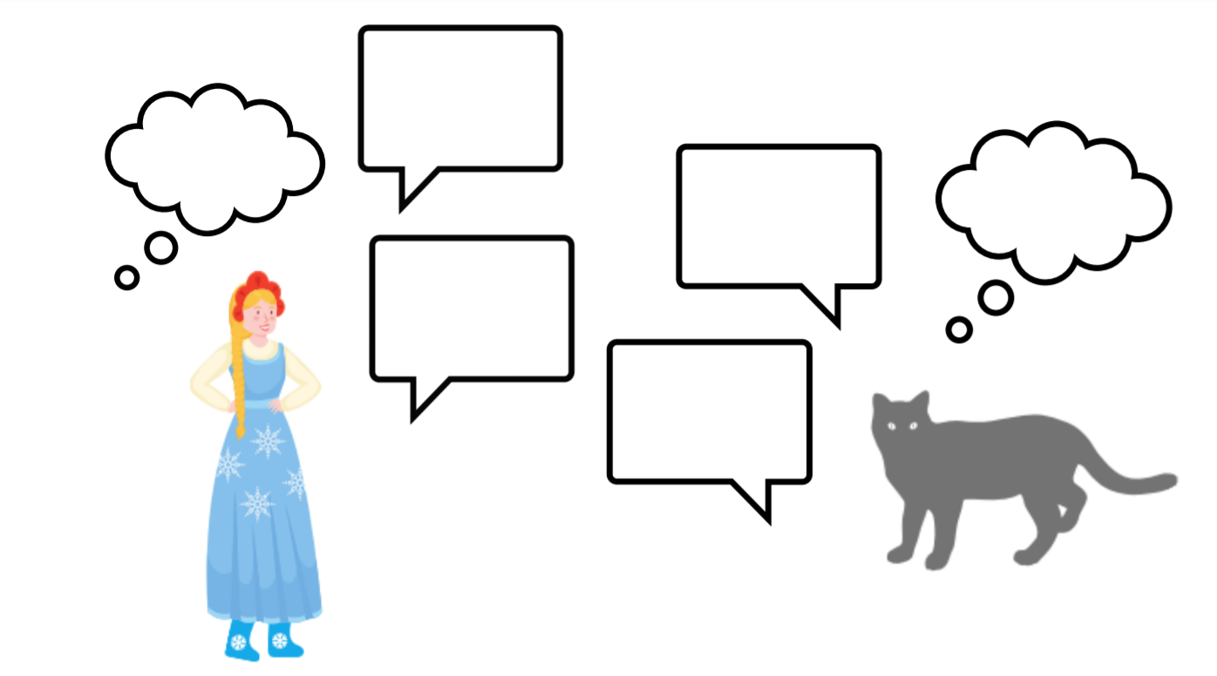
Use the speech bubbles from yesterday to practise/act out a conversation between the Snow Child and Koshka.
Maybe you could use teddies or figures to act the conversation out?
Have fun!

Slide 5
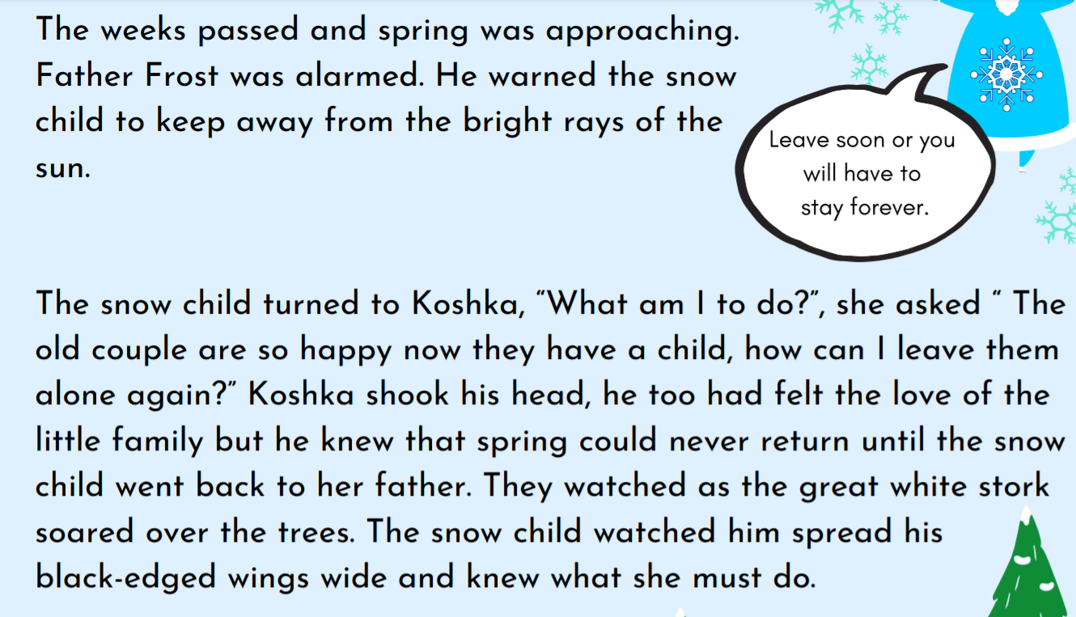
This section of the text might help you with what both characters could be saying.

