Slide 1


English
Date: 20.01.20
Week 3 – Lesson 3
The Girl and the Robot

Slide 2

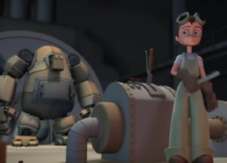
Activity 1
Click on the sound button to hear activity 1 explained to you.
Re-watch the animation ‘Girl and Robot’ from yesterday’s lesson:
https://www.youtube.com/watch?v=5Qx5hf1zLmk
This time as you watch it, create a brief timeline of events.

Slide 3
Activity 2
Click on the sound button to hear activity 2 explained to you.
Write a story about what happened from the viewpoint of either the girl OR the robot.
Think about:
• What happened
• How you were feeling
• Describe in detail what you saw, heard and felt
Have a look on the next slide for an example…

Slide 4
Click on the sound button to hear the example read to you.
Example of story beginning (from the viewpoint of the girl):
I looked up at him in admiration. Pride was bursting out of me! However, my heart sank when I started the cogs up and nothing happened. He stood motionless. My admiration quickly turned to sorrow and frustration. Why wasn’t it working? What had I done wrong?
As the night went on, I continued to adjust and improve my design but still I couldn’t fire him into action…
Checklist:
Paragraphs
Emotive vocabulary
Personification
Rhetorical questions
Fronted adverbials

Slide 5



