Slide 1


Starlings Maths Home Learning
Wednesday 20th January

Slide 2



TIME LESSON FIVE
Today we are going to have some fun playing games to see how much time things take to complete because we need to learn from experience how to estimate time.
We measure time in seconds, minutes and hours.
There are 60 minutes in 1 hour and that is why the minute hand takes 60 minutes to move all the way around a clock in a clockwise direction.
Do you know how many seconds in 1 minute?

Slide 3
Can you find a timer in your house – perhaps a kitchen timer, a timer on a phone or on the computer?
Can you time yourself doing some of these activities? Decide if you’re going to measure in seconds, minutes or hours and can you make an estimate (a guess) first?
Activity | Would you measure is seconds, minutes or hours? | Estimate how long it would take | Actual time it took
Doing 10 star jumps
Reading a page of your book
Saying the days of the week
Running up to your bedroom
Choose some more and have some fun timing your family!

Slide 4
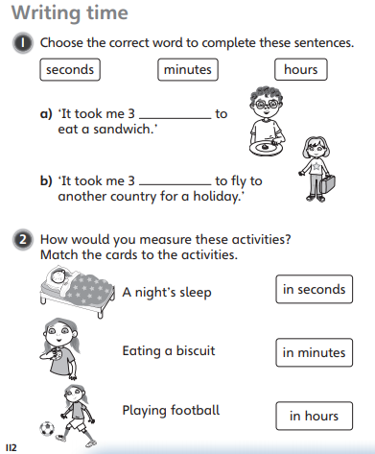
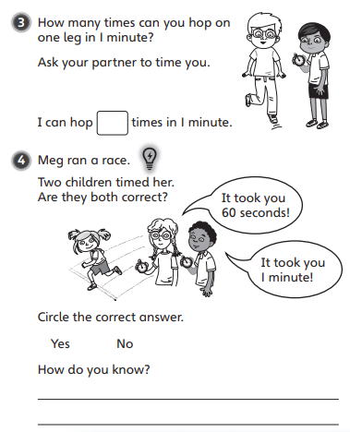
Now have a go at answering these questions:

Slide 5

