Slide 1
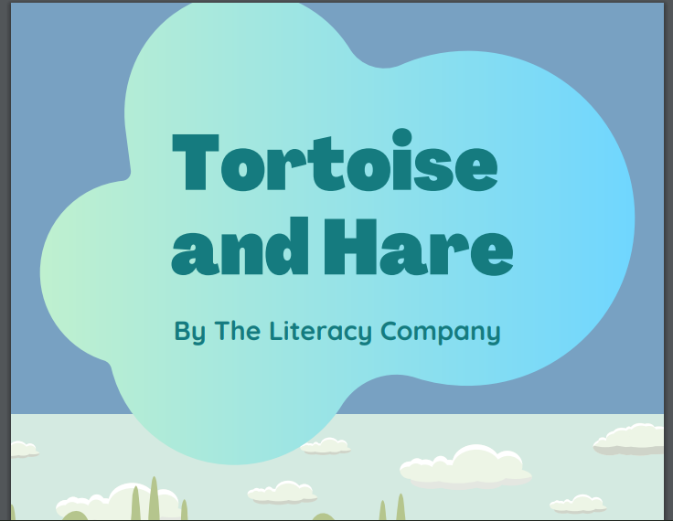

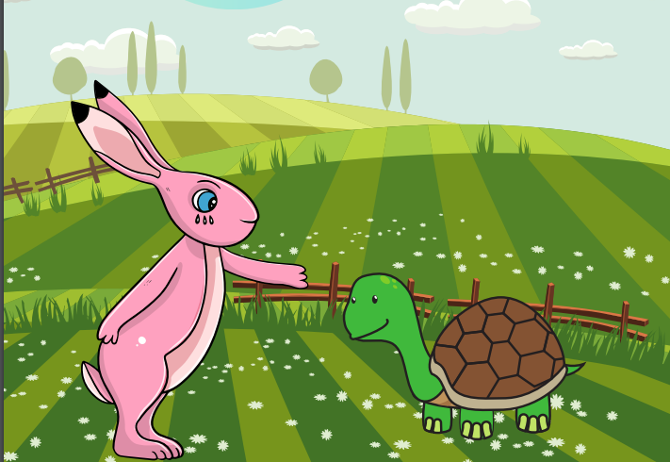
Starlings English Home Learning
Wednesday 20th January

Slide 2



Today we are going to start a new story called The Tortoise and the Hare. This story is a fable which means it’s a story (usually with animals in it) which gives us a lesson on how to behave.
That means we will:
Listen to the story of The Tortoise and the Hare.
Talk about some of the vocabulary (words) we have used.
Retell the story orally (by saying it) using pictures to help us.

Slide 3
Listen to the Tortoise and The Hare Story and if you like, you can follow the words and look at the pictures on the attachment on the Starlings blog.

Slide 4

Can you find some new words that maybe you have never heard of before or you didn’t understand?
I found:
teasing
boasted
plodded
Can you tell me the meaning of these words?
Can you put these words into a sentence?
For example: Mrs Judge didn’t like the children teasing each other.
What type of word are these?

Slide 5
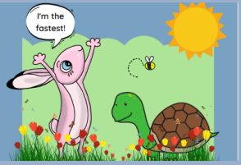
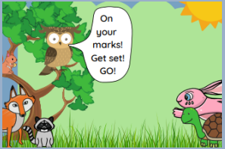
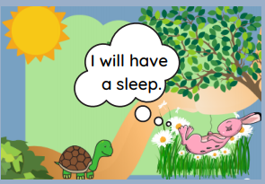
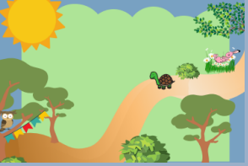
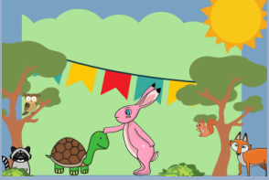
Now I would like you to retell the story orally (out loud) in your own words – use the pictures to help you.

Slide 6
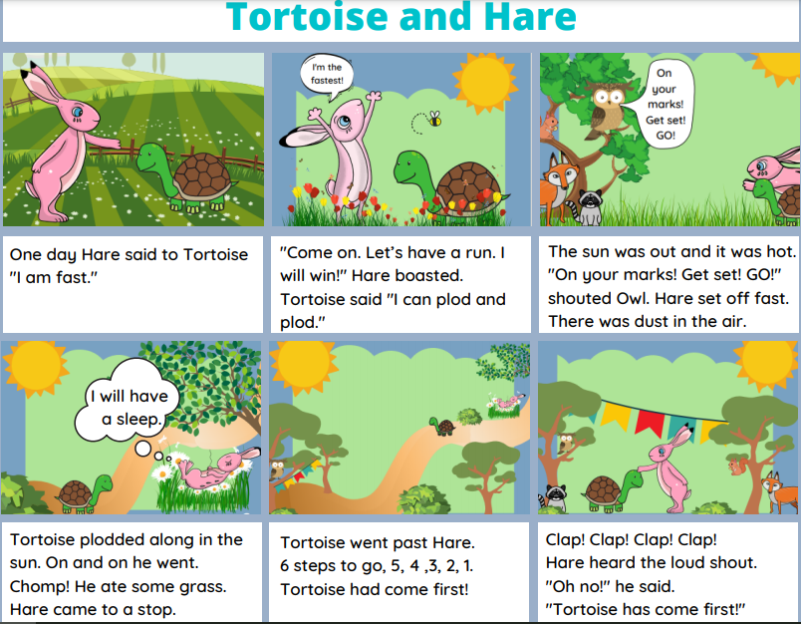
Here’s my version retelling the story.
If you really enjoyed this fable, have a look online and see if you can find some more.

Slide 7
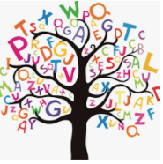
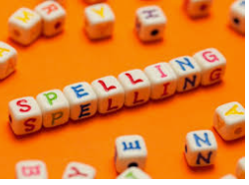



Words of the day!
Skip skipping skipped
Can you write the word skip 5 times in your prettiest handwriting?
Can you write the word skipping 5 times using your other hand?
Can you write the word skipped 5 times sticking your tongue out?

