Slide 1





Wednesday 20th January 2021
Writing

Slide 2
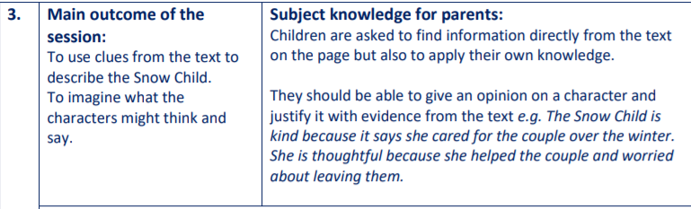
This section is for your grown ups!
Read the story up to the part where she must decide whether to stay or go to the end of page 3.
“The Snow Child watched him spread his black-edged wings wide and knew what she must do.”
I wonder what she will decide to do?
What do you think she will decide?
Jot your ideas down now please.

Slide 3
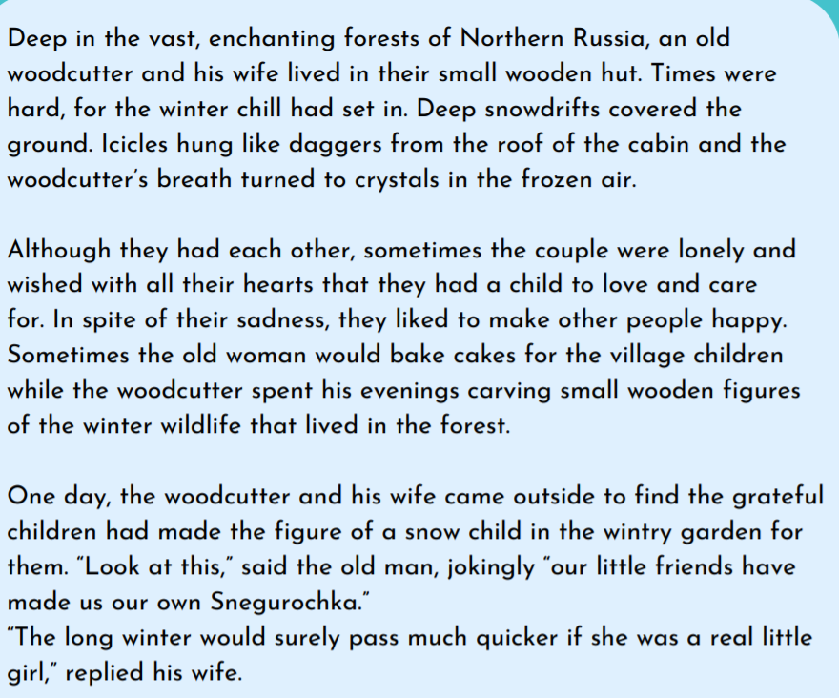

Slide 4
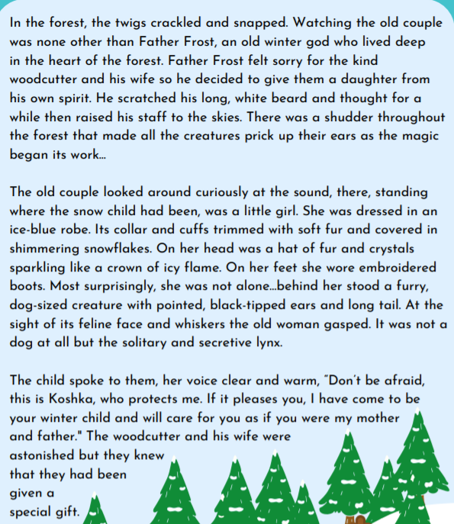

Slide 5
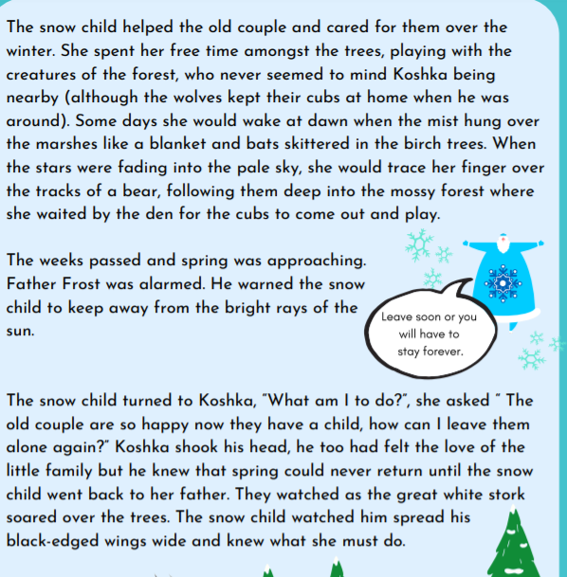

Slide 6
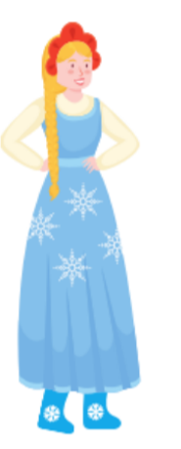
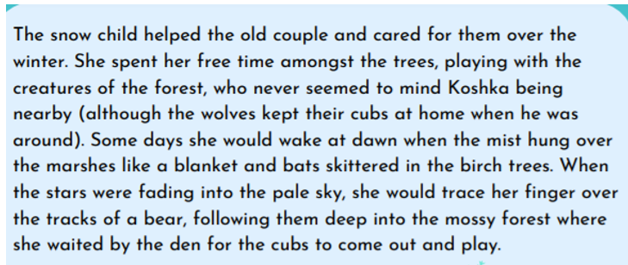
What sort of person do you think the Snow Child is?
Draw an outline of her and write your ideas inside.
Try to use clues and evidence from the story to help you
The paragraph below is great for finding character clues.

Slide 7
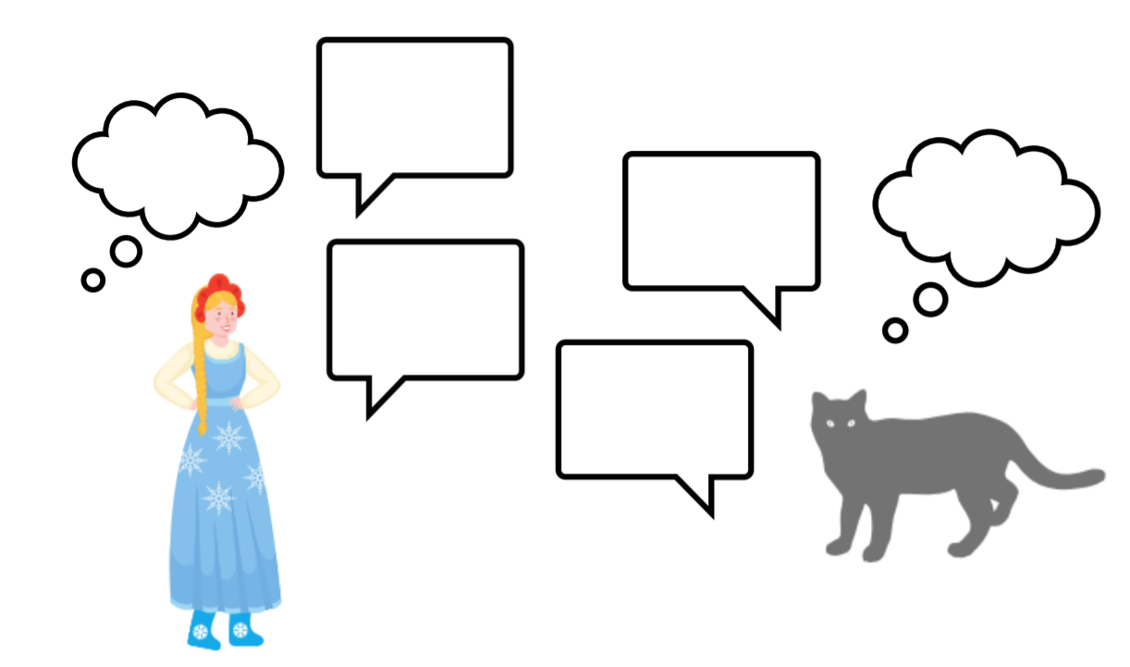
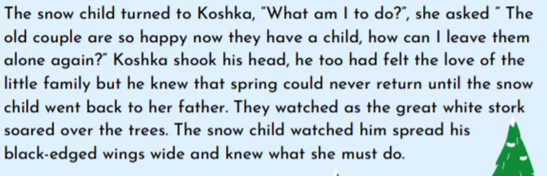
Use the pictures of The Snow Child and Koshka to complete the bubbles with your ideas about what they might be saying and thinking when they are deciding whether to stay or leave. You can add more bubbles of your own if you like.

