Slide 1


Starlings English Home Learning
Tuesday 19th January

Slide 2


So yesterday you drew a picture of either the next part of the story or your alternative ending. Today we are going to write this using all the skills we have learnt in the last 9 sessions.
That means you will
Practise (orally rehearse) what you will write in your sentence and say this out loud to help you to remember.
Write sentences with capital letters, finger spaces and full stops in the correct places.
Read and check your sentence once you are done.

Slide 3
Some information for parents:
The children need to know how to turn their plans and ideas into a final piece of writing.
They need to talk through their ideas before writing them down sentence by sentence.
Use the modelled example on slide 6 and ask your child to check it by highlighting the use of ‘and’ , capital letters and full stops. You can print it off it helps or just ask your child to verbally point them out.
Prompt your child with questions to help them formulate each sentence for their next part of the story –
          What happens next?
          Then what happens?
          What does Little Red / Grandma / woodcutter do?
If you have a device that can record your child’s answers that would be beneficial so that they can listen back when they are writing.
Let your child write the next part of the story independently
When they have finished repeat the checking process by first asking them to read it back and then highlighting the skill used:
          Full stops
          Capital letters (for names and at the start of a sentence)
          Using ‘and’ between words

Slide 4

Here is the story again just in case you want to refresh your memory.

Slide 5
On the next slide I have modelled and read to you what I think happened next.
With your adult can you point out where I have used capital letters, full stops and also used ‘and?
If you want to, you can print the slide and use coloured pencils to highlight the capital letters, full stops and the use of the word ‘and
On slide 7 I have highlighted the capital letters, full stops and where I have used ‘and’. I hope I highlighted them all, did I miss any?

Slide 6
Grandma was so happy. She asked them all to stay for tea and cakes. They ate the cakes from Little Red’s basket. The brave and strong woodcutter had his tea. Then he said he had to go back to work. They told him he could come and visit again any time.
Grandma was feeling better now. She walked Little Red back along the track. Little Red’s mum couldn’t believe it when she heard the tale. The next time Little Red went to Grandma’s house she made sure she didn’t talk to anyone on the way.

Slide 7
Grandma was so happy. She asked them all to stay for tea and cakes. They ate the cakes from Little Red’s basket. The brave and strong woodcutter had his tea. Then he said he had to go back to work. They told him he could come and visit again any time.
Grandma was feeling better now. She walked Little Red back along the track. Little Red’s mum couldn’t believe it when she heard the tale. The next time Little Red went to Grandma’s house she made sure she didn’t talk to anyone on the way.

Slide 8

Remember, just do one sentence at a time.
You can choose a character to start with such as Grandma - tell me what she does.
Grandma jumped out of bed and ran to Little Red.
I have then re-read the sentence I have written and checked for capital letters and full stops. I know that Grandma is a name but it is also at the beginning of my sentence and Little Red is also a name so that needs a capital letter too. I have made sure I have ended my sentence with a full stop and in this sentence I have also used and.
Next I might tell you what Little Red does…
Now it is your turn!
Remember how amazing you all are and think about
all the incredible writing you have already completed this year.

Slide 9

Red group – you need to look out for set 1 videos on the link below:
https://www.youtube.com/channel/UCo7fbLgY2oA_cFCIg9GdxtQ
We would like you to watch 3 videos: set 1 speed sounds, set 1 word time and set 1 spellings please.
Green group you need to look out for set 2 videos on the link below:
https://www.youtube.com/channel/UCo7fbLgY2oA_cFCIg9GdxtQ
We would like you to watch 4 videos: set 2 speed sounds, set 2 spelling, red words 1, and read and hold a sentence 1
Pink, yellow and blue groups you need to look out for set 3 videos on the link below.
https://www.youtube.com/channel/UCo7fbLgY2oA_cFCIg9GdxtQ
We would like you to watch 4 videos: set 3 speed sounds, set 3 spelling, red words 2 and read and hold a sentence 2

Slide 10

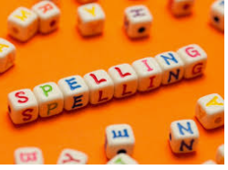


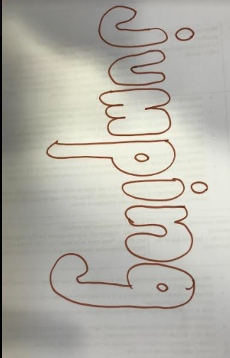
Words of the day!
jump jumped jumping
Can you write the word jump 5 times inside your squiggles?
Can you write the word jumped 5 times in joined up handwriting?
Can you write the word jumping 5 times in bubble writing?

