Slide 1


Starlings Maths Home Learning
Tuesday 19th January

Slide 2
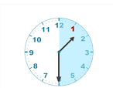


TIME LESSON FOUR
Today we are using our clocks again and will tell the time to the hour and half past the hour and draw the hands on a clock face to show these times.
You already know that the minute hand pointing straight up indicates ‘something o’clock’. Now you are finding out what happens when the minute hand (the long hand) is pointing straight down: these are ‘half-past something’ times. You find out the ‘something’ by looking at the hour hand (the short hand) – the time is half past the hour that the hour hand has just passed.
You also need to know that the hands turn clockwise.

Slide 3
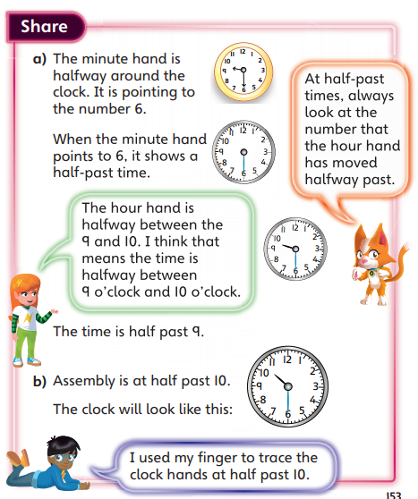
Have a look at this video as it will help you: https://www.youtube.com/watch?v=lZVy5d7JAiU
Remember sometimes we say half past six or sometimes we say 6.30.
This information might help you:
You could use your ‘make your own clock’ to help you so you could have lots of fun moving the hands to ‘o’clock’ and half past – maybe you could test your grown ups!

Slide 4
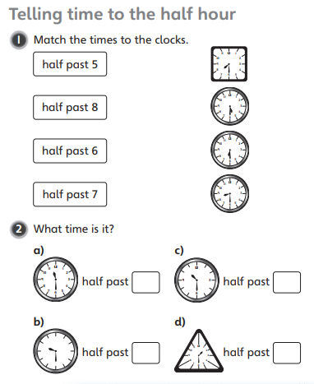
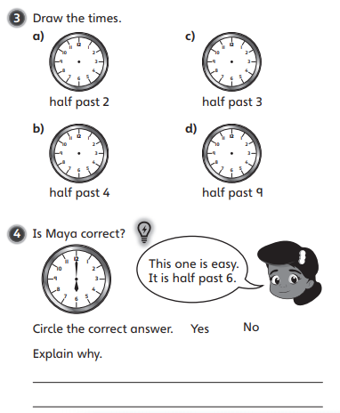
Can you try and match and draw these times to half an hour? Or make them on your own clock. Remember that the hour hand is the short hand which will be half way between an hour and the minute hand is longer and will point down to the number 6 because it’s half way around the clock.

Slide 5

