Slide 1



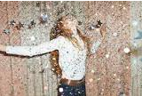
English
A sprinkle of glitter
Year 2 Swallows Class
Tuesday 19th January 2021

Slide 2
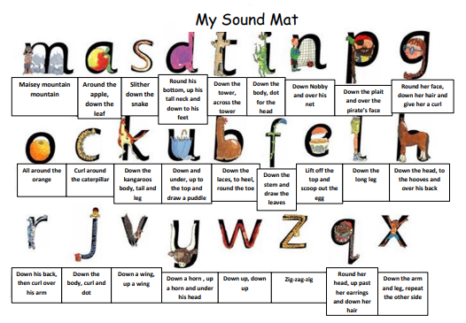

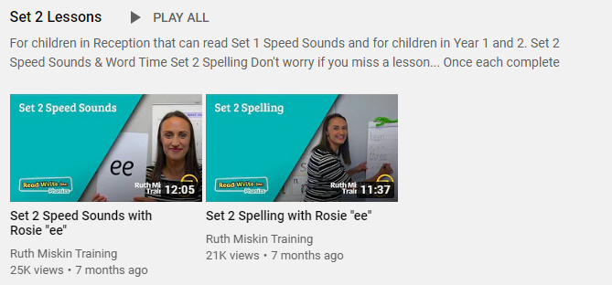
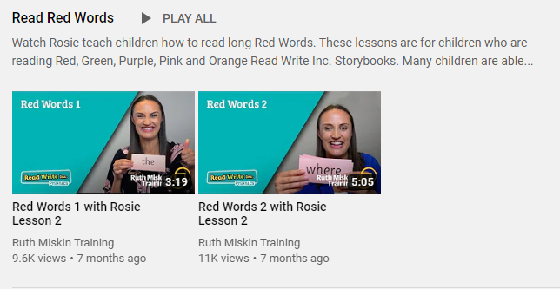
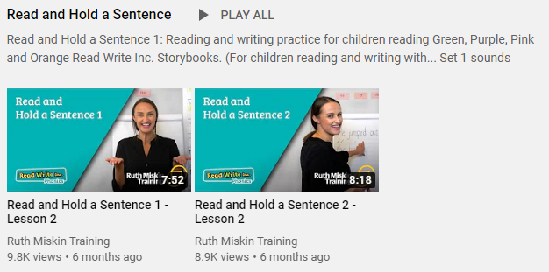
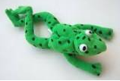
Read Write Inc
Set 2
If you are currently reading green books, please follow the link below to your Read Write Inc lesson today. Each day you will need to click on the video’s shown in the screen shots below. Please remember that although the screen shot says /ee/, the sound will change each day but will be found in the same place. https://www.youtube.com/channel/UCo7fbLgY2oA_cFCIg9GdxtQ
Video 1: Please watch ‘Set 2 Speed sound’ lesson.
Video 2: Please watch ‘Set 2 Spelling’ lesson.
Please complete all 4 video’s each day ☺
Video 3: Please watch ‘Red words 1’ lesson only.
Video 4: Please watch ‘Read and Hold a sentence 1’

Slide 3
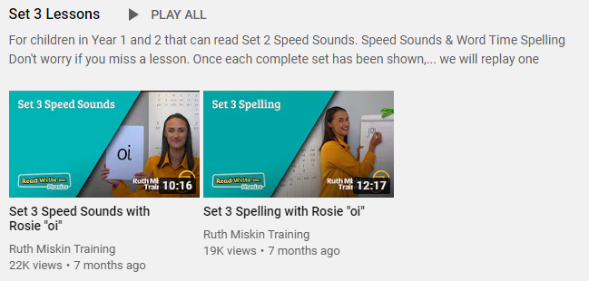
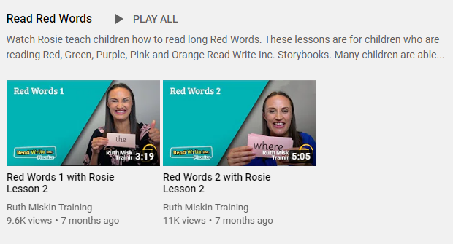
Set 3
If you are currently reading pink, orange, yellow, blue or grey books, please follow the links below to your Speed Sound lesson, red word focus lesson and hold a sentence activity for today. Each day you will need to click on the video’s shown in the screen shots below. Please remember that although the screen shot says /ee/, the sound will change each day but will be found in the same place. https://www.youtube.com/channel/UCo7fbLgY2oA_cFCIg9GdxtQ
Video 1: Please watch ‘Set 3 Speed sound’ lesson.
Video 2: Please watch ‘Set 3 Spelling’ lesson.
Video 3: Please watch ‘Red words 2’ lesson only.
Video 4: Please watch ‘Read and Hold a sentence 2’

Slide 4
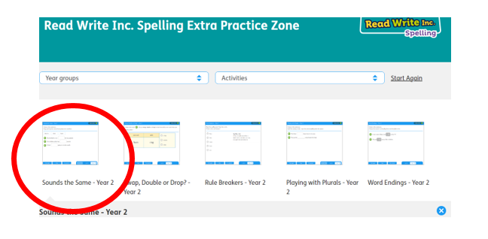
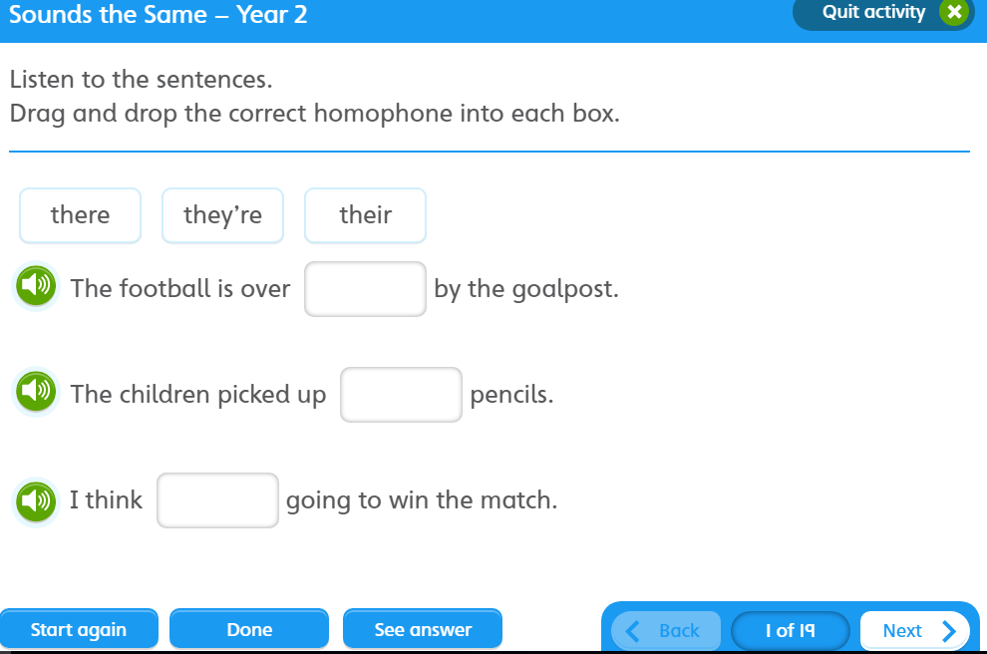

https://www.oxfordowl.co.uk/for-pupils/pupil-home?current_page=home
Username: starlings1 Password: Home
Sounds the Same

Slide 5
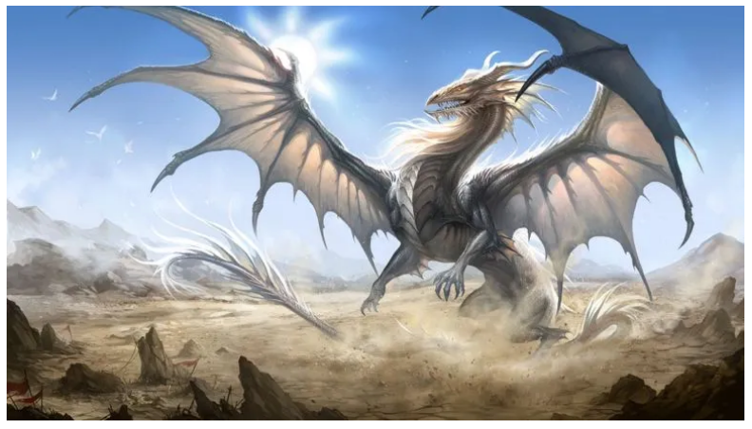
Writing
Can I write sentences about dragons using because/when?

Slide 6
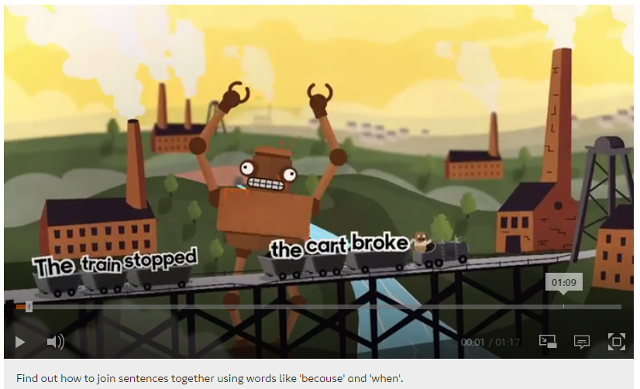
Writing
Can I write sentences about dragons using because/when?
because
when
https://www.bbc.co.uk/bitesize/topics/zwwp8mn/articles/zqk37p3

Slide 7
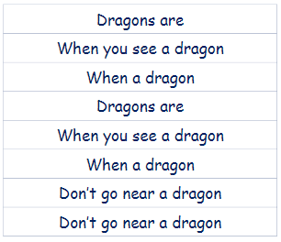
Can I write sentences about dragons using because/when?
because
when

Slide 8

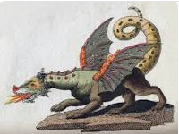
Can I write sentences about dragons using because/when?
because
when
Dragons are dangerous because they breathe fire.
When a dragon is hungry it will eat anything.
Don’t go near a terrifying dragon when it is hungry.

Slide 9


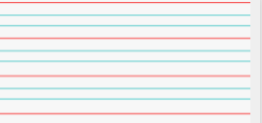
Can you re-read what you have written to check that it makes sense?
because/when
Joined handwriting

Slide 10


Where does Plop live?
Who said that they like fireworks?
Do you think that Plop will enjoy the fireworks in
the end?
What do you think will happen in our story tomorrow?
Author: Jill Tomlinson
Illustrator: Paul Howard
Publisher: Egmont

Slide 11

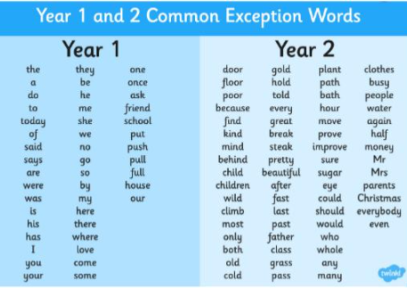
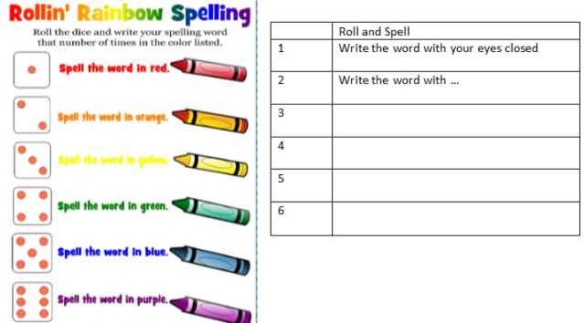
Spellings
Can you read and spell the words below?
bath hour move prove improve

