Slide 1



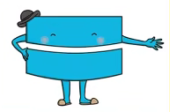
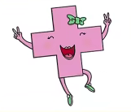
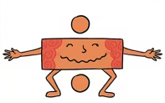


Maths
Year Two Swallows
Tuesday 19th January 2021

Slide 2
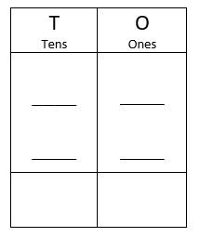
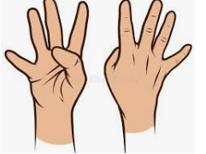
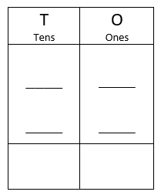
4 A Day
42 + 36 = | 83 –52 =
5 x 5 = | 20 ÷ 5 =

Slide 3


Answers
42 + 36 = 78 | 83 –52 = 31
5 x 5 = 25 | 20 ÷ 5 = 4
4 2
3 6
7 8
8 3
5 2
3 1

Slide 4
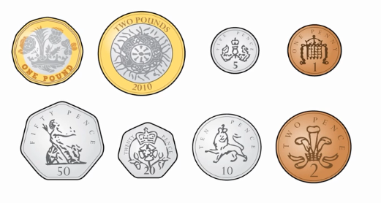
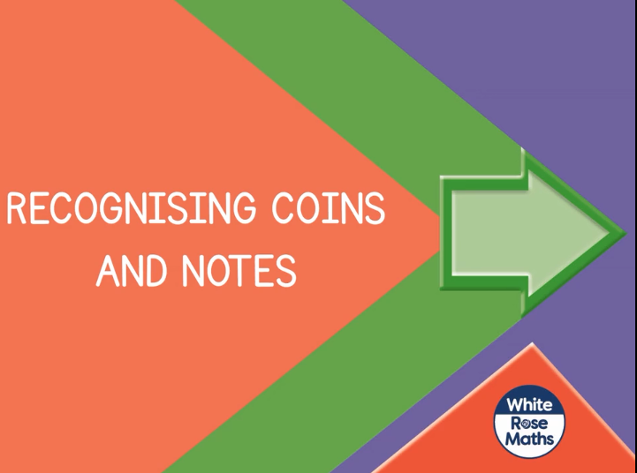
`
Can I recognise coins and notes?
https://vimeo.com/470140979
Knkkkkkkkkkkkkkk kkVideo

Slide 5
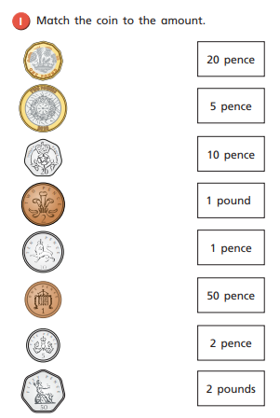
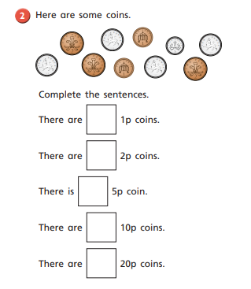
Note: There are 2 worksheets to complete today. The style of question is repetitive so I don’t think this will take any longer than our usual worksheet. If it is too much, have a break and come back to it later.
Your Turn

Slide 6
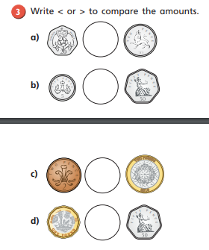
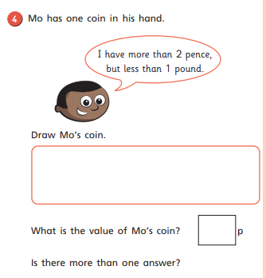
Your Turn

Slide 7
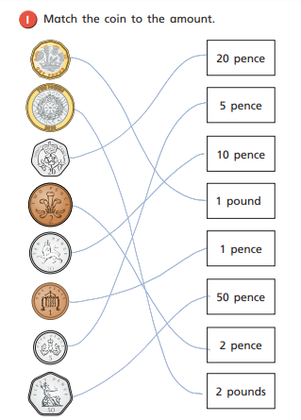
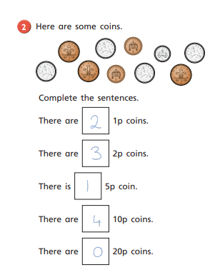
Answers

Slide 8
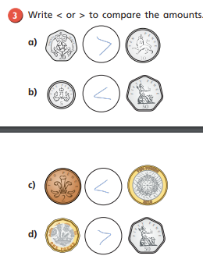
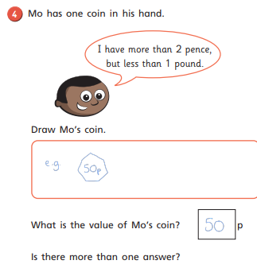
Answers

Slide 9
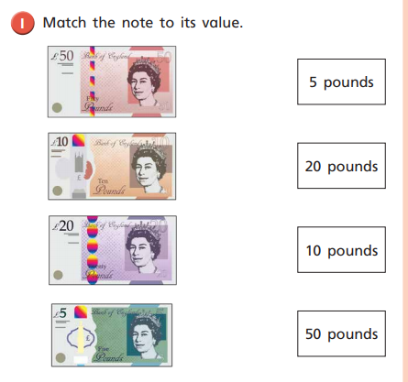
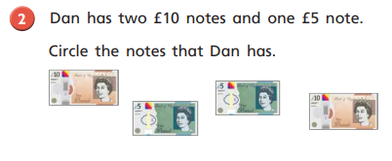
Your Turn

Slide 10
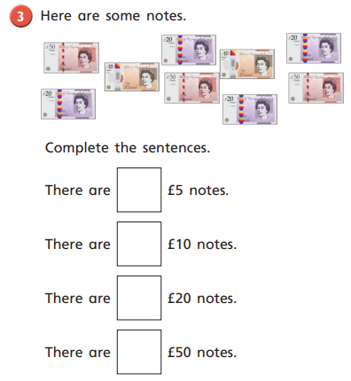
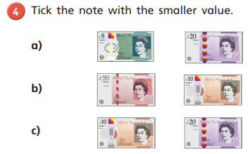

Slide 11
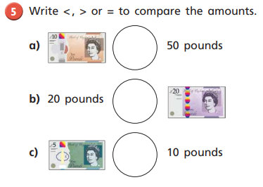
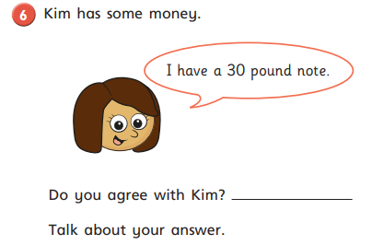

Slide 12
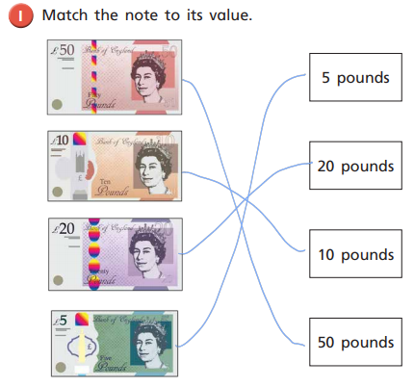
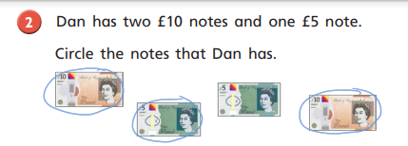
Answers

Slide 13
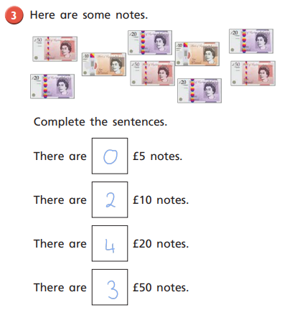
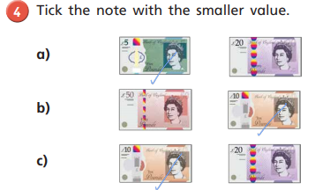
Answers

Slide 14
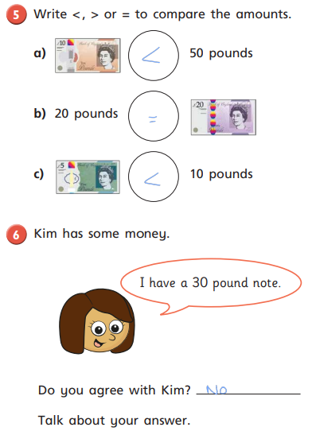
Answers

Slide 15


Optional Challenge
True or False?

Slide 16
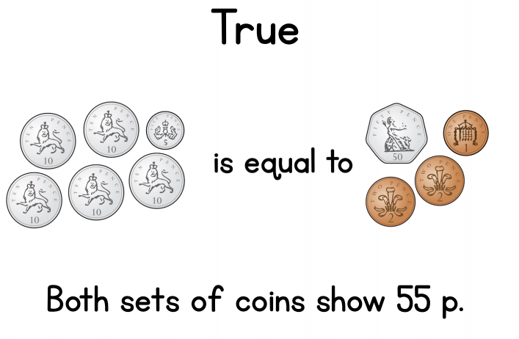
Optional Challenge - Answers
True or False?

