Slide 1

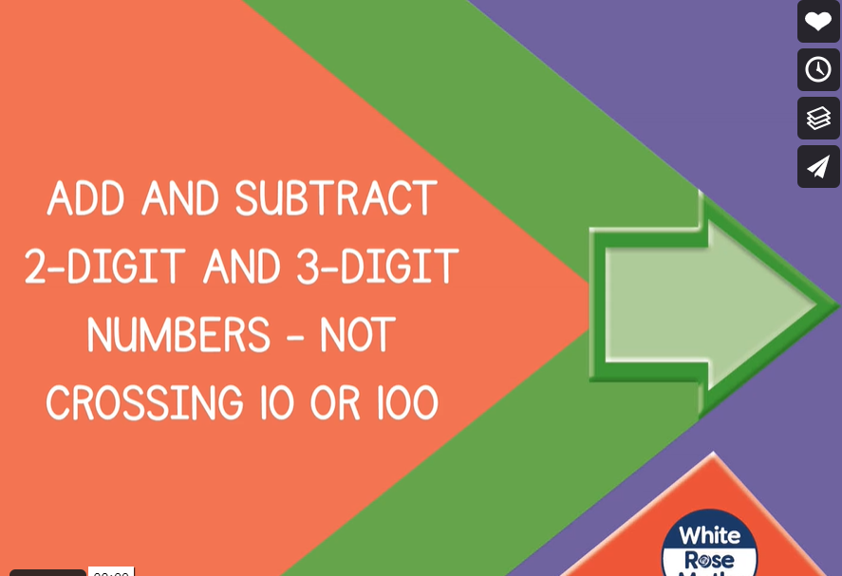


Tuesday 18th January 2021
Today, we are going to be adding and subtracting 2 and 3 digit numbers using the column method.
Please click on the link below to watch today’s video.
https://vimeo.com/464966035

Slide 2
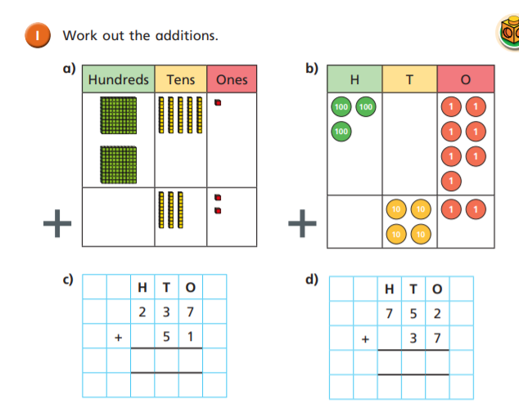

Slide 3
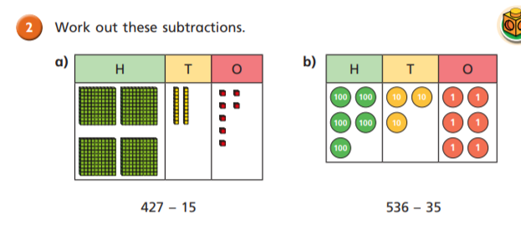
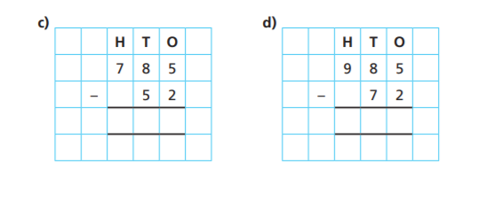

Slide 4
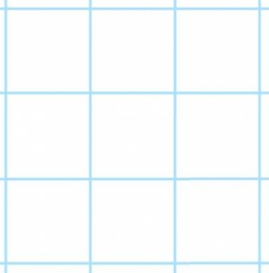
Use the column method to solve these calculations:
H T O
69 + 220 =
314 + 42 + 23 =
Remember you must line your digits up correctly in their columns as if they move, their value will change.

Slide 5
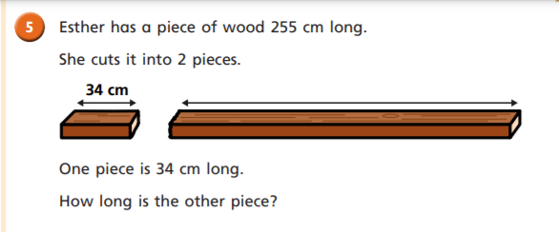
A little word problem for you:
I wonder if this is an addition or a subtraction calculation?
If I start with 255cm and one piece is 34cm, how long is the other piece…?
Use the column method to solve.
Remember to position your digits up correctly.
Think carefully about how you will position the number 34.

Slide 6
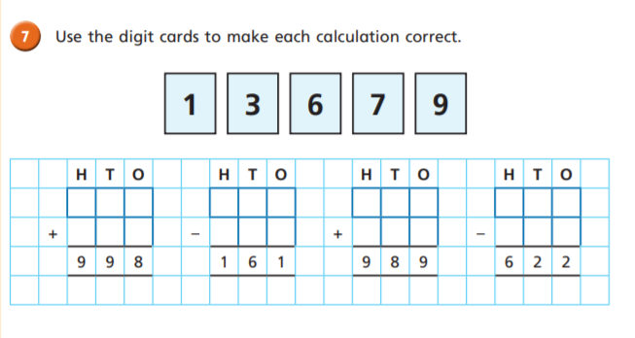
Challenge Time

Slide 7
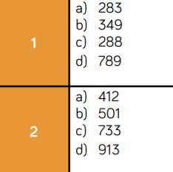
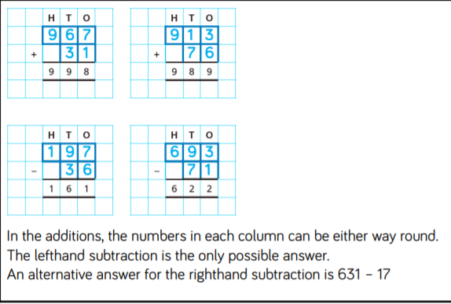

Time to check your work.

