Slide 1


English
Date: 19.01.21
Week 3 – Lesson 2
The Girl and the Robot

Slide 2

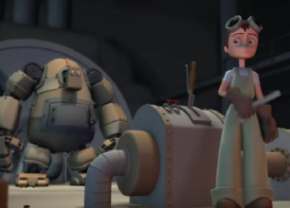
Activity 1
Click on the sound button to hear activity 1 explained to you.
Watch the animation ‘Girl and Robot’
https://www.youtube.com/watch?v=5Qx5hf1zLmk

Slide 3
Activity 2
Click on the sound button to hear activity 2 explained to you.
Now, make a poster to advertise the robot for sale or design your own robot with its own special features.
You should:
Include a picture of it
Label its unique features
Explain: Why should somebody buy it? What will it do for you? Why is it better than other robots?
WAGOLL

Slide 4
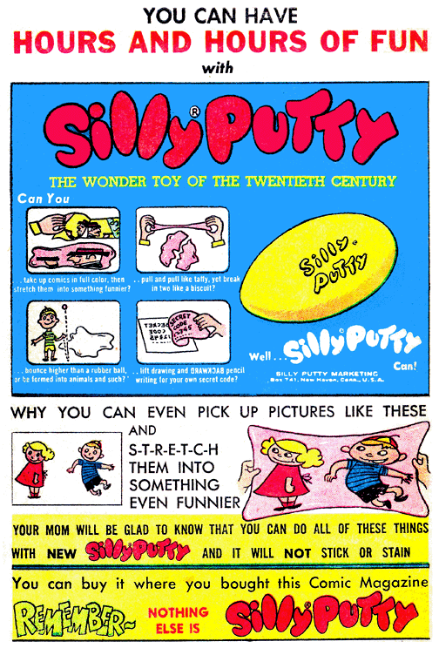
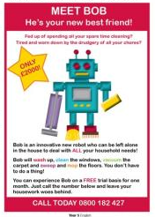
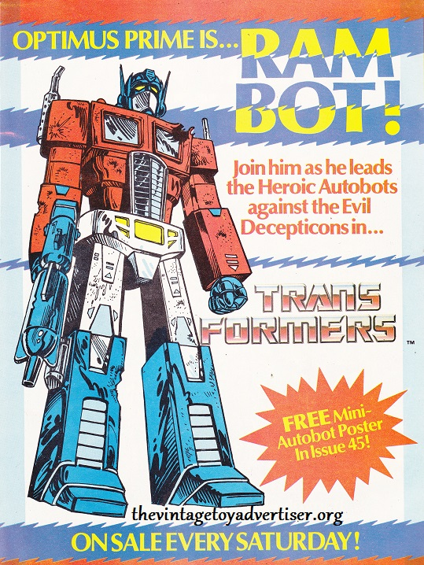
WAGOLL
You should:
Include a picture of it
Label its unique features
Explain: Why should somebody buy it? What will it do for you? Why is it better than other robots?
Include figurative language (e.g. alliteration, similes, personification, etc.)
Click on the sound button to hear the WAGOLLs explained.

Slide 5
