Slide 1


Starlings Maths Home Learning
Monday 18th January

Slide 2

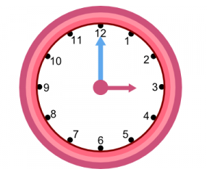

TIME LESSON THREE
Good Morning and welcome to our third week of home learning. Listen to this fun song to get you started: https://www.youtube.com/watch?v=tEmg914-9xY
Today we are going to looking at telling the time to the hour on an analogue clock (a clock with moving hands). See if you can have a look around your house and count how many analogue clocks or watches you have.
I had four analogue clocks plus lots of digital clocks – do you know what a digital clock is?
Look at one of your analogue clocks (or the one attached) and have a look at where the numbers are on the face. What do they go up to?

Slide 3
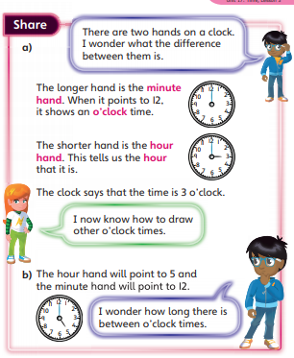
Play guess the time to the hour on YouTube video:
https://www.youtube.com/watch?v=EIxaxnageTo
This information might help you:
I’ve also attached a ‘make your own clock’ to help you so, if you like, you could have lots of fun making your own clock and moving the hands to ‘o’clock’ – maybe you could test your grown ups!

Slide 4
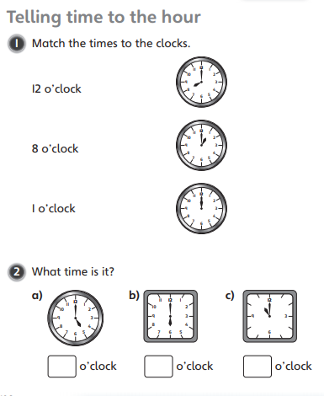
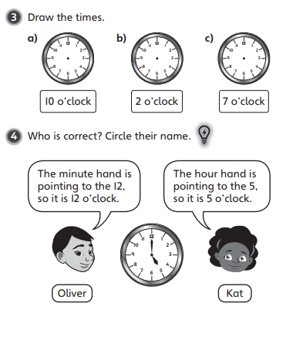
Can you try to tell and draw the time on these clocks? Or make them on your own clock. Remember you are looking or drawing the hour hand (the shorter hand) and the minute hand will be pointing to 12:

Slide 5
