Slide 1

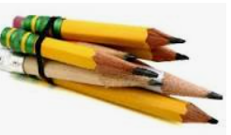



Monday 17th January 2021
Writing

Slide 2
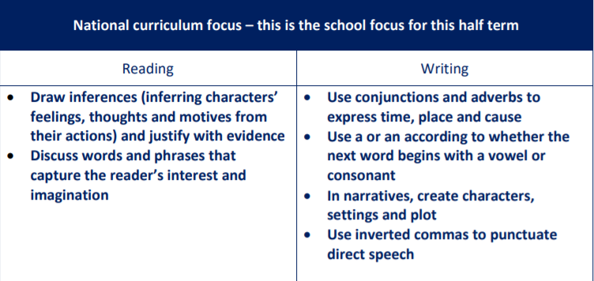

Slide 3
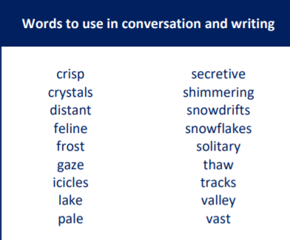
You may like to use these words in your writing during this unit.
Solitary:
This means when a person or animal lives alone or it can mean “single”
For example:
“We do not have a solitary piece of evidence to prove that Mrs Rice stole the biscuits!”

Slide 4


Slide 5
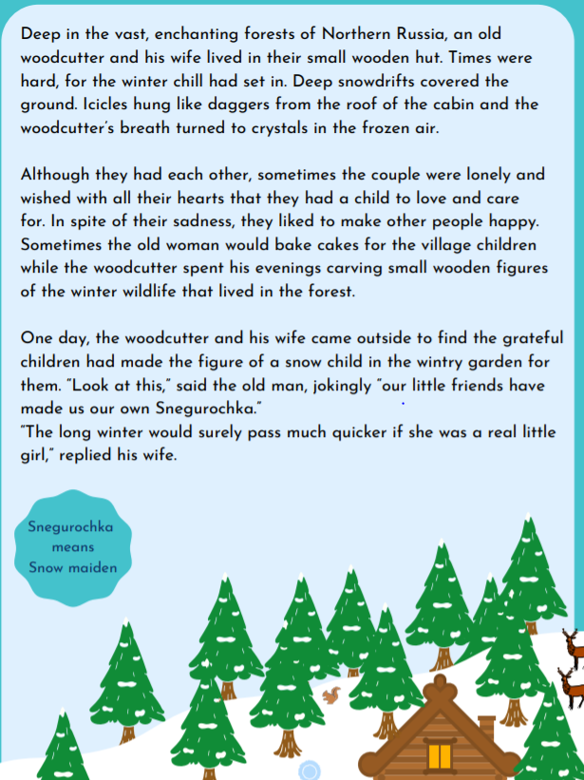
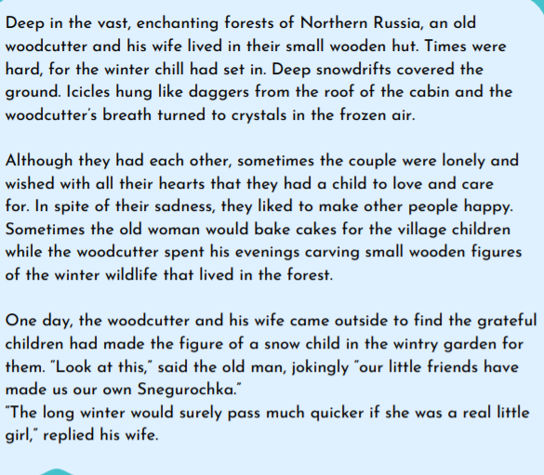
This is page 1 then page 1 again, a zoomed in version.

Slide 6
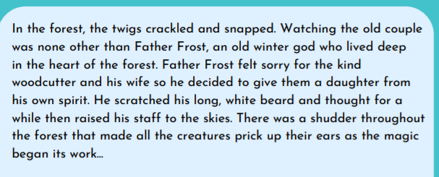
Page 2 (The first paragraph)

Slide 7
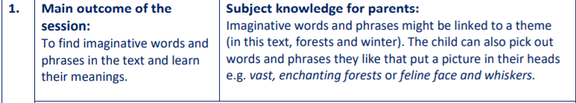
Let’s get started:
Robins, please read the beginning of the story together up to,
‘…the magic began its work.’ (pg.2)
Write three ideas about what the magic could be.
What could happen next?

Slide 8

Second job for today…
Hunt through the opening part of the story to find as many wintry words and phrases as you can e.g. snowflakes, winter chill, deep snowdrifts, crystals
Try to find at least 5 and jot them down.
Write three sentences which include some of these words
e.g. Every snowflake is made of different shaped crystals.
Use a dictionary if you have one, or an online version to look up the meanings of any new words.

Slide 9
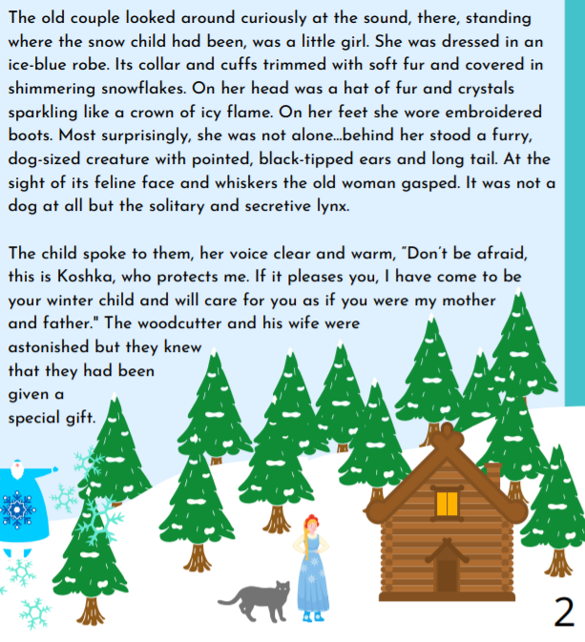
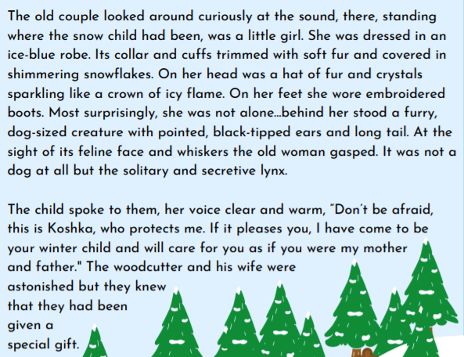
Page 2 so that you could see the illustrations and then page 2 zoomed in on the text.

Slide 10
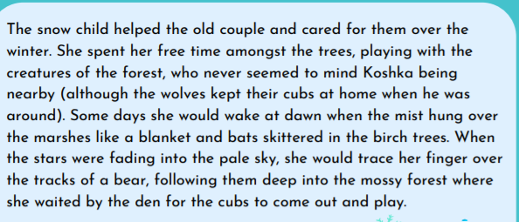
Page 3 (The first paragraph)

Slide 11
Last little job today Robins…
Read the story together up to,
‘…she waited by the den for the cubs to come out and play’ (pg. 3).
Find and note any more words and phrases you like while reading the text.
Please keep all of your work from today safe, maybe in a little note book, as you will be adding to it as the lessons go on and referring back to what you have jotted down to use in your independent writing.

