Slide 1

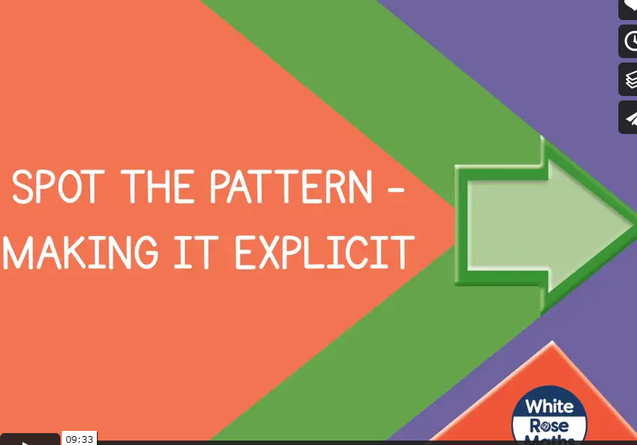


Monday 17th January 2021
https://vimeo.com/463009983
We are going to be spotting patterns.
Please click on the link below to watch today’s video.

Slide 2
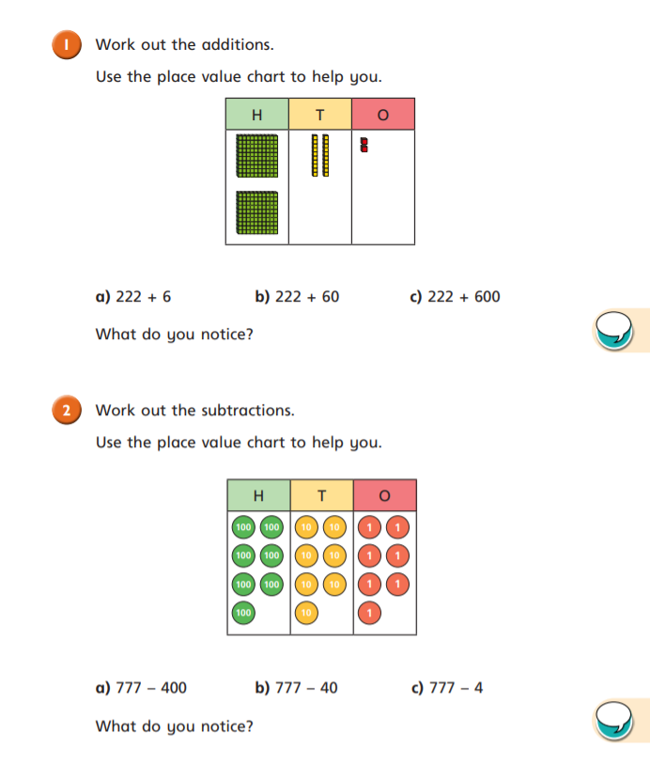

Slide 3
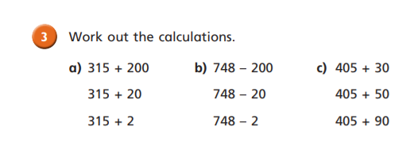

Slide 4
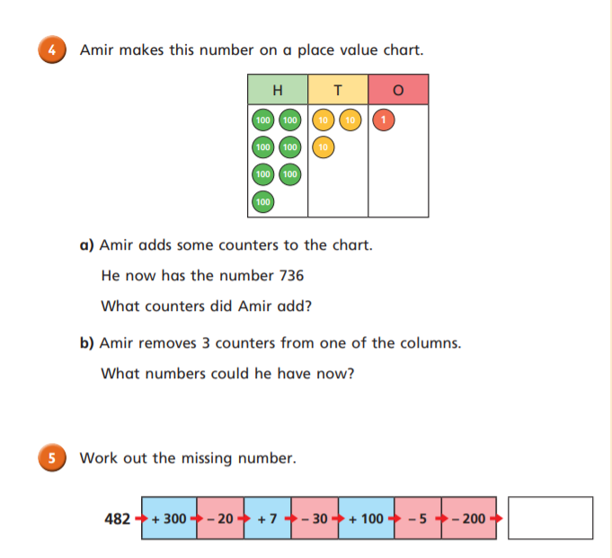

Slide 5
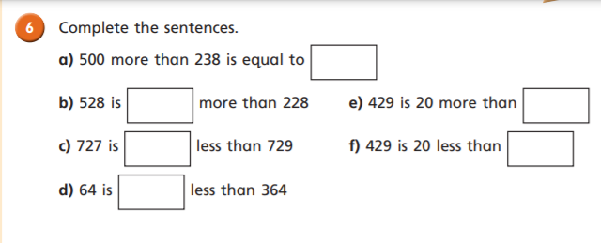
Challenge Time

Slide 6
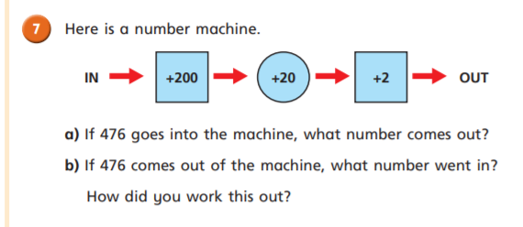
Challenge Time

Slide 7
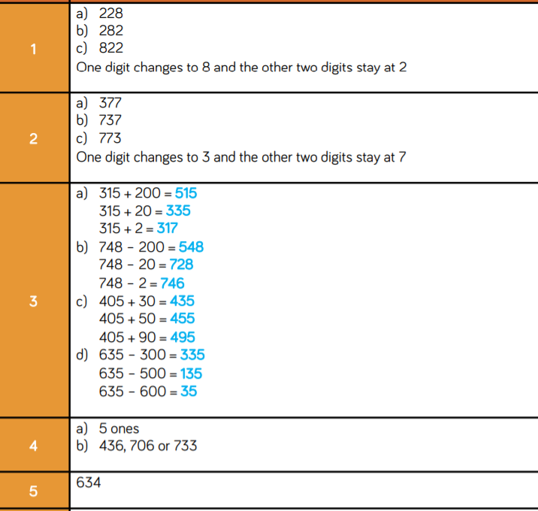
Time to check your answers my lovely Robins!

Slide 8
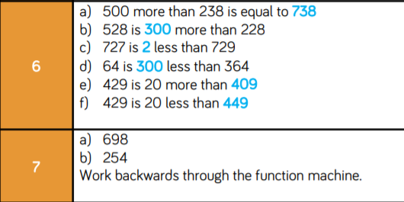
Challenge Time Answers

