Slide 1


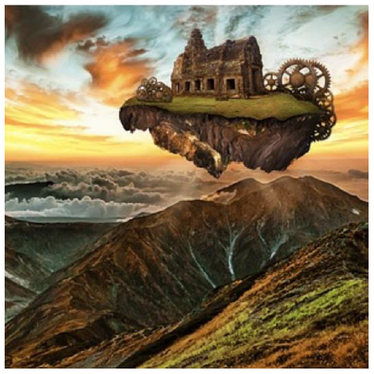
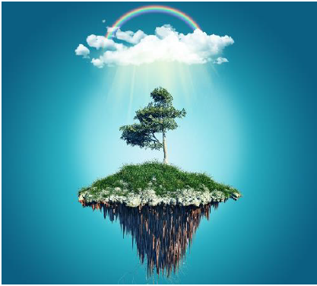


English
Floating Island

Slide 2

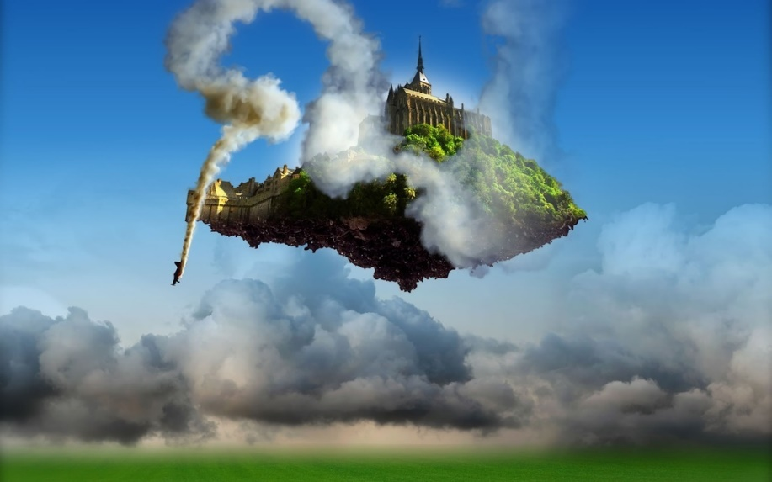
Revisit your ideas from Thursday & Friday’s lessons
Design your own floating island. Consider:
• What size and shape is it?
• What vegetation is on the surface?
• What provides you with shelter?
• What are the roots of your island like?
• What is the weather like above you?

Slide 3
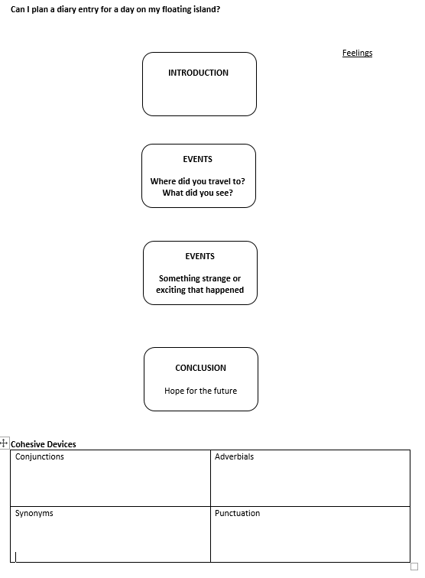
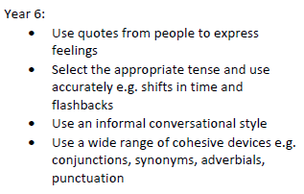
Can I plan a diary entry?
Plan a diary entry for a day on your floating island. Remember to include both description and your point of view/feelings. Use all the writing features you have learnt so far in school. Particularly focus on cohesion (how your writing flows) and a range of devices that allow this to happen.
Things to consider in your plan:
Did something strange/exciting happen?
Where did you travel to?
How did you feel?
Success Criteria

Slide 4
Ideas for your writing:
Please be as imaginative as possible. Absolutely anything at all can happen on your floating island.
Maybe you could be floating out in space…
Maybe you may be floating around planet Earth.
You can use Google Earth to imagine you are actually doing it.
I used this link to help me…
Google Earth Animals from Above or there is this one…
Cities from their street maps
Continue to the next slide for my modelled plan.
Success Criteria

Slide 5
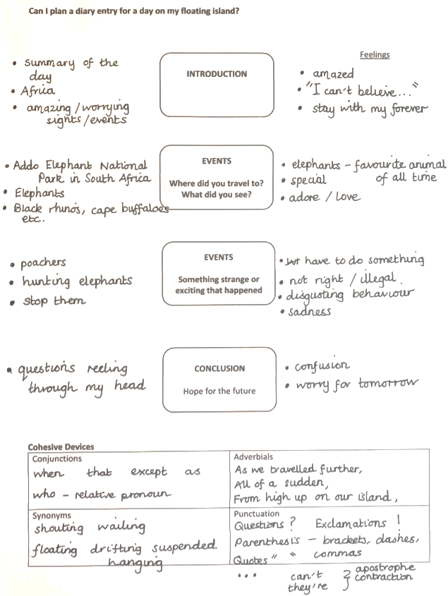

Slide 6

Here is the video link to see Mrs Whittingham read part 2 of this beautiful book.
https://youtu.be/q6q6E1KhJLQ

