Slide 1


Spring Arithmetic Test 1
Audio 1
Audio 2

Slide 2
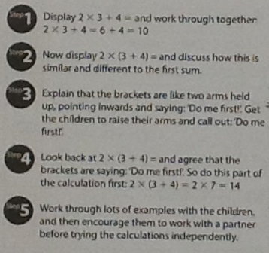
Brackets first!

Slide 3
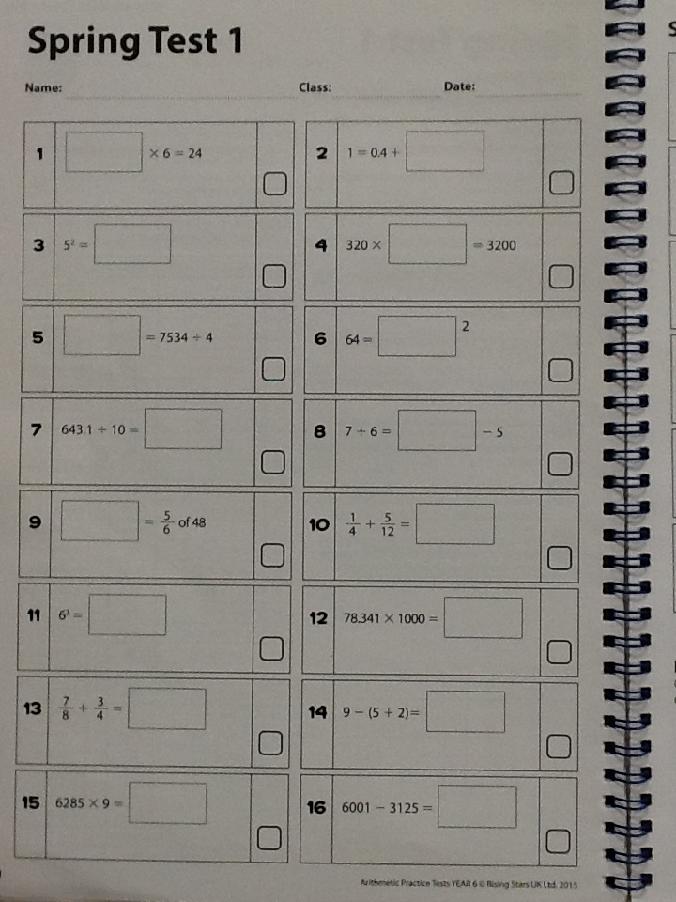

Slide 4
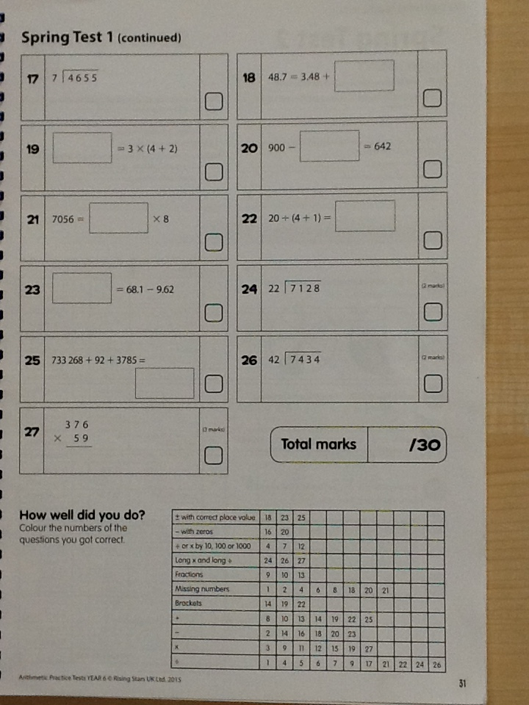

Slide 5
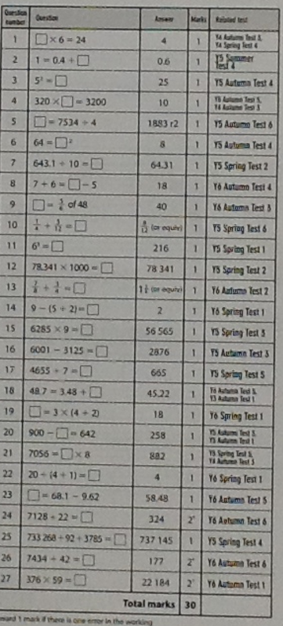
Answers

