Slide 1


Mathematics
Date: 18.01.21
Week 3 – Lesson 1
Equivalent Fractions

Slide 2
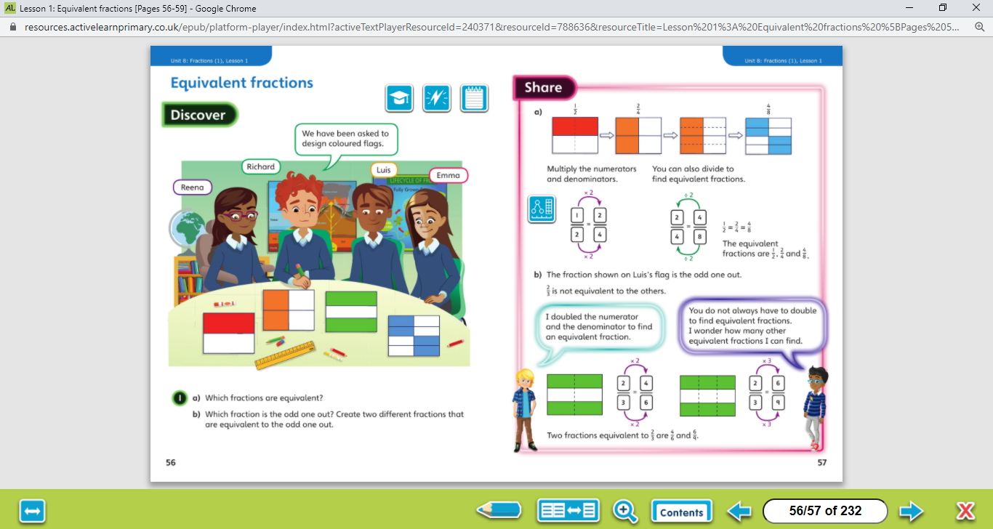

Let’s work together!
Equivalent means equal in value
Look at the picture clue. What can you see?
Have a look at the questions.
Click on the sound button below to hear the questions read to you. We will also talk through the questions together like we do in school.
We will go through the possible methods and answers on the next slide.

Slide 3
Let’s work together!
Click on the sound button below to hear the answers and possible methods for question A.
Click on the sound button below to hear the answers and possible methods for question B.

Slide 4
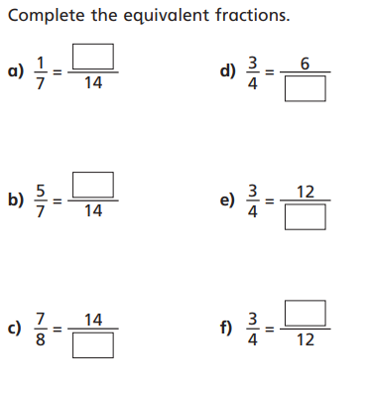
Let’s work together!
Remember: you must multiple the numerator and denominator by the same number.
2
x2
Click on the sound button below to hear the question read to you. We will work together to reach the answer.
10
x2
Click on the next slide to hear the answers.
16
x2

Slide 5
Let’s work together!
Remember: you must multiple the numerator and denominator by the same number.
2
8
x2
x2
10
Click on the sound button below to hear the answers.
16
x2
x4
9
16
x2
x3

Slide 6
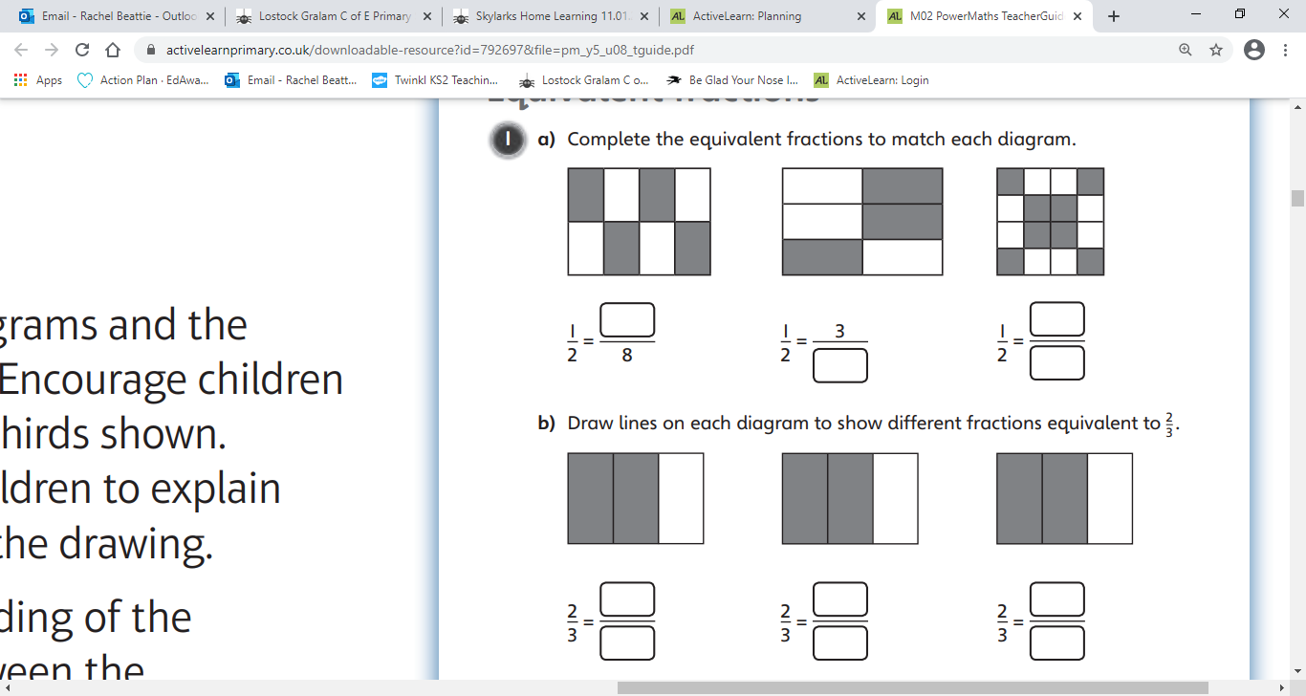
Have a go at these questions independently. Click on the button below if you would like the questions read to you.
Your Turn…
Can you write three different fractions that are equivalent to $\frac{2}{3 }$?
Click on the sound button below to hear the answers.

Slide 7
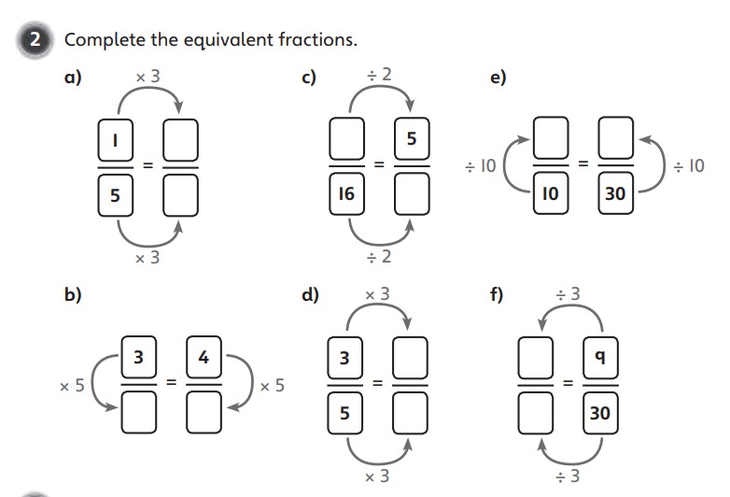
Have a go at these questions independently. Click on the sound button if you would like the questions read to you.
Your Turn…
Click on the sound button to hear the answers.

Slide 8
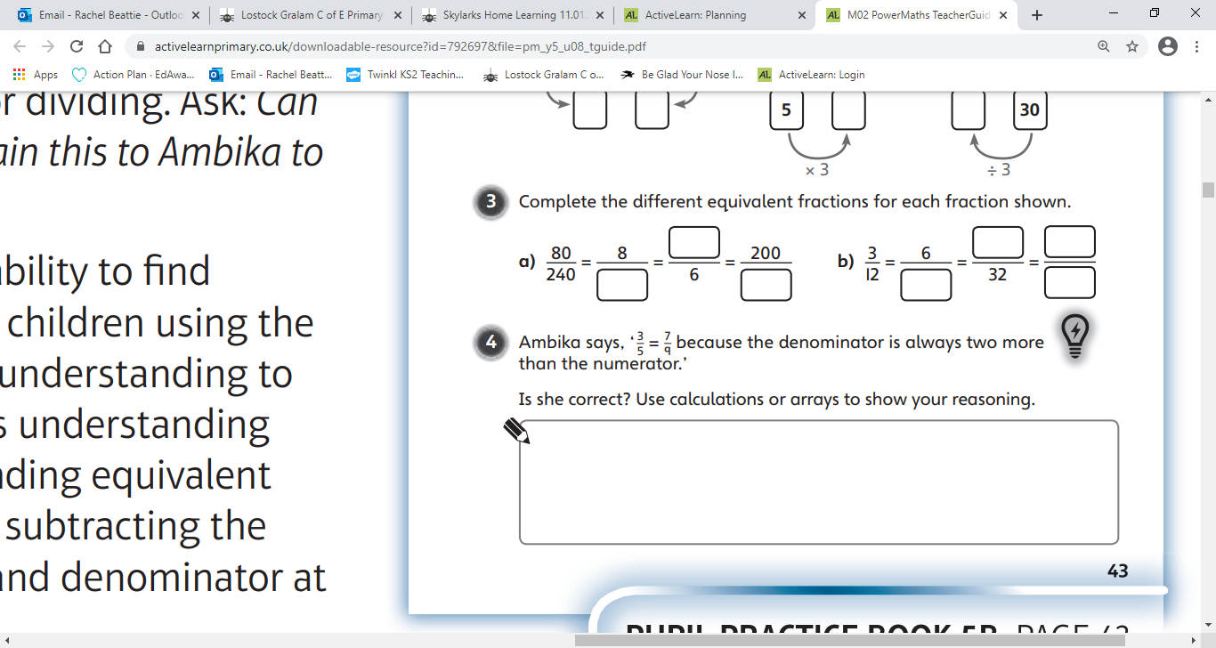
Have a go at these questions independently. Click on the sound button if you would like the questions read to you.
Your Turn…
2
24
600
÷ 10
÷ 4
x 100
Click on the sound button to hear the answers.

Slide 9
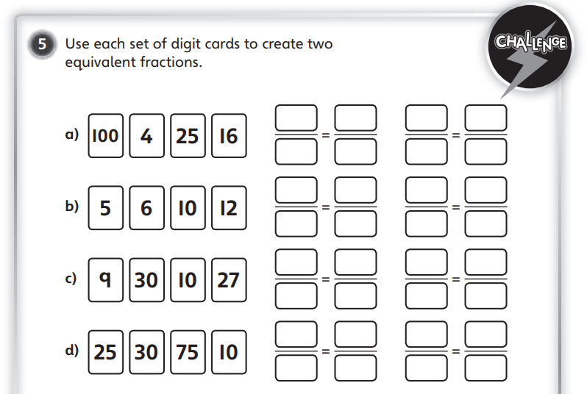
Challenge Time!
Only try this question if you are feeling confident ☺
Your Turn…
Click on the button below if you would like the question read to you.
Click on the next slide to hear the answer.

Slide 10
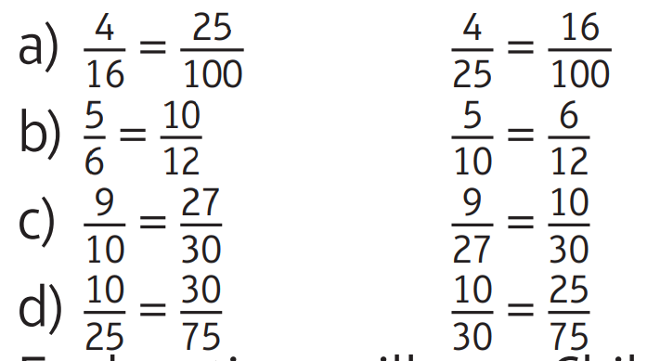
Challenge Time Answers:
Your Turn…
Click on the sound button to hear the answer.

