Slide 1


English
Date: 18.01.21
Week 3 – Lesson 1
Picture Play

Slide 2
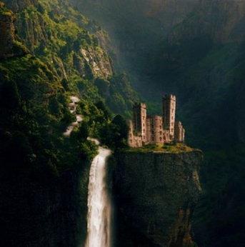

Click on the sound button to hear activity 1 explained to you.
Activity 1
Imagine you are walking in the mountains and you see this scene.
Have a think about what you might see, hear and smell and make some notes.
E.g. See: thick, luscious trees
Hear: cascading water
Smell: damp undergrowth and
fresh, wild flowers

Slide 3
Activity 2
Click on the sound button to hear activity 2 explained to you.
Write a description of the place in first person (I, me, my) explaining what you saw, heard, smelt and felt as you approached it.
What did you see and hear when you arrived?
What did you do?
Did you meet anyone?
Can you use some of these fronted adverbials in your writing?
As I approached the castle…
When I arrived…
As I got closer…
Carefully…
In the distance…
Without making a sound…
Unexpectedly…
Without warning…
After a while…
As fast as I could…

Slide 4
WAGOLL
Click on the sound button to hear the WAGOLL read to you.
As I was walking through the forest, I was surrounded by thick, luscious trees and I could smell the sweet scent of fresh, wild flowers. In the distance, I could hear the faint sound of cascading water. I followed it and as I got closer I could see the crystal clear water pounding over the jagged cliff face through a gap in the trees. Unexpectedly, beyond the waterfall, there lay a mammoth castle with towers standing like giants. It was a miraculous sight.
Can you use some of these fronted adverbials in your writing?
As I approached the castle…
When I arrived…
As I got closer…
Carefully…
In the distance…
Without making a sound…
Unexpectedly…
Without warning…
After a while…
As fast as I could…

Slide 5
