Slide 1



English
Year 2 Swallows Class
Monday 18th January 2021

Slide 2
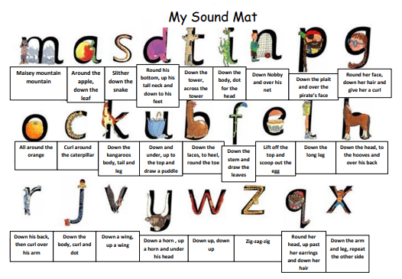

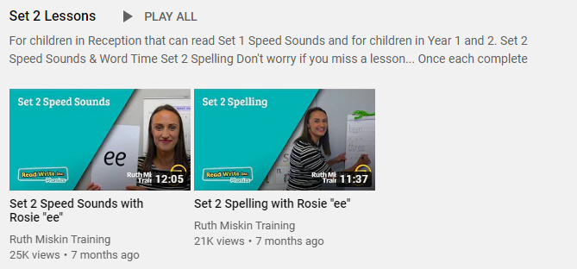
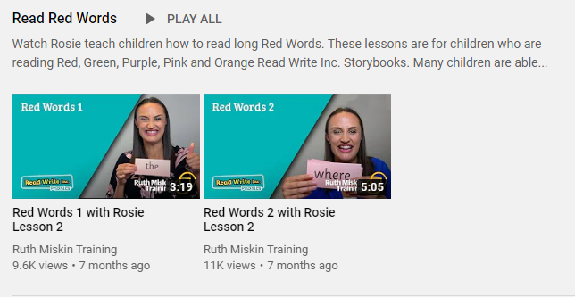
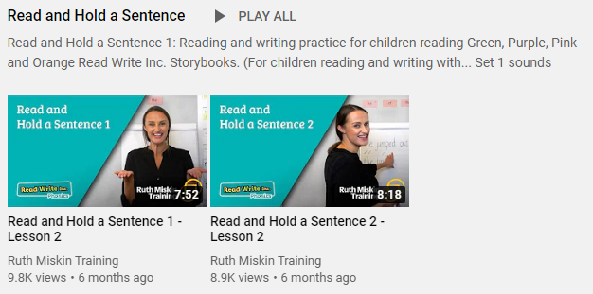
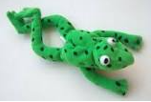
Read Write Inc
Set 2
If you are currently reading green books, please follow the link below to your Read Write Inc lesson today. Each day you will need to click on the video’s shown in the screen shots below. Please remember that although the screen shot says /ee/, the sound will change each day but will be found in the same place. https://www.youtube.com/channel/UCo7fbLgY2oA_cFCIg9GdxtQ
Video 1: Please watch ‘Set 2 Speed sound’ lesson.
Video 2: Please watch ‘Set 2 Spelling’ lesson.
Please complete all 4 video’s each day ☺
Video 3: Please watch ‘Red words 1’ lesson only.
Video 4: Please watch ‘Read and Hold a sentence 1’

Slide 3
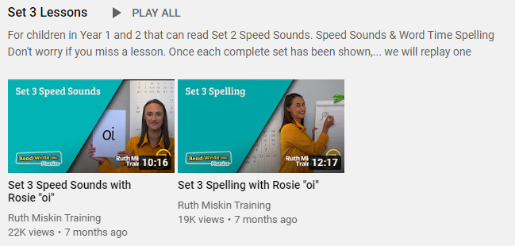
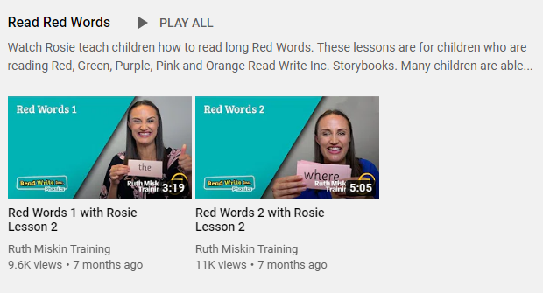
Set 3
If you are currently reading pink, orange, yellow, blue or grey books, please follow the links below to your Speed Sound lesson, red word focus lesson and hold a sentence activity for today. Each day you will need to click on the video’s shown in the screen shots below. Please remember that although the screen shot says /ee/, the sound will change each day but will be found in the same place. https://www.youtube.com/channel/UCo7fbLgY2oA_cFCIg9GdxtQ
Video 1: Please watch ‘Set 3 Speed sound’ lesson.
Video 2: Please watch ‘Set 3 Spelling’ lesson.
Video 3: Please watch ‘Red words 2’ lesson only.
Video 4: Please watch ‘Read and Hold a sentence 2’

Slide 4
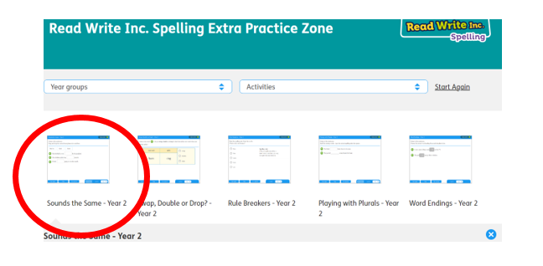
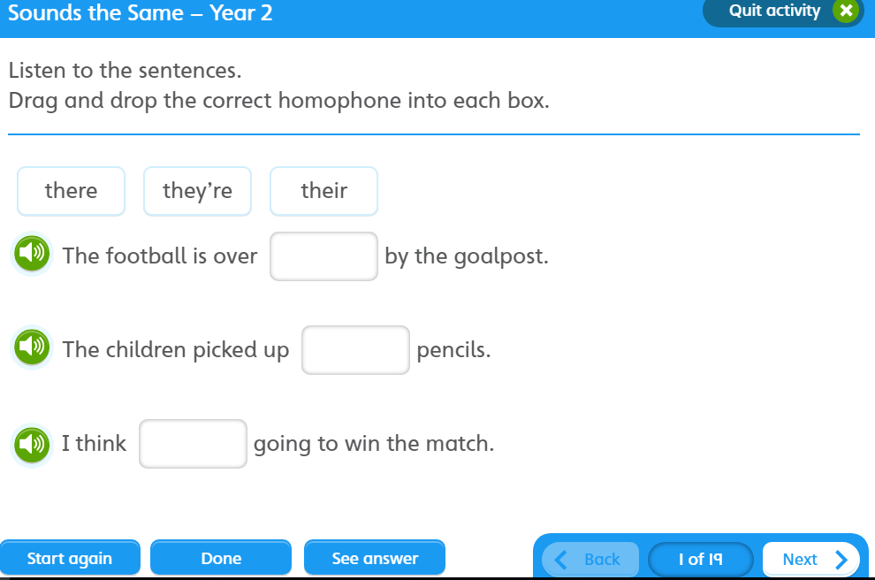

https://www.oxfordowl.co.uk/for-pupils/pupil-home?current_page=home
Username: starlings1 Password: Home
Sounds the Same

Slide 5

Writing
Can I ask questions about the legend of Saint George?

Slide 6
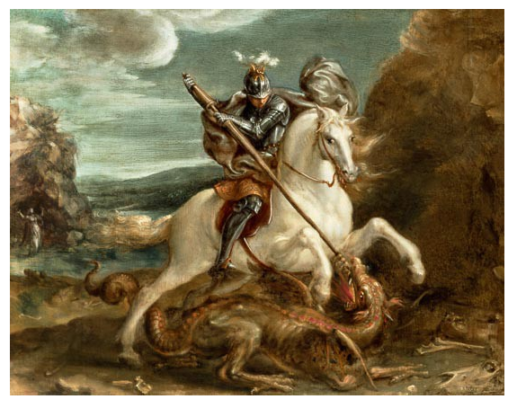
Saint George and the Dragon
What do we already know about Saint George?
What else would you like to know about Saint George?

Slide 7
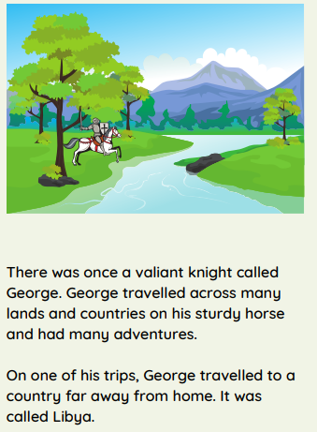

Slide 8
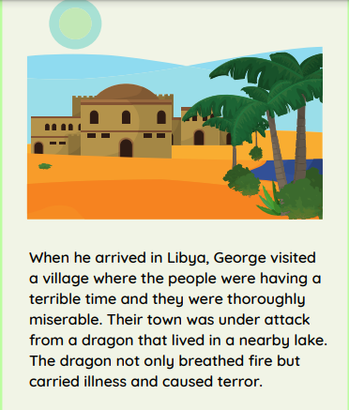

Slide 9
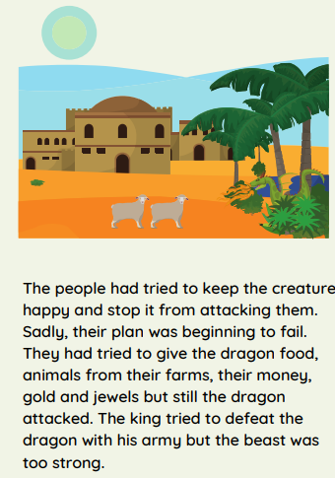

Slide 10
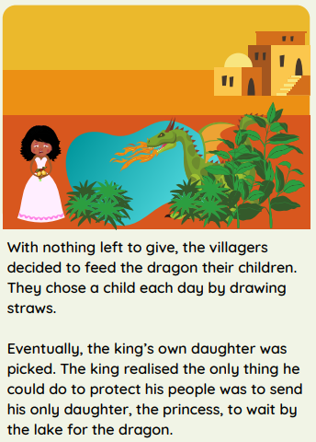

Slide 11
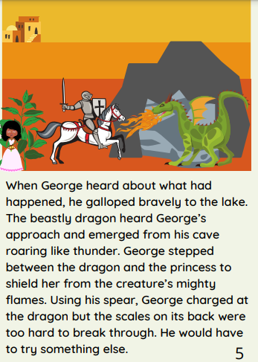

Slide 12
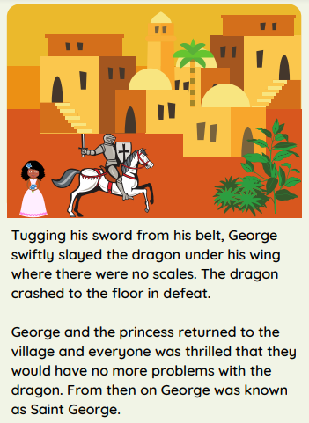

Slide 13
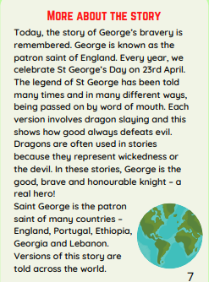

Slide 14

What else would you like to know about Saint George?
Who
Where
What
Why
When
How

Slide 15

Where was Saint George born?
Where is Lebanon?
What is it like in Ethiopia?
How many days is it until Saint George’s Day?
Task: Can you write 3 – 5 questions?

Slide 16


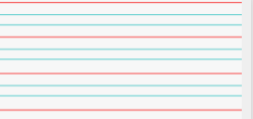
Can you re-read what you have written to check that it makes sense?
sense
Joined handwriting
https://www.activityvillage.co.uk/st-georges-day

Slide 17


What happened when Plop tried to get out of
the tree?
Why was the little boy disappointed?
What do you think Plop and the little boy are going to do next?
What do you think will happen in our story tomorrow?
Author: Jill Tomlinson
Illustrator: Paul Howard
Publisher: Egmont

Slide 18

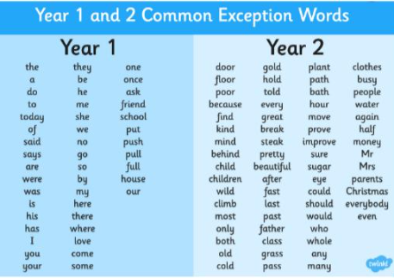
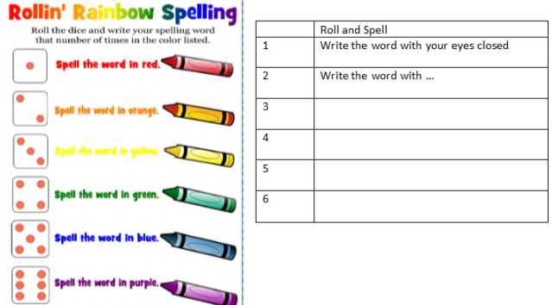
Spellings
Can you read and spell the words below?
bath hour move prove improve

