Slide 1

Islam
Can I explain how prayer brings Muslims together?

Slide 2
One Community (Umma)
I hope you have remembered the work that we did last week about the mosque being a community.
Muslims believe in the idea of Umma, where they all belong to one community worldwide because they all follow the same religion – Islam.
Lets go on a virtual visit to a mosque
https://www.truetube.co.uk/film/holy-cribs-mosque

Slide 3
Muslim call to prayer
http://islam.about.com/cs/prayer/f/adhan_english.htm
Take a look at this website which tells you about The Adhan, the Islamic call to prayer. Have a look down the webpage and play the video to have a listen to it.
How does this call to prayer show the idea of being part of one big community? Jot down your ideas.

Slide 4
Allah says ‘The whole world has been made a mosque for you’.
What does this mean? Jot down your ideas
How many times a day do Muslims pray?

Slide 5
What happens in a Mosque?

Slide 6
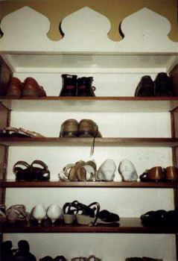
Before going into the mosque, shoes are removed and placed on a special rack. Those arriving for prayer will go to the ablutions or wash room next.

Slide 7
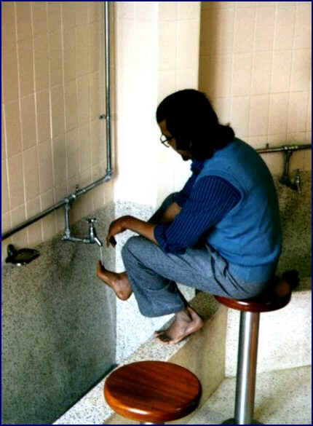
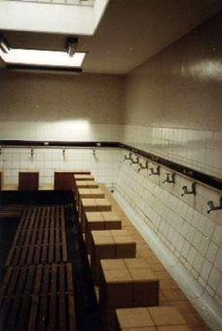
This area is used for Wuzu, the ceremonial washing before prayer.

Slide 8
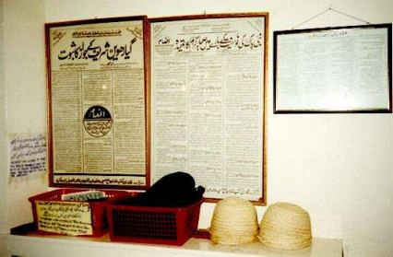
Spare head coverings are kept just inside the prayer hall, as it is customary to cover the head for prayer.

Slide 9
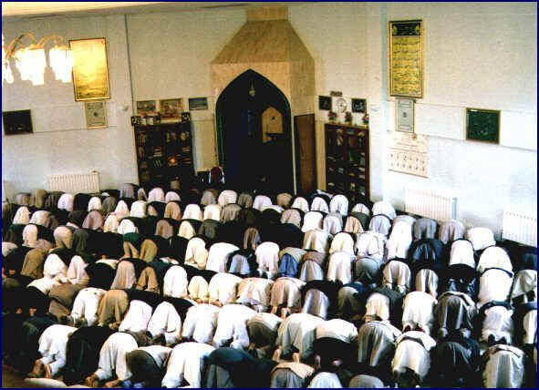
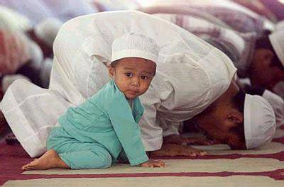
Services are held every day at the Mosque. On Friday at noon, the most important of the weekly services is held.

Slide 10
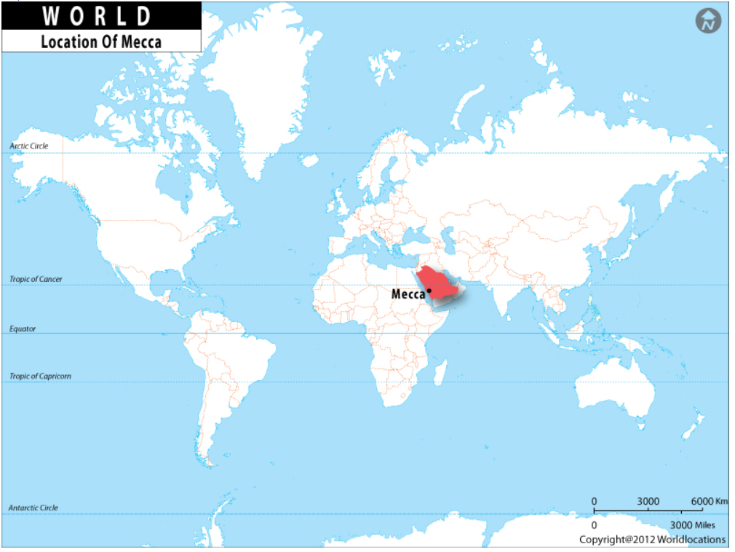
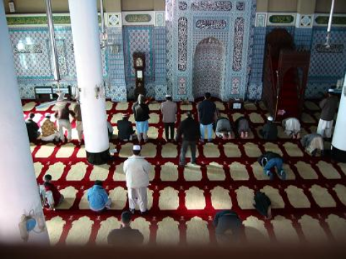
Prayers are said facing Mecca

Slide 11
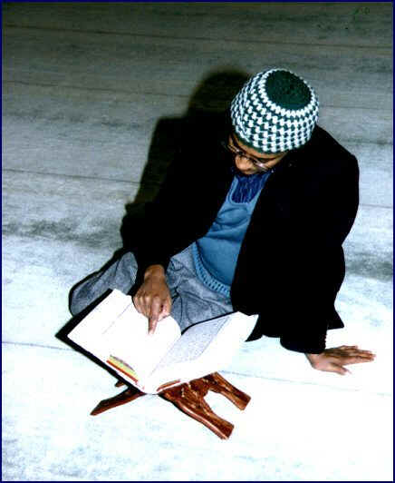
Muslims have a special book called the Qur’an. Muslims treat the Qur'an with great respect because they believe that the Qur'an is from Allah, and every word and every letter is sacred.

Slide 12
What happens in a Mosque?
Task: to create a fact file or poster showing what you have learned about what happens in mosque

Slide 13
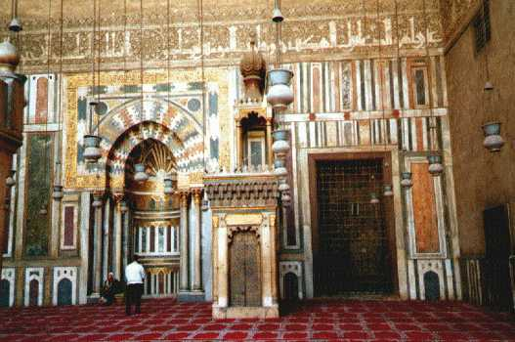
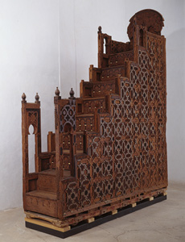
Next week
We will look more closely at what is inside a mosque.

