Slide 1

Goldfinches Arithmetic Lesson
18.1.21

Slide 2
Times Tables
Can we begin by counting in 3s, now lets do the same for 4s, 6s and 7s.
Now lets see if you can write down these multiples and then you can check them on the next slide. Start with multiples of 3, then 4, then 6 and finally multiples of 7.

Slide 3
Times Tables
Multiples of 3 – 3, 6, 9, 12, 15, 18, 21, 24, 27, 30, 33, 36
Multiples of 4 – 4, 8, 12, 16, 20, 24, 28, 32, 36, 40, 44, 48
Multiples of 6 – 6, 12, 18, 24, 30, 36, 42, 48, 54, 60, 66, 72
Multiples of 7 – 7, 14, 21, 28, 35, 42, 49, 56, 63, 70, 77

Slide 4
Times Tables
Now here’s a game to revise our Times Tables – Hit The Button
https://www.topmarks.co.uk/maths-games/hit-the-button
You can choose ‘Mixed’ for a variety of times tables or choose a specific one to work on e.g. ‘x7’

Slide 5
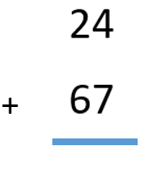
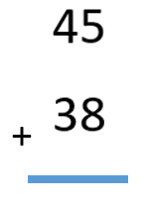
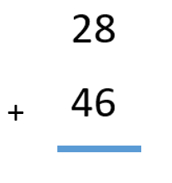
Four Rules of Number - ADDITION

Slide 6



Four Rules of Number - ADDITION

Slide 7
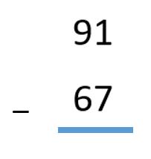
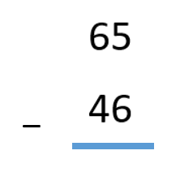
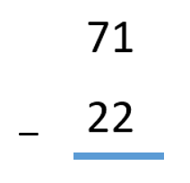
Four Rules of Number - Subtraction

Slide 8



Four Rules of Number - Subtraction

Slide 9
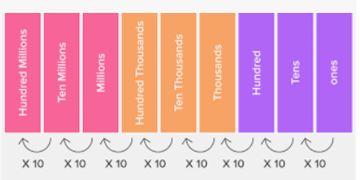
Multiply by 10
5 x 10 = 50
7 x 10 = 70
9 x 10 = 90
13 x 10 = 130
34 x 10 = 340
56 x 10 = 560
Now its your turn
4 x 10 =
6 x 10 =
11 x10 =
26 x 10 =
67 x 10 =

Slide 10
Next Week
Arithmetic test, just like we do in class and we will go through the answers together.
Now have a go at this game to test your knowledge of the four operations – addition, subtraction, multiplication, division
You can select how easy or difficult you want the questions
https://www.topmarks.co.uk/maths-games/mental-maths-train

