Slide 1



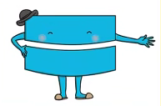

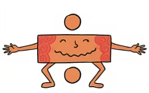


Maths
Year Two Swallows
Monday 18th January 2021

Slide 2
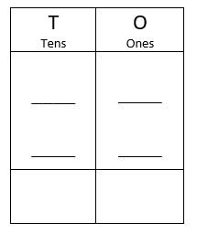
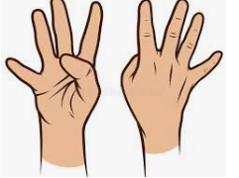
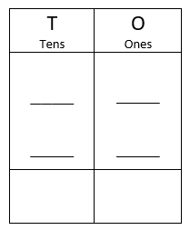
4 A Day
66 + 31 = | 75 –34 =
3 x 5 = | 10 ÷ 5 =

Slide 3
Answers
66 + 31 = 97 | 75 –34 = 41
3 x 5 = 15 | 10 ÷ 5 = 2

Slide 4
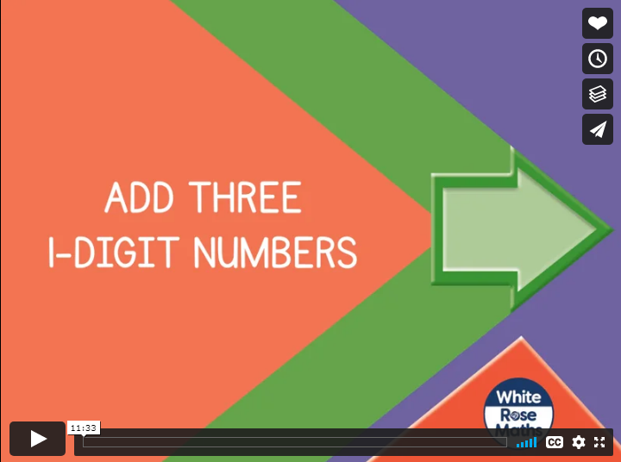
Can I add three one digit numbers?
https://vimeo.com/470178269
Knkkkkkkkkkkkkkk kkVideo

Slide 5
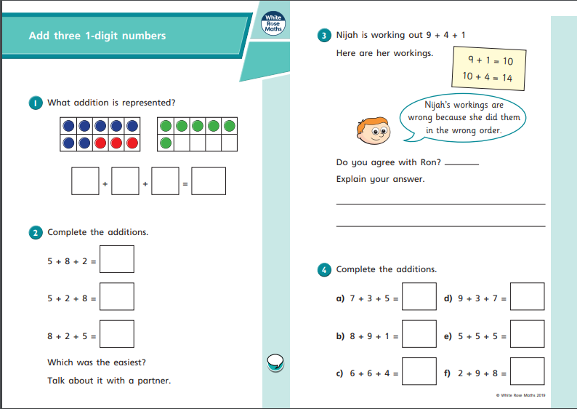
Your Turn

Slide 6
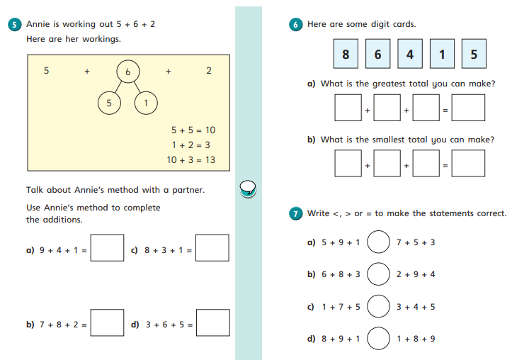
Your Turn

Slide 7
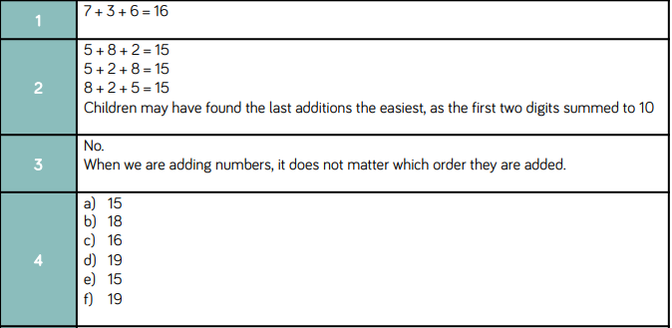
Answers

Slide 8
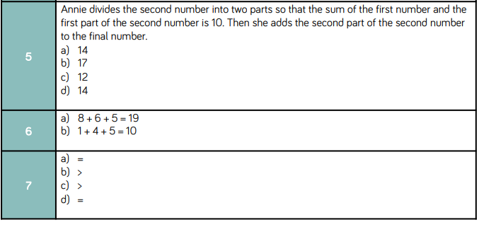
Answers

Slide 9
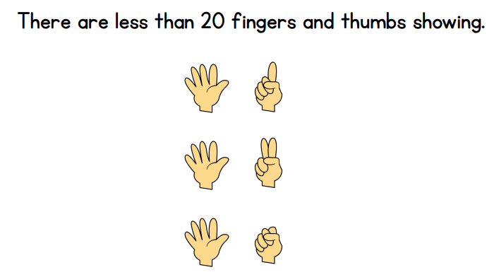

Optional Challenge
True or False?

Slide 10
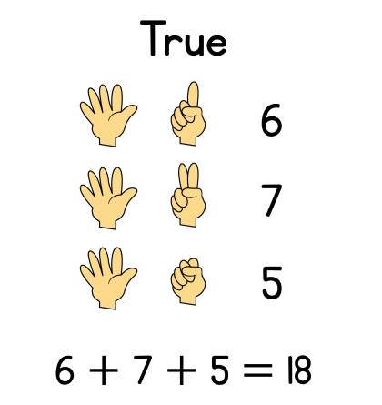
Optional Challenge - Answers
True or False?

