Slide 1


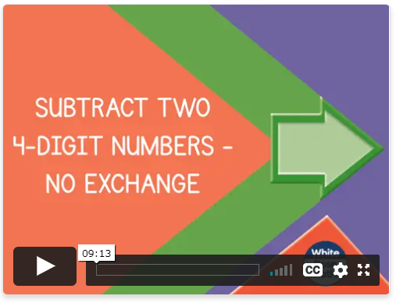
Friday 15th January
TTrock stars today. Remember, little and often is the best way to learn your times. The more regularly you practise, the quicker you will get so don’t be put off if you don’t feel like you are going fast straight away.
https://ttrockstars.com/
Can I subtract two 4-digit numbers with no exchange?
https://whiterosemaths.com/homelearning/year-4/week-6-number-addition-subtraction/

Slide 2
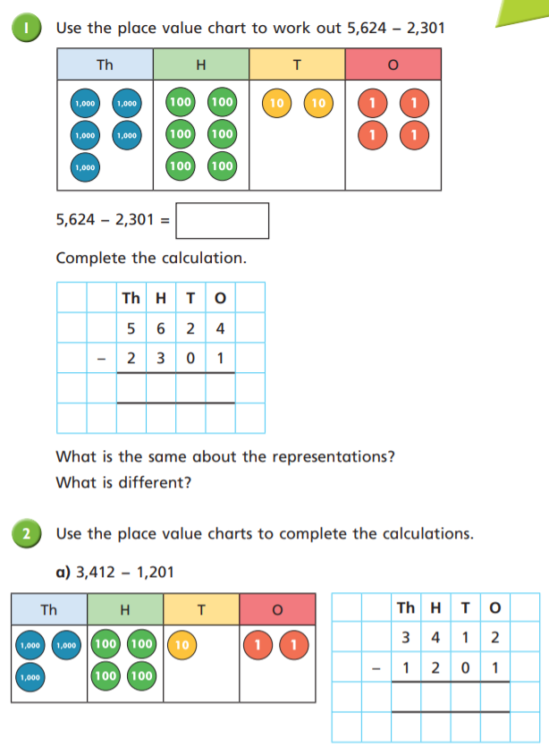
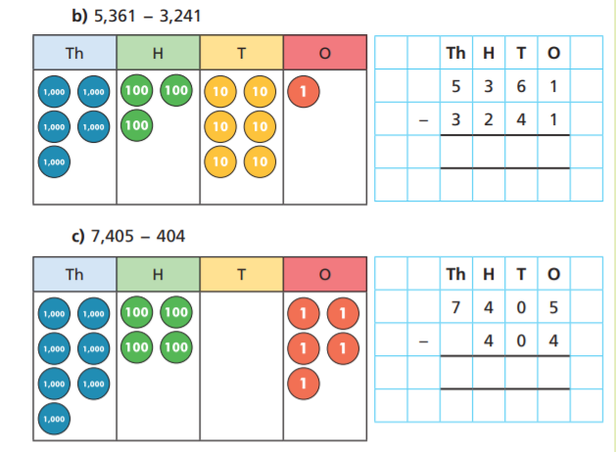

Slide 3
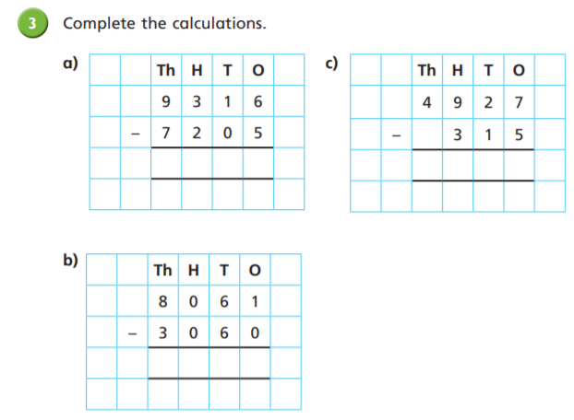
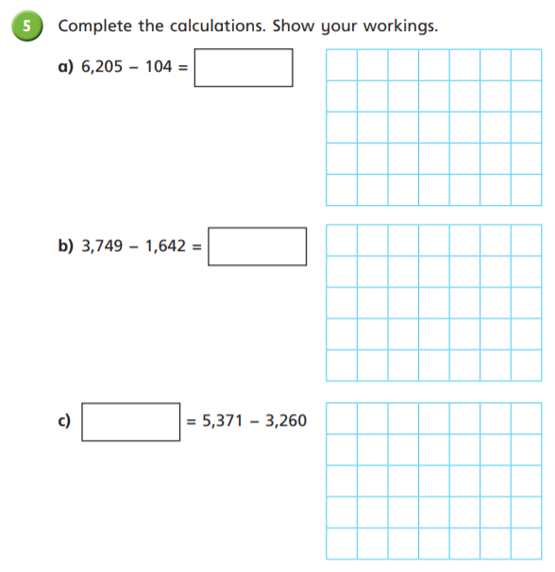
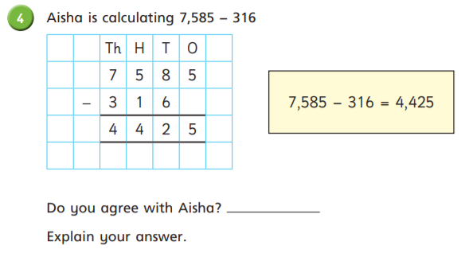
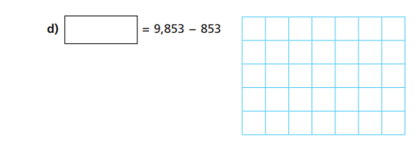

Slide 4
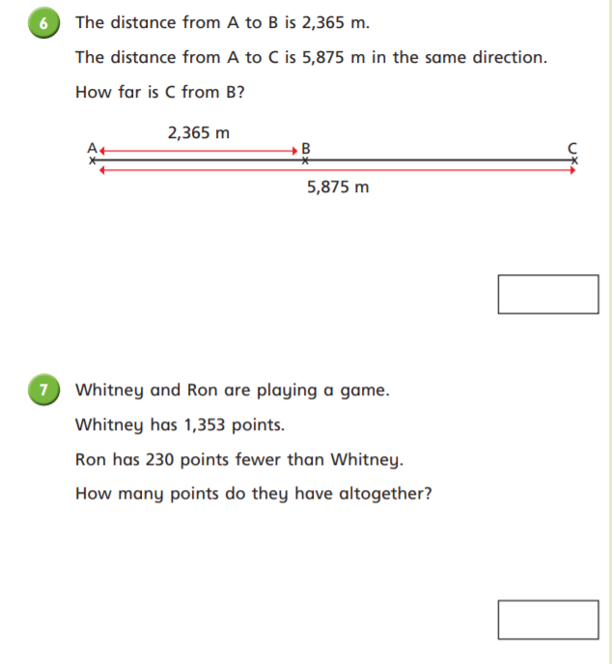
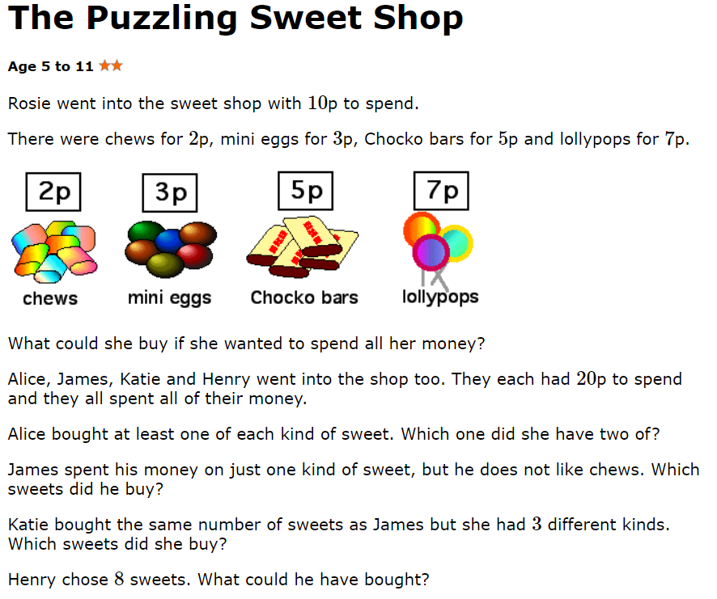
Challenge
https://nrich.maths.org/223
Have a look at this link for a sweet shop challenge.

Slide 5
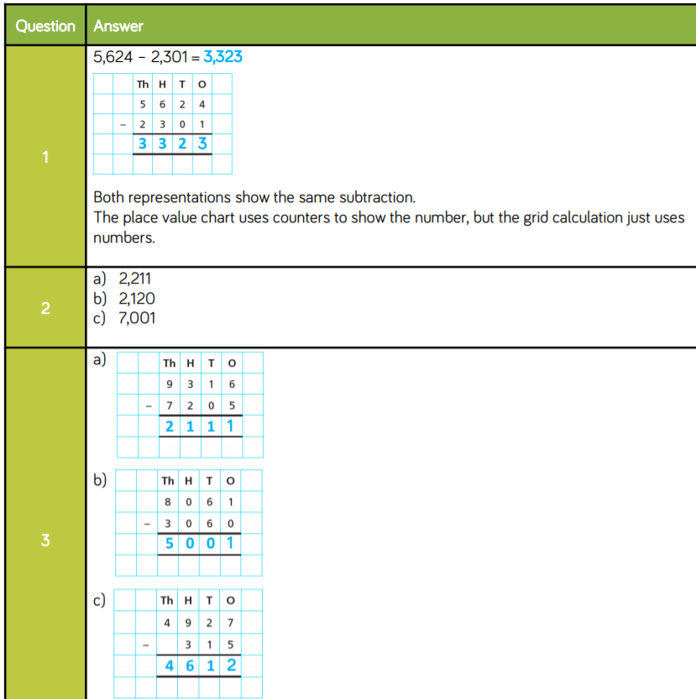

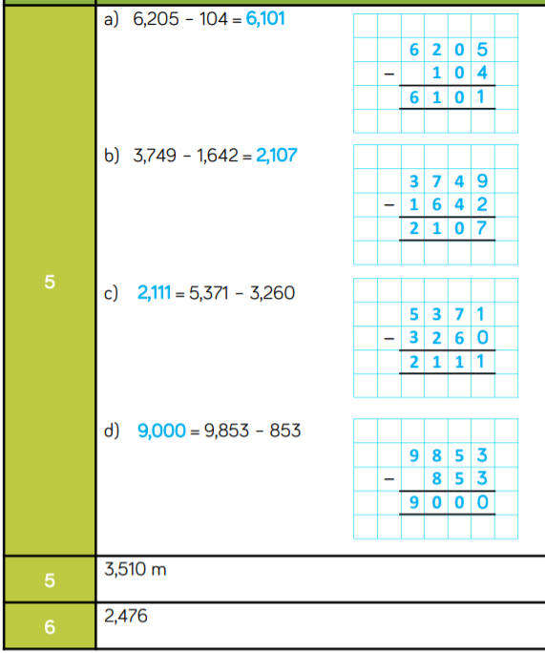

Slide 6
