Slide 1
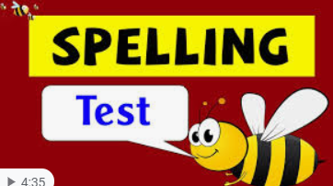



Click the microphone to hear your spelling quiz!
Good Luck xxx

Slide 2
Here are the answers.
Time to ticky tick and dotty dot!
adventure
mixture
creature
capture
future
picture
nature

Slide 3
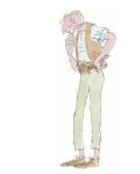


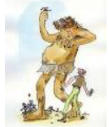
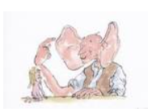
Story Time

