Slide 1





Friday 15th January 2021
Writing

Slide 2
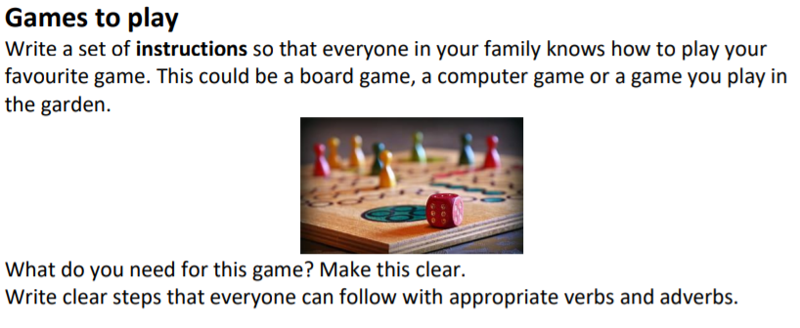
Non Fiction Instructional Writing
Take a look at this BBC clip that focuses on imperative verbs which we will need when we write our own instructions.
https://www.bbc.co.uk/programmes/p02lr3df

Slide 3
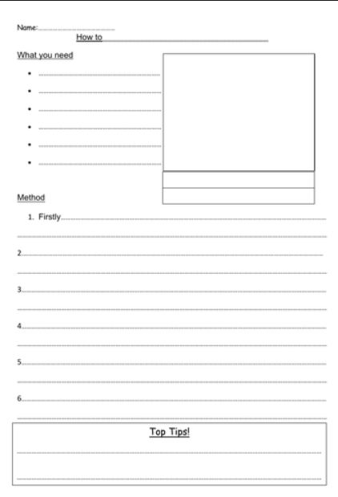
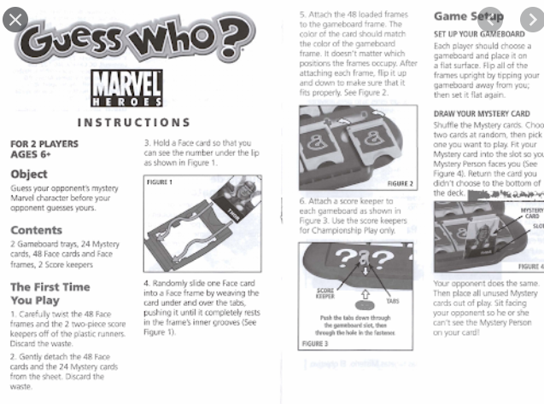
Here are 2 examples of different layouts.

Slide 4

Points to include:
A clear title
An equipment section
Organise your instructions using numbers in a list or bullet points
Each instruction to have an imperative verb (bossy verbs eg cut, roll, spin, flip, tear, move)
Adverbs to tell me how to do the imperative verb. These can go in front of or behind the verb
(eg Carefully move... or Move carefully… Neatly lay the mat or Lay the mat neatly)
A Top Tips or Handy Hint section to provide an extra little nugget of information to help the players.
1
2

Slide 5
My Turn:
How To Play Twister. (My title)
Equipment:
The large mat with coloured spots on
The instruction spinner
2 or more other people to play with
Instructions:
1.Lay the mat out flat onto the floor.
2.Sensibly nominate one person to be in charge of the spinner.
3. Stand on the edge of the mat.
4. Listen intently to the caller.
5. Follow each instruction specifically.
6. Carefully move each body part onto a new spot when told.
*If you fall, you are out.
Top Tip
Ensure you know your left from your right.

