Slide 1


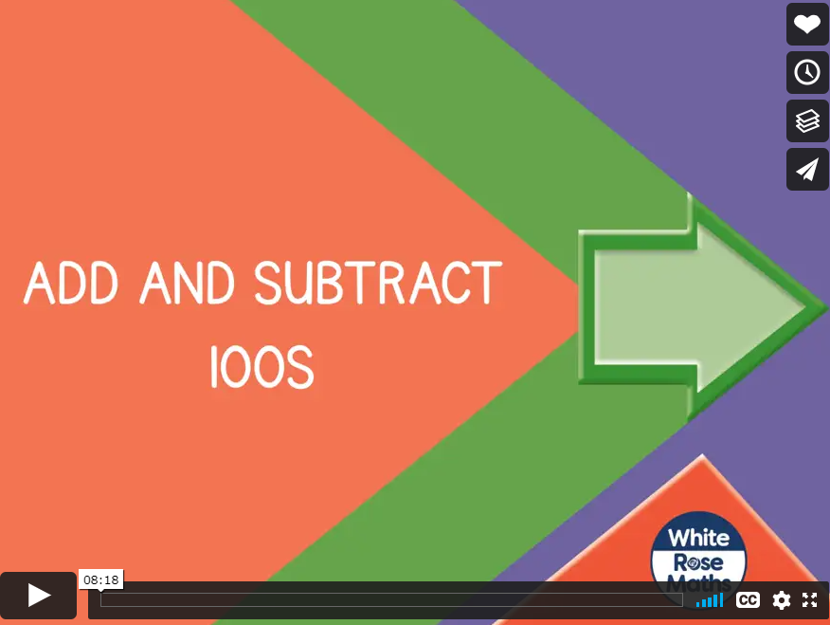

Friday 15th January 2021
https://vimeo.com/46179531
We are going to be adding and subtracting hundreds.
Please click on the link below to watch today’s video.

Slide 2
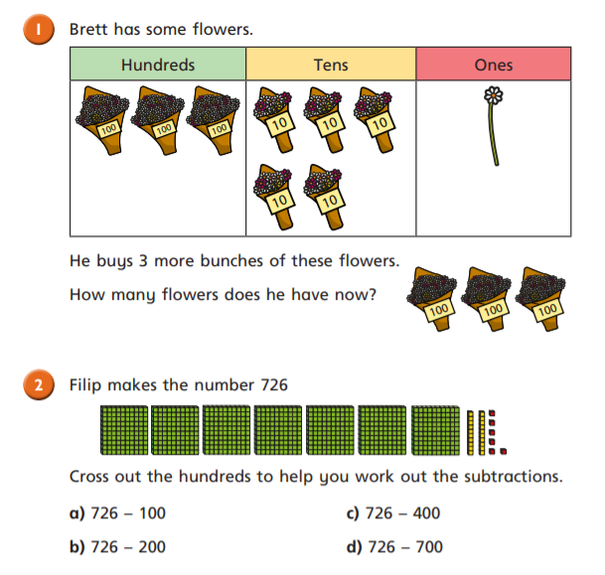
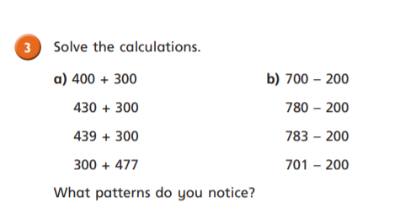
Remember when we add/subtract just hundreds, the tens and the ones do not change.

Slide 3
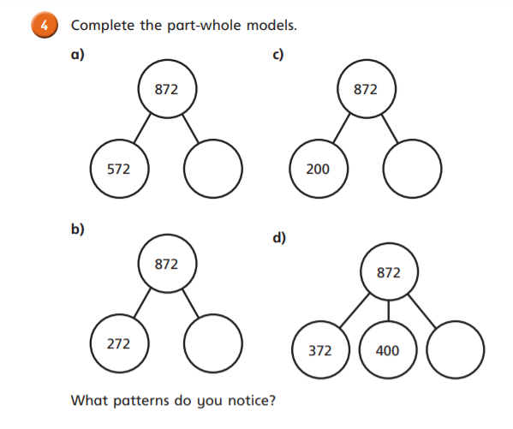
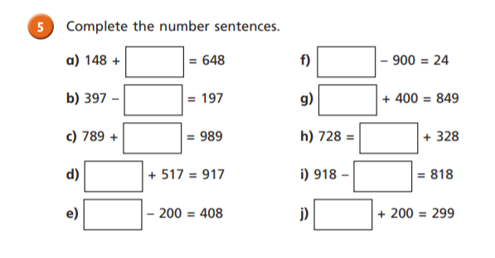

Slide 4
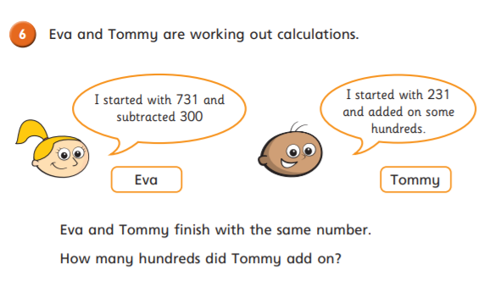
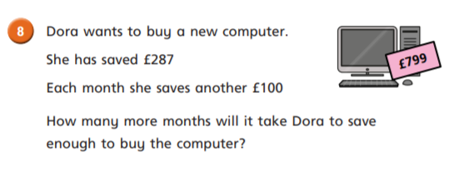
Challenge Time
Word problems are a great extension activity to see if you can solve questions in a context.

Slide 5
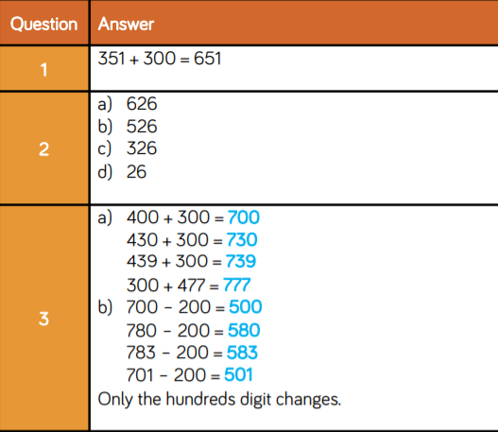
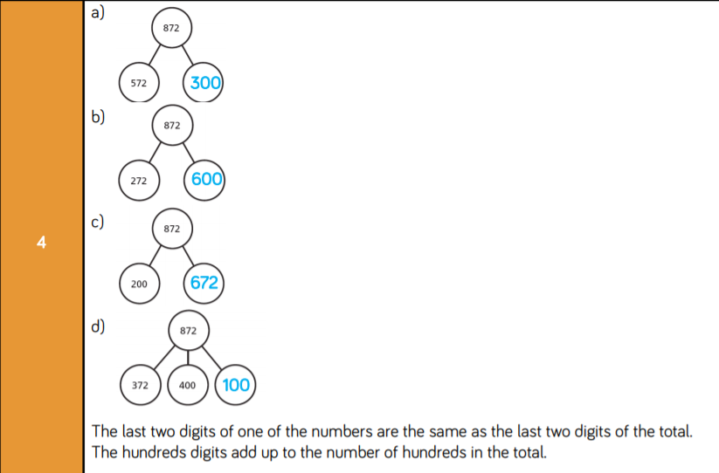

Slide 6
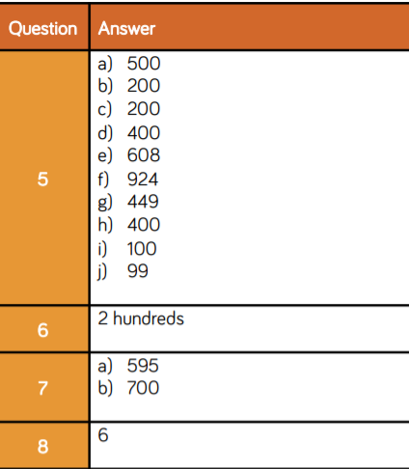
We haven’t looked at Question 7 today.
Questions 6 and 8 were our Challenge Time questions.

