Slide 1






English
Friday 15th January

Slide 2
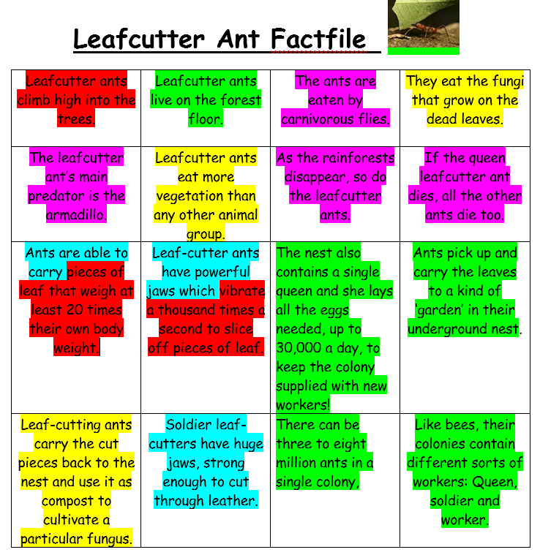
Friday 15th January
Can I write a non-chronological report?
Use your fact file remind yourself about the colour coded key.
Read your sentences from yesterday’s conjunction work.
Carnivorous flies eat the Leafcutter Ants but their main predator is the armadillo.
After Leafcutter ants climb high into the trees, they use their powerful jaws to slice off pieces of leaf.
Today you might want to use a folded piece of paper like a booklet or leaflet to present your report. Or you could use your computer to present it if you prefer.
Useful websites
https://zoo.sandiegozoo.org/
https://www.chesterzoo.org/our-zoo/animals/

Slide 3
Can I write a non-chronological report?
Subordinating conjunctions
When
That
If
Because
Although
After
As
Since
While
Before
Organise your report into different sections using sub headings. You can choose which order to put your paragraphs in.
Think about what information needs to go in each section and these will create your report paragraphs. You can look at and use the work you did yesterday to help you.
Coordinating conjunctions
and
but
or
so
yet
Use fronted adverbials that grab the reader’s interest:
Amazingly, Sadly,
Surprisingly, Importantly,
Unbelievably, Devastatingly,
Worryingly, Cleverly,
Unfortunately, Carefully,

Slide 4
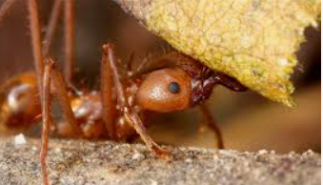
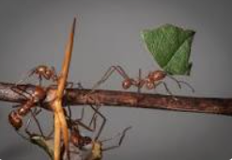
Mrs Evans’ model
The Leaf Cutter Ant
Habitat
Although they like to climb high into the trees to collect leaves, leaf cutter ants live on the forest floor in a type of underground nest . These tiny creatures live in colonies with different roles: Queen, soldier and worker. Unbelievably, there is only one queen and she produces up to 30,000 eggs a day to keep the colony supplied with new workers. Because the queen produces so many eggs, there can be three to eight million ants in a single colony.
Diet
Worker ants pick up and carry leaves to a kind of ‘garden’ in their underground nest so they can use them as compost to cultivate a particular fungus. Before the Leafcutter ants eat the fungi, they have to compost the leaves first. Surprisingly, leaf cutter ants eat more vegetation than any other animal group.
Animals under threat
While the leafcutter ant’s main predator is the armadillo, carnivorous flies also eat the ants. Worryingly, these fascinating creatures are also under threat of losing their habitat as the rainforests are disappearing.
Fascinating facts
Did you know? Leafcutter ants are tiny creatures yet they are able to carry pieces of leaf that weigh at least 20 times their own body weight.
Did you know? Soldier leaf cutters have huge jaws that are strong enough to cut through leather.

