Slide 1


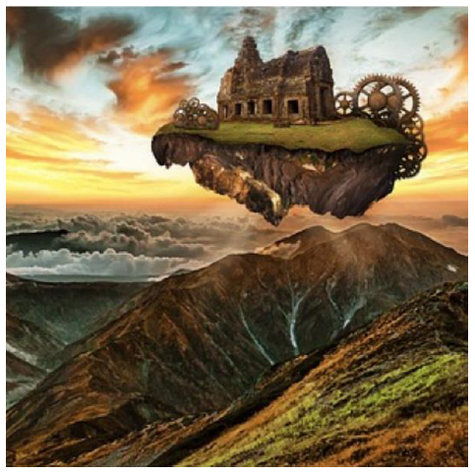
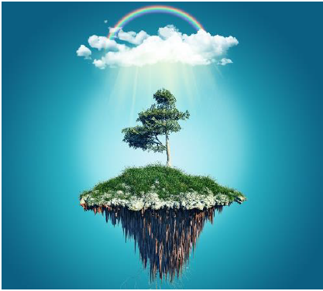


English
DATE
Picture Play
Floating Island

Slide 2

A day on my island…
Design your own floating island. Consider:
• What size and shape will it be?
• What vegetation is on the surface?
• What will provide you with shelter?
• What are the roots of your island like?
• What is the weather like above you?
Draw a diagram of your island and add detailed, descriptive labels to explain the features.

Slide 3

Here is the video link to see Mrs Whittingham begin to read this beautiful book to you.
https://youtu.be/gKNENwOiUA0

