Slide 1




English
Year 2 Swallows Class
Friday 15th January 2021

Slide 2
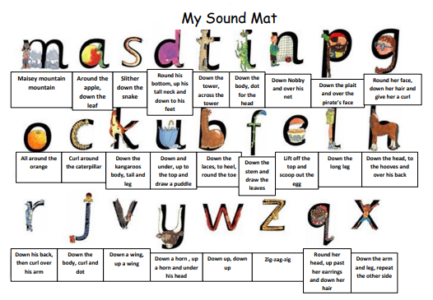

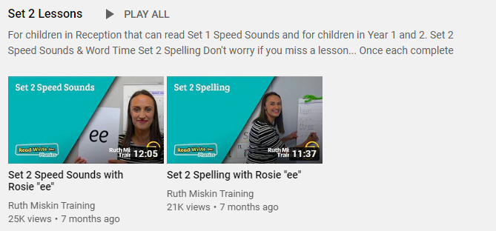
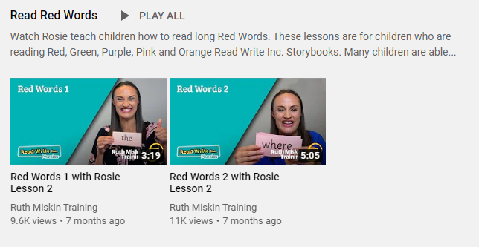
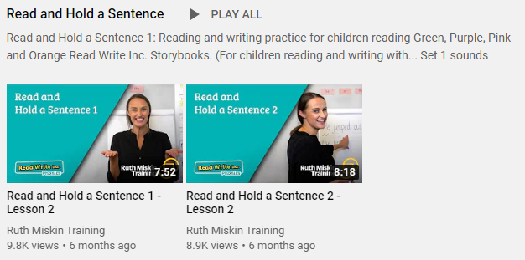
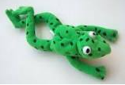
Read Write Inc
Set 2
If you are currently reading green books, please follow the link below to your Read Write Inc lesson today. Each day you will need to click on the video’s shown in the screen shots below. Please remember that although the screen shot says /ee/, the sound will change each day but will be found in the same place. https://www.youtube.com/channel/UCo7fbLgY2oA_cFCIg9GdxtQ
Video 1: Please watch ‘Set 2 Speed sound’ lesson.
Video 2: Please watch ‘Set 2 Spelling’ lesson.
Please complete all 4 video’s each day ☺
Video 3: Please watch ‘Red words 1’ lesson only.
Video 4: Please watch ‘Read and Hold a sentence 1’

Slide 3
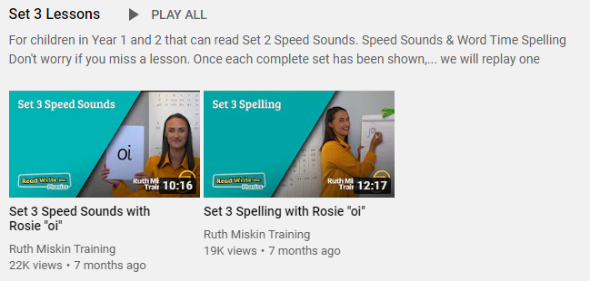
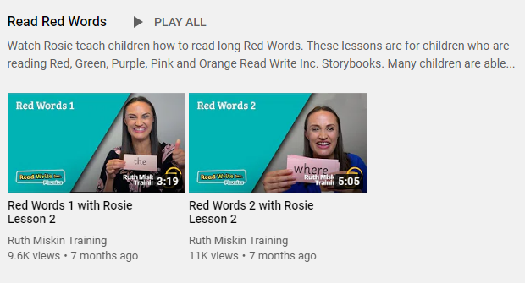
Set 3
If you are currently reading pink, orange, yellow, blue or grey books, please follow the links below to your Speed Sound lesson, red word focus lesson and hold a sentence activity for today. Each day you will need to click on the video’s shown in the screen shots below. Please remember that although the screen shot says /ee/, the sound will change each day but will be found in the same place. https://www.youtube.com/channel/UCo7fbLgY2oA_cFCIg9GdxtQ
Video 1: Please watch ‘Set 3 Speed sound’ lesson.
Video 2: Please watch ‘Set 3 Spelling’ lesson.
Video 3: Please watch ‘Red words 2’ lesson only.
Video 4: Please watch ‘Read and Hold a sentence 2’

Slide 4
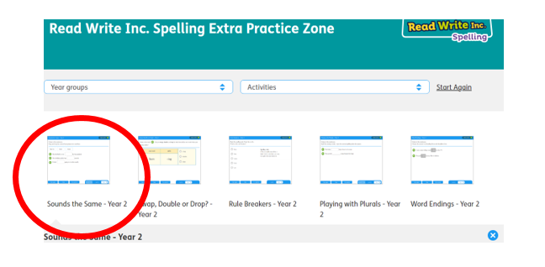
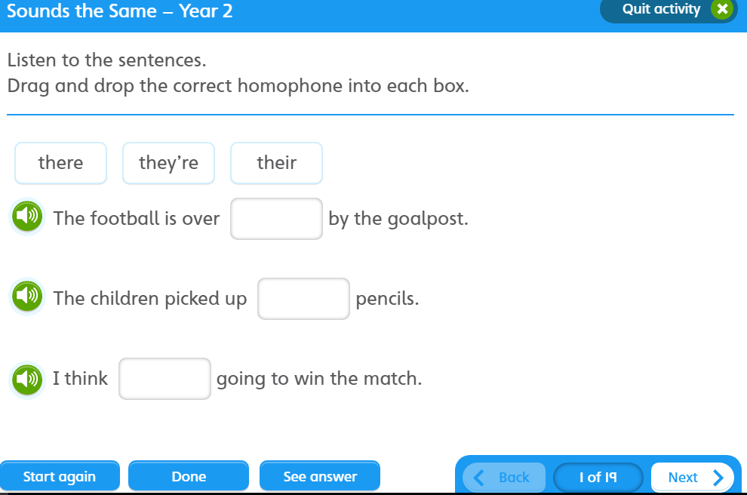

https://www.oxfordowl.co.uk/for-pupils/pupil-home?current_page=home
Username: starlings1 Password: Home
Sounds the Same

Slide 5

Writing
Can I write statements and exclamations about Saint George?

Slide 6
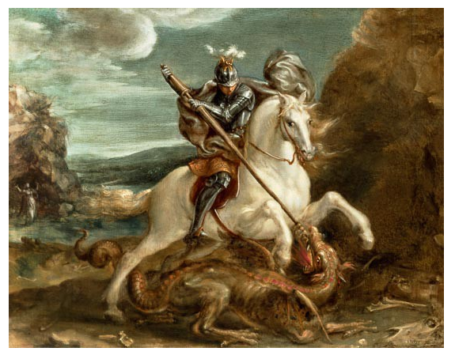
Saint George
What have we learnt about Saint George so far? Can you think of three things?
Can you write these things down as sentences? These sentences will be statements.

Slide 7

Saint George was a valiant knight.
Saint George travelled across many countries on his sturdy horse and he was a hero.

Slide 8
Task 1
Write 3 sentence about Saint George.

Slide 9

What might the villagers, king and princess say about Saint George?

Slide 10
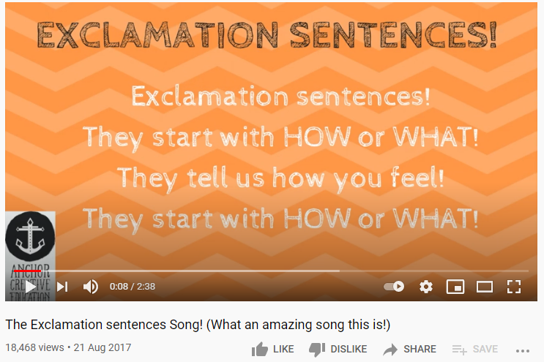
Exclamation Sentences https://www.youtube.com/watch?v=Vfk_sOZ3aOo&feature=youtu.be

Slide 11
What might the villagers, king and princess say about Saint George?
How
What

Slide 12
Exclamation sentences start with what or how and end with a verb and exclamation mark.
How courageous and kind he is!
What a brave knight he is!
How lucky I am!
How wonderful that is!
What sharp teeth the dragon has!

Slide 13
Task
Can you write an exclamation?
How _____ and _____ he is!
What a ____ and ___ knight he is!
What _____ the dragon has!

Slide 14

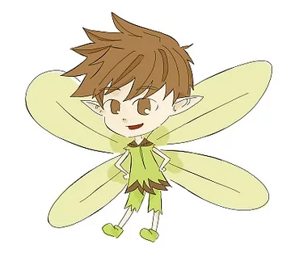
Can you re-read what you have written to check that it makes sense?
Fairy Clap

Slide 15


What does Plop look like?
What is Plop afraid of and why?
How do you think Pop’s mum might be feeling?
Author: Jill Tomlinson
Illustrator: Paul Howard
Publisher: Egmont

Slide 16


Spellings
Can you read and spell the words below?
class grass pass plant path

