Slide 1



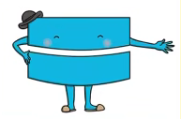




Maths
Year Two Swallows
Friday 15th January 2021

Slide 2
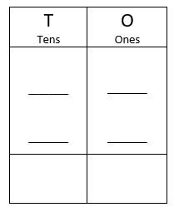
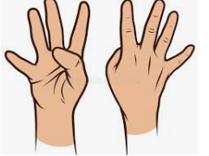
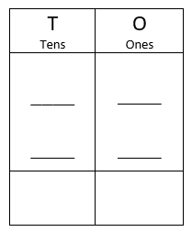
4 A Day
25 + 24 = | 68 –50 =
1 x 10 = | 100 ÷ 10 =

Slide 3
Answers
25 + 24 = 49 | 68 –50 = 18
1 x 10 = 10 | 100 ÷ 10 = 10

Slide 4
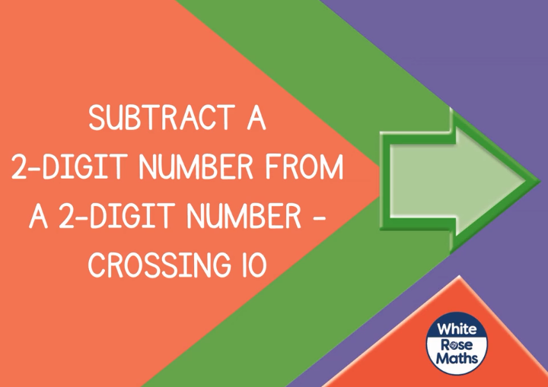
Can I subtract 2-digit numbers crossing tens?
https://vimeo.com/468562834
Knkkkkkkkkkkkkkk kkVideo

Slide 5
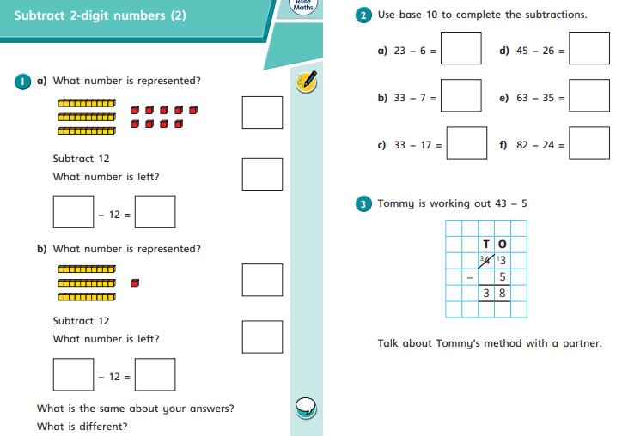
Your Turn

Slide 6
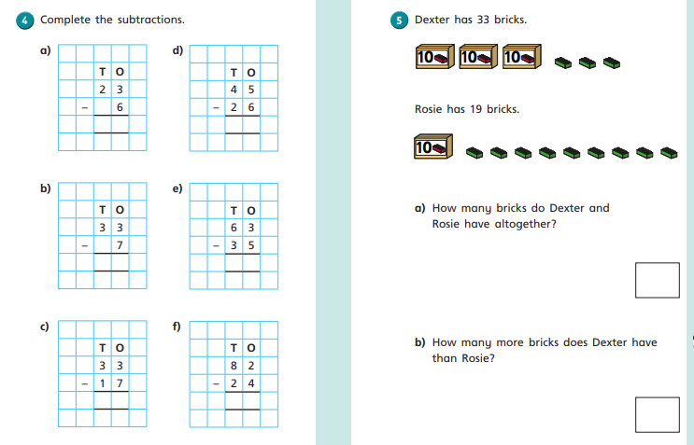
Your Turn

Slide 7
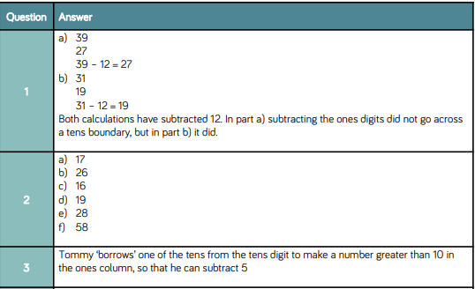
Answers

Slide 8
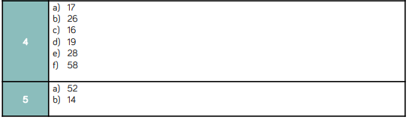
Answers

Slide 9
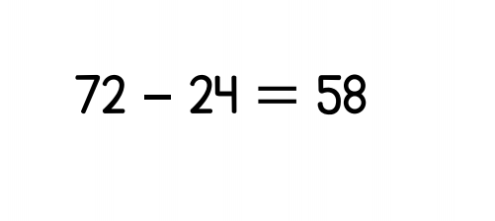

Optional Challenge
True or False?

Slide 10
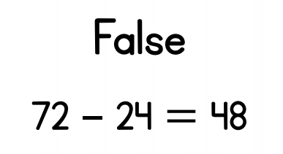
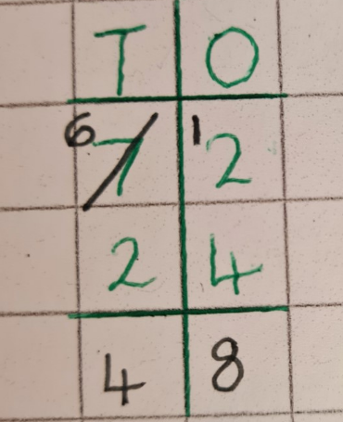
Optional Challenge - Answers
True or False?

Slide 11


