Slide 1


Starlings Maths Home Learning
Friday 15th January

Slide 2
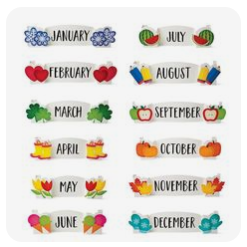
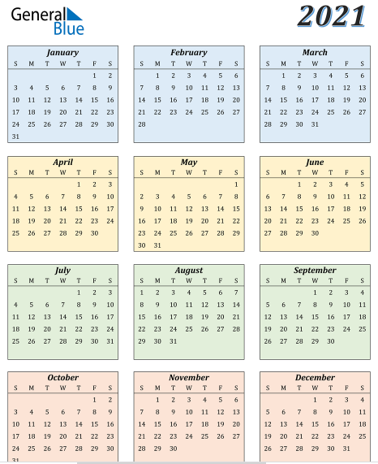

TIME LESSON TWO
Today we are going to be looking at calendars. You could use the one we made in class with your handprints or have a look at the one I have attached.
There is so much you can tell from a calendar. It shows us how many days are in each month. It also tells us what day each date is.
Can you remember what year we’re in now? What was last year and what will next year be?

Slide 3
Our first task is to think about the months of the year.
Can you name them all?
Have a look at this video to help you remember:
https://www.youtube.com/watch?v=Fe9bnYRzFvk
How many months of the year do we have?
Do they all have the same number of days?
What month is the odd one out? Do you know why?
You could play a game by writing down the months of the year (don’t forget they start with a capital letter!) and then mixing them up and trying to put them back in the right order.

Slide 4
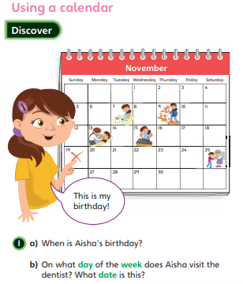
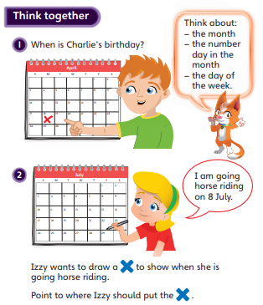
Can you answer these questions about calendars?:

Slide 5
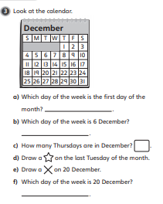

Look at the 2021 calendar and see if you can answer these questions. Remember that when we use the calendar we must go across first and then down
What day of the week is your birthday?
What about Christmas?
How many months start on a Monday?
How many Tuesdays are there in June?
Which months have 31 days?
What happens to February in a leap year?
If I know today’s date, how can I use the calendar to find the date in a week’s time?

