Slide 1

Starlings English Home Learning
Friday 15th January

Slide 2



Today you are learning strategies for spelling tricky words.
That means you will
Reading tricky words and recognise some without sounding out
Find the part of a word that is tricky
Create a ‘spelling squiggle’ of your tricky words.
Challenge yourself to put some tricky words into a sentence.

Slide 3
to
she
was
you
said
house
come
some
go
so

Slide 4
to
she
was
you
said
house
come
some
go
so

Slide 5
to
she
was
you
said
house
come
some
go
so

Slide 6
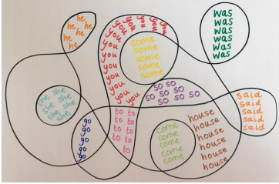

Slide 7

Red group – you need to look out for set 1 videos on the link below:
https://www.youtube.com/channel/UCo7fbLgY2oA_cFCIg9GdxtQ
We would like you to watch 3 videos: set 1 speed sounds, set 1 word time and set 1 spellings please.
Green group you need to look out for set 2 videos on the link below:
https://www.youtube.com/channel/UCo7fbLgY2oA_cFCIg9GdxtQ
We would like you to watch 4 videos: set 2 speed sounds, set 2 spelling, red words 1, and read and hold a sentence 1
Pink, yellow and blue groups you need to look out for set 3 videos on the link below.
https://www.youtube.com/channel/UCo7fbLgY2oA_cFCIg9GdxtQ
We would like you to watch 4 videos: set 3 speed sounds, set 3 spelling, red words 2 and read and hold a sentence 2

