Slide 1


English
Date: 15.01.21
Week 2 – Lesson 5
Creature Feature

Slide 2

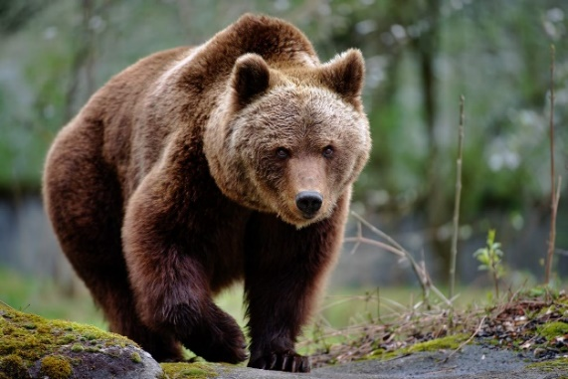
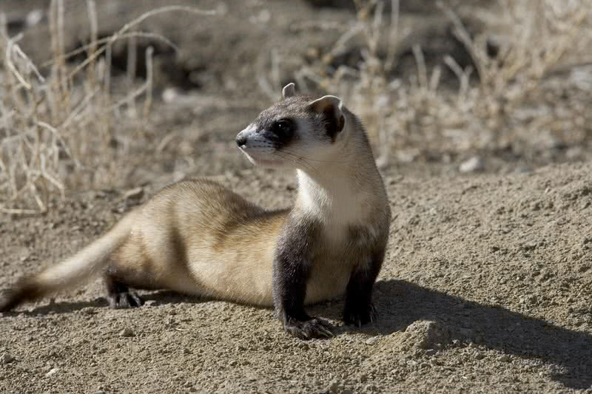
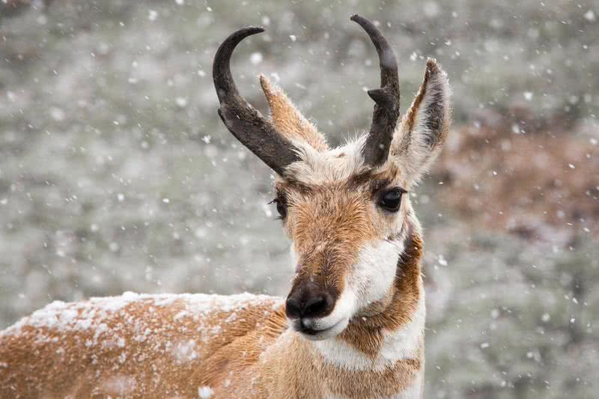
Activity 1
Click on the sound button to hear activity 1 explained to you.
Recap which North American animal you choose to research yesterday – What did you learn about it? Can you recall 3 key facts you learnt from your research?

Slide 3
Activity 2
Click on the sound button to hear activity 2 explained to you.
Write a non-chronological report about your animal.
Think about:
• What sections you need to have (e.g. appearance, habitat, diet)
• How you are going to set it out (e.g. headings and subheadings)
• How you are going to make your information interesting to read
The following website has lots of examples of non-chronological reports to use as a WAGOLL. I will go through an example of one of these on the next slide.
https://www.literacywagoll.com/non-chronological-report.html
You could present your report on paper or on a laptop using software such as Word.

Slide 4
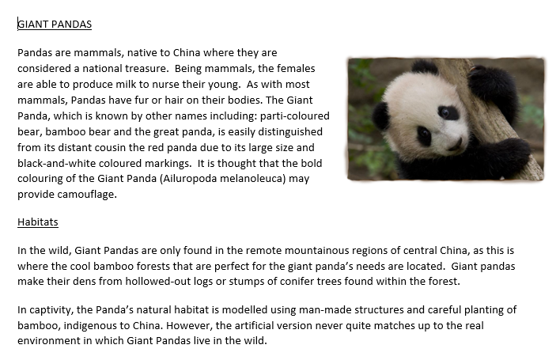
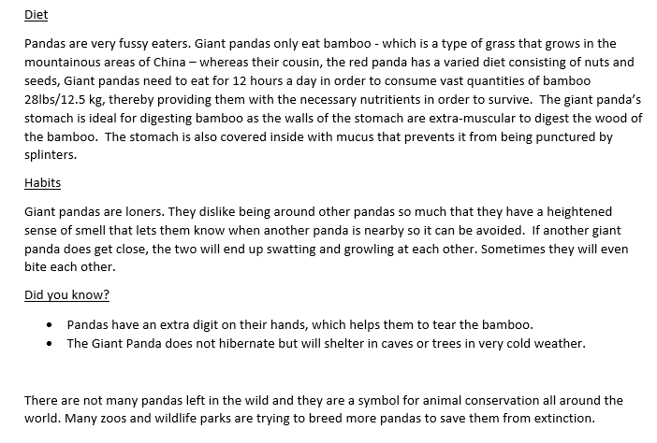
WAGOLL
(What A Good One Looks Like)
Click on the sound button to hear the WAGOLL read to you.

Slide 5

Click on the sound button to hear the spellings for this week’s quiz.

Slide 6
Answers:
fasten
castle
glistening
whistle
listening
Click on the sound button to hear the spelling quiz answers.

Slide 7
