Slide 1






English
Thursday 14th January

Slide 2
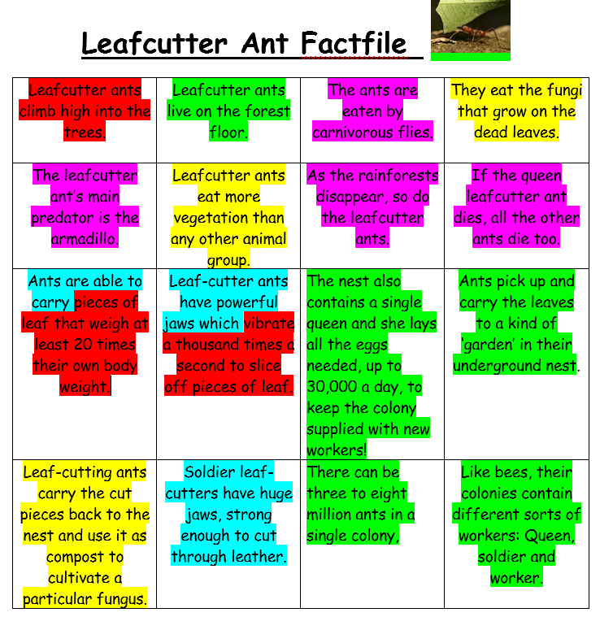
Thursday 14t^{h} January
Use your fact file from yesterday to remind you all about the animal you researched .
Read the facts and remind yourself about the colour coded key
Useful websites
https://zoo.sandiegozoo.org/
https://www.chesterzoo.org/our-zoo/animals/

Slide 3
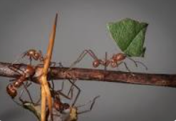
Can I use co-ordinating conjunctions to join sentences?
Mrs Evans’ model
and but or
so yet
Leafcutter ant are tiny creatures yet they are able to carry pieces of leaf that weigh at least 20 times their own body weight.
Ants pick up and carry the leaves to a kind of ‘garden’ in their underground nest so they can use them as compost to cultivate a particular fungus.
Carnivorous flies eat the Leafcutter Ants but their main predator is the armadillo.
There can be three to eight million ants in a single colony so these ants eat more vegetation than any other animal group.
Leaf cutter ants live on the forest floor and like to climb high into the trees.

Slide 4
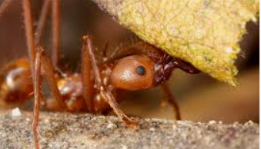
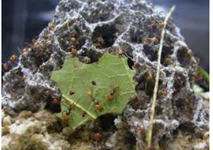
Can I use subordinating conjunctions?
When
If
Because
Although
After
As
Since
While
Before
When the queen Leafcutter ant dies, all the other ants die too.
While the leafcutter ant’s main predator is the armadillo, carnivorous flies also eat the ants.
After Leafcutter ants climb high into the trees, they use their powerful jaws to slice off pieces of leaf.
Because there can be three to eight million ants in a single colony, Leafcutter ants eat more vegetation than any other animal group.
Before the Leafcutter ants eat the fungi, they have to compost the leaves first.

