Slide 1


Starlings Maths Home Learning
Thursday 14th January

Slide 2



TIME LESSON ONE
Morning Starlings! We are going to start a new topic on time. I am very proud of all the work you did about money. Let’s see if you can work just as hard on time!
Our first day is all about sequencing events in chronological order which means can we order things that happen in the day in the right order of time.
We’re going to be using the words: before, after, yesterday, today, tomorrow so ask your grown up if you’re not sure about any of these words.
You will also order the days of the week.

Slide 3
To get us going for the day can you tell me what you do before and after:
breakfast
lunch
school
bath time etc.
Now we’re going to think about the days of the week. Watch this video to help remind you of the order: https://www.youtube.com/watch?v=mXMofxtDPUQ

Slide 4
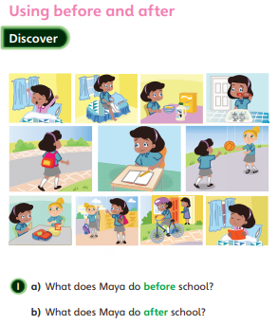
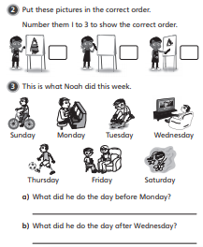
Can you look at these pictures of a girl called Maya and a boy called Noah who are six and find out what Maya does before and after school and what Noah does in the week?
Play a pointing game and choose an event in Maya’s day and Noah’s week and point to what happens before and after it.

Slide 5
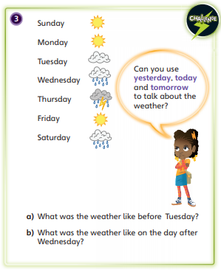
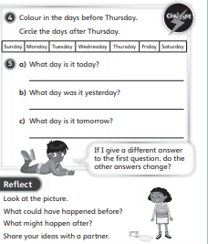
Can you use the days of the week flashcards I’ve attached and put them in the right order? Then answer the questions below:

Slide 6

If you like, you could you draw some pictures to show what you do in your day and put them in the correct order.
If you want a challenge then write the days of the week out yourself checking the spelling and make sure they start with a capital letter.

