Slide 1

Starlings English Home Learning
Thursday 14th January

Slide 2



Today you are going to write a letter to one of the characters from the story.
That means you will
Choose a character to write your letter to.
Decide on a purpose for your letter. Are you going to warn Little Red about the wolf? Are you going to say get well soon to Grandma? Are you going to say thank you to the woodcutters?
Start your letter with the Dear or To …
End your letter with From

Slide 3
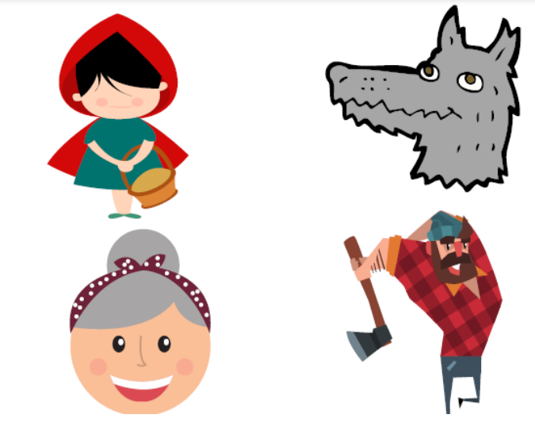

Slide 4
Idea 1
Idea 2
Idea 3

Slide 5
Dear ____________
_Idea 1_________________________________________________________________________________________
__________________________________________________________________________________________
__Idea 2________________________________________________________________________________________
__________________________________________________________________________________________
_Idea 3_________________________________________________________________________________________
__________________________________________________________________________________________
From _____________________

Slide 6

Idea 1
You have made me sad.
Dear wolf,
You made lots of people sad today with your selfish choices.
You must not go into somebody’s house if you are not invited. What you did was wrong.
Because of your rude and selfish choices you stopped Little Red from helping Grandma when she needed her.
You should say sorry to Little Red and Grandma.
From Mrs. O’Marah
Idea 2
It is wrong to go into a house if you’re not invited.
Idea 3
You stopped Little Red from helping her Grandma when she needed help.

Slide 7
Dear ____________
__________________________________________________________________________________________
__________________________________________________________________________________________
__________________________________________________________________________________________
__________________________________________________________________________________________
__________________________________________________________________________________________
__________________________________________________________________________________________
From _____________________

Slide 8

Red group – you need to look out for set 1 videos on the link below:
https://www.youtube.com/channel/UCo7fbLgY2oA_cFCIg9GdxtQ
We would like you to watch 3 videos: set 1 speed sounds, set 1 word time and set 1 spellings please.
Green group you need to look out for set 2 videos on the link below:
https://www.youtube.com/channel/UCo7fbLgY2oA_cFCIg9GdxtQ
We would like you to watch 4 videos: set 2 speed sounds, set 2 spelling, red words 1, and read and hold a sentence 1
Pink, yellow and blue groups you need to look out for set 3 videos on the link below.
https://www.youtube.com/channel/UCo7fbLgY2oA_cFCIg9GdxtQ
We would like you to watch 4 videos: set 3 speed sounds, set 3 spelling, red words 2 and read and hold a sentence 2

Slide 9

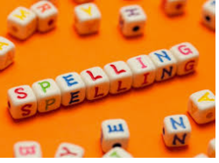



Words of the day!
said the what
Can you write the word said 5 times in your prettiest writing?
Can you write the word the 5 times with your eyes closed?
Can you write the word what 5 times using your other hand?

