Slide 1


English
Date: 14.01.21
Week 2 – Lesson 4
Creature Feature - Research

Slide 2

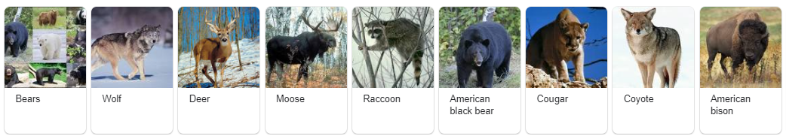
Activity 1
Click on the sound button to hear activity 1 explained to you.
Select one animal that lives in North America.
If you simply type into google ‘North American animals’, it will display lots of ideas.
Which animal is your favourite?
Why?

Slide 3
Click on the sound button to hear activity 2 explained to you.
Do some research online and make some brief notes about your chosen creature.
This does not have to be written in full sentences, you could simply list some bullet points.
  For example:
  Eats bamboo
  Lives in forests in southwest China
  Black and white coat which is very thick
You could think about dividing your notes into sections, such as appearance, habitat and diet – this is not essential, however it will help you with tomorrow’s lesson.
San Diego Zoo has a good website you might want to use to help with your research:
https://zoo.sandiegozoo.org/animals-plants
Activity 2:

Slide 4
Please come and share your most interesting fact with me and the rest of your Skylark friends over on our class discussion.
Keep your research some safe as you will need it in tomorrow’s lesson.

Slide 5
