Slide 1


Mathematics
Date: 14.01.21
Week 2 – Lesson 4
Multiplying whole numbers by
10, 100 and 1000

Slide 2
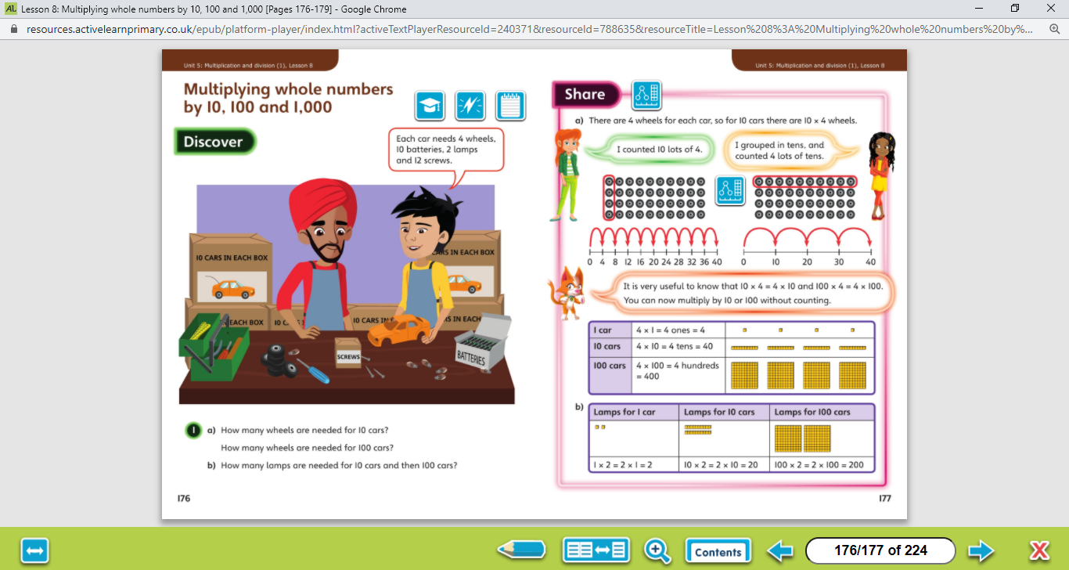

Let’s work together!
Look at the picture clue. What can you see?
Have a look at the questions.
Click on the sound button below to hear the questions read to you. We will also talk through the questions together like we do in school.
We will go through the possible methods and answers on the next slide.

Slide 3
Let’s work together!
Click on the sound button below to hear the answers and possible methods for question A.
Click on the sound button below to hear the answers and possible methods for question B.

Slide 4
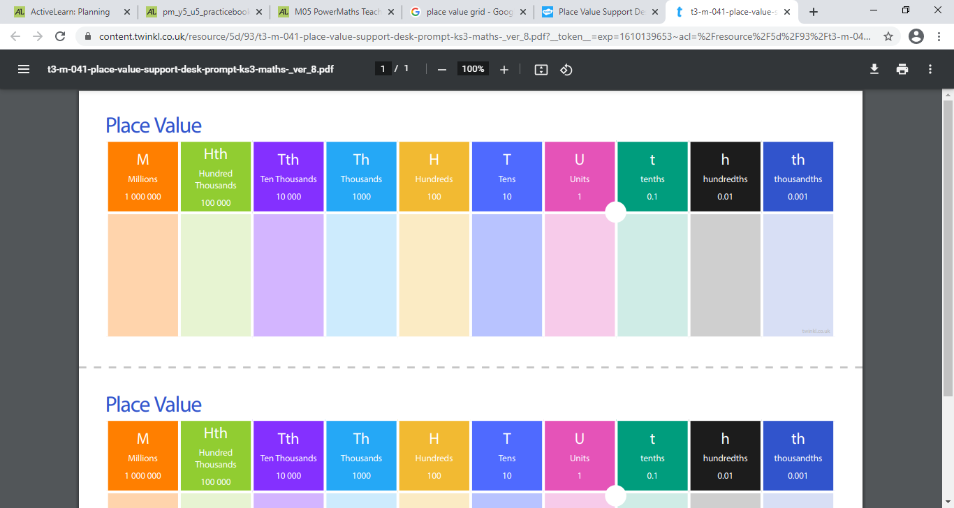
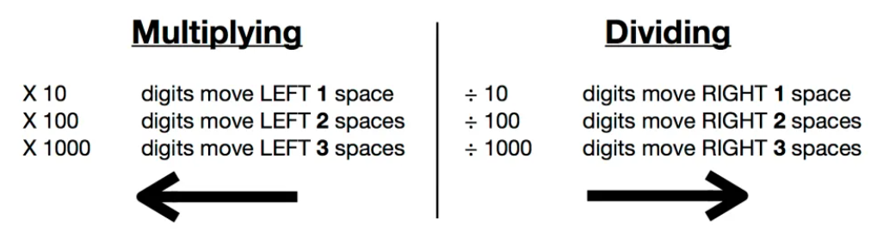
Let’s work together!
Don’t forget to add your zeros as place holders after you have moved the numbers.
Click on the sound button below to hear the question read to you. We will work together to reach the answer.
57 x 10 =
189 x 100 =
73 x 1000 =
We will go through the answers together on the next slide.

Slide 5
Let’s work together!
Don’t forget to add your zeros as place holders after you have moved the numbers.
57 x 10 = 570
189 x 100 = 18,900
73 x 1000 = 73,000
Click on the sound button below to hear the answers.

Slide 6
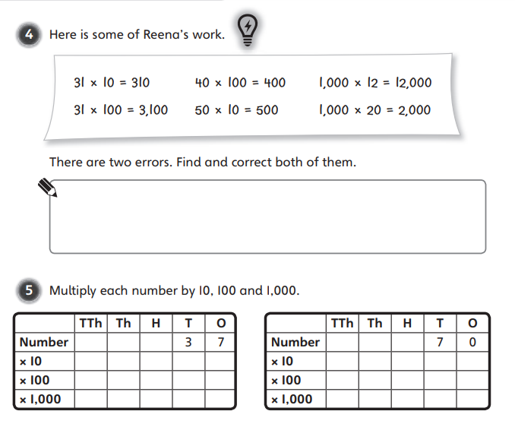
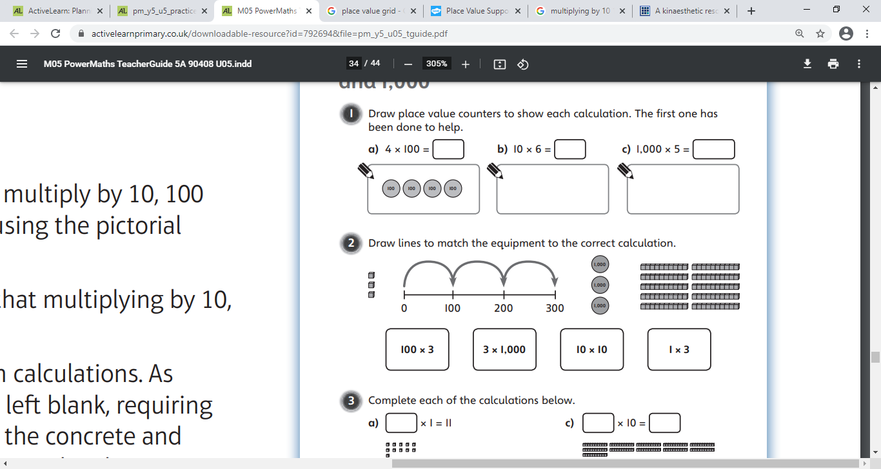
Your Turn…
Have a go at these questions independently. Click on the button below if you would like the questions read to you.
Click on the sound button below to hear the answers.

Slide 7
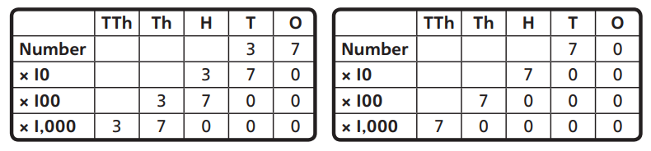
Your Turn…
I thought it might be useful to physically see the answers for question 2 so that you can mark your work:

Slide 8
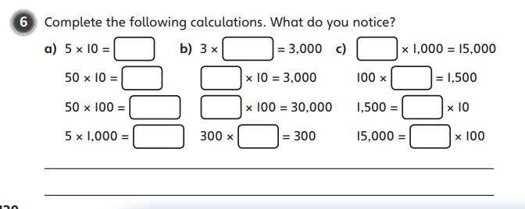
Your Turn…
Have a go at these questions independently. Click on the button below if you would like the questions read to you.
Move to the next slide to see the answers.

Slide 9
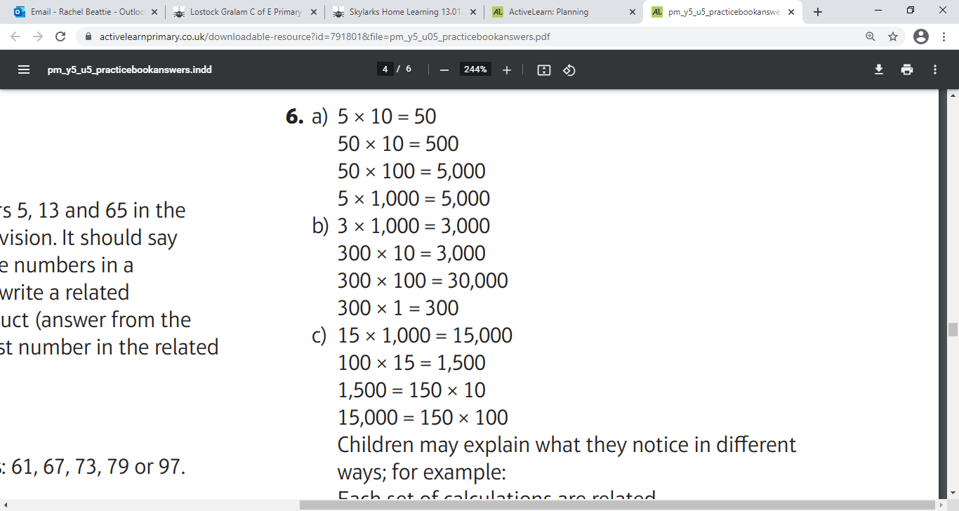
Your Turn…
Click on the sound button to hear the answers.
I notice…
The answers are all related/linked
All the answers end in a 0
The answers in A all start with a 5
The answers in B all start with a 3
The answers in C all start with a 1

Slide 10
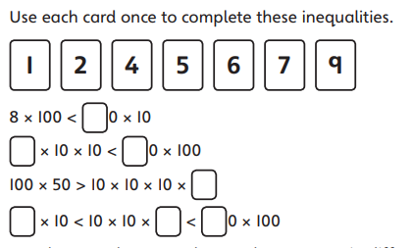
Your Turn…
Challenge Time!
Only try this question if you are feeling confident ☺
Click on the button below if you would like the question read to you.
Move to the next slide to hear the answer.

Slide 11
Challenge Time Answers
There are different possible answers so if you want to upload a photo of your challenge to our discussion, I will gladly mark it for you. Here is one possible answer:
Your Turn…
Click on the button below if you would like the answer read to you.
9
5
2
4
7
6
1

